Slide 1

Scheduling and Analysis of Limited-Preemptive Moldable Gang Tasks Weekly Meeting
Joan Marcè i Igual
25th of March, 2020

Slide 2
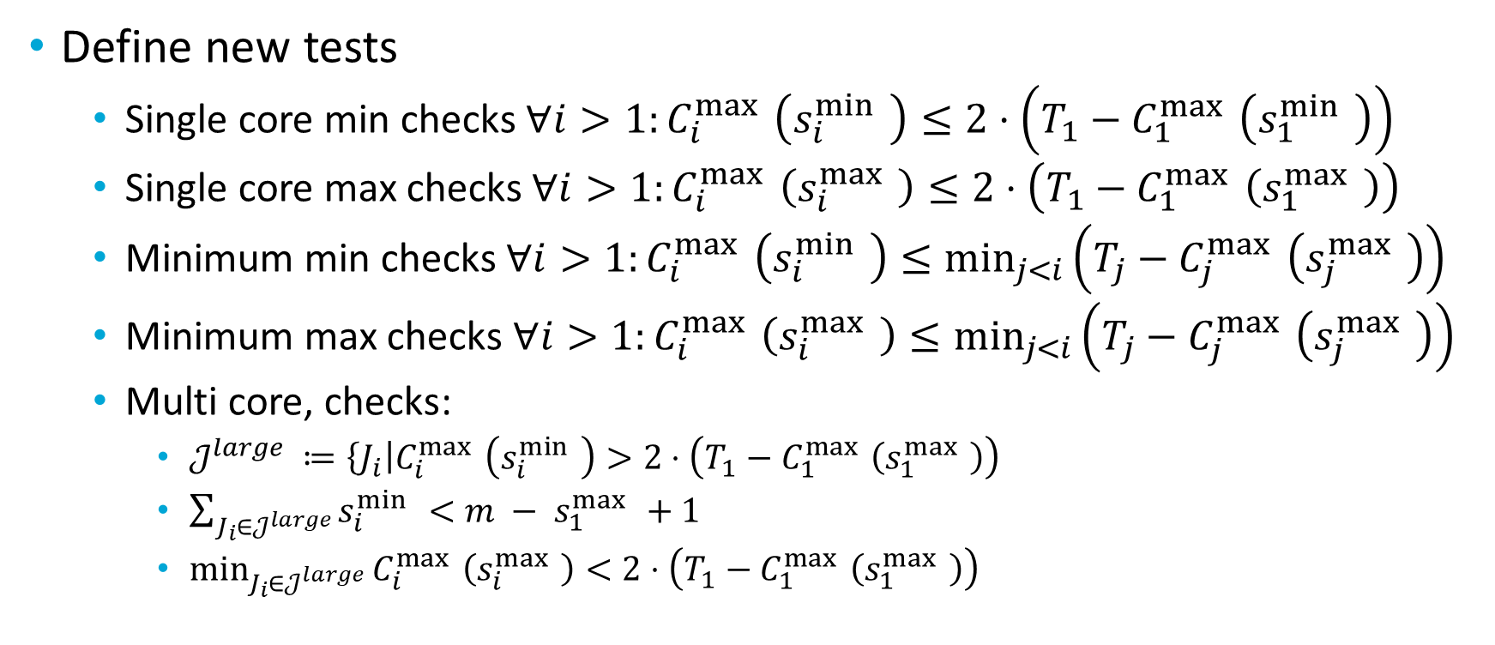
What has been done?
Define new tests
Single core min checks $∀i>1:C_{i}^{\max{ }}\left(s_{i}^{\min{ }}\right)≤2⋅\left(T_{1}−C_{1}^{\max{ }}\left(s_{1}^{\min{ }}\right)\right)$
Single core max checks $∀i>1:C_{i}^{\max{ }}\left(s_{i}^{\max{ }}\right)≤2⋅\left(T_{1}−C_{1}^{\max{ }}\left(s_{1}^{\max{ }}\right)\right)$
Minimum min checks $∀i>1:C_{i}^{\max{ }}\left(s_{i}^{\min{ }}\right)≤\min_{j<i}\left(T_{j}−C_{j}^{\max{ }}\left(s_{j}^{\max{ }}\right)\right)$
Minimum max checks $∀i>1:C_{i}^{\max{ }}\left(s_{i}^{\max{ }}\right)≤\min_{j<i}\left(T_{j}−C_{j}^{\max{ }}\left(s_{j}^{\max{ }}\right)\right)$
Multi core, checks:
$𝒥^{large} ≔\left\{J_{i}\right|C_{i}^{\max{ }}\left(s_{i}^{\min{ }}\right)>2⋅\left(T_{1}−C_{1}^{\max{ }}\left(s_{1}^{\max{ }}\right)\right)$
$\sum_{J_{i}∈𝒥^{large}}{s_{i}^{\min{ }}}<{m − s}_{1}^{\max{ }}+1$
$\min_{J_{i}∈𝒥^{large}}{C_{i}^{\max{ }}\left(s_{i}^{\max{ }}\right)<2⋅\left(T_{1}−C_{1}^{\max{ }}\left(s_{1}^{\max{ }}\right)\right)}$
Notes:
First of all, let’s explain what gang scheduling is.
<click>
Let’s say that we have multiple threads that we want to schedule. If we want to convert them to a gang task we would put them together as a “gang” <click> and then we would schedule as a single task<click> so the execution would not start until there are enough free cores.

Slide 3
What has been done?
Fix bugs
When running nptest tool the number of cores was not set properly
After fixing execution takes a reasonable amount of time. Do we have a computing cluster/machine?
Some tasks where created with utilization 0
Generate new task sets
New LPMGRS scheduler implemented
Notes:
First of all, let’s explain what gang scheduling is.
<click>
Let’s say that we have multiple threads that we want to schedule. If we want to convert them to a gang task we would put them together as a “gang” <click> and then we would schedule as a single task<click> so the execution would not start until there are enough free cores.

Slide 4
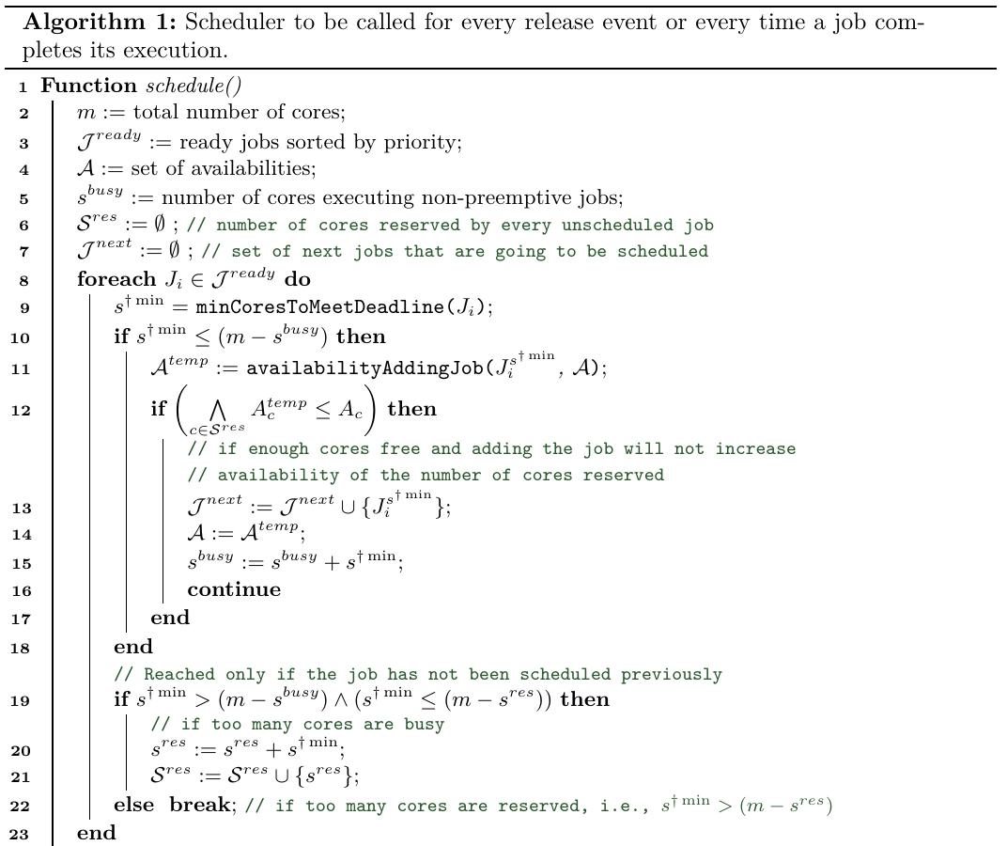
Algorithm change

Slide 5
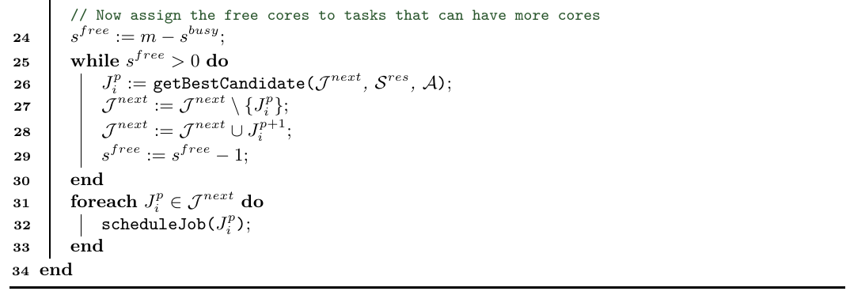
Algorithm change

Slide 6
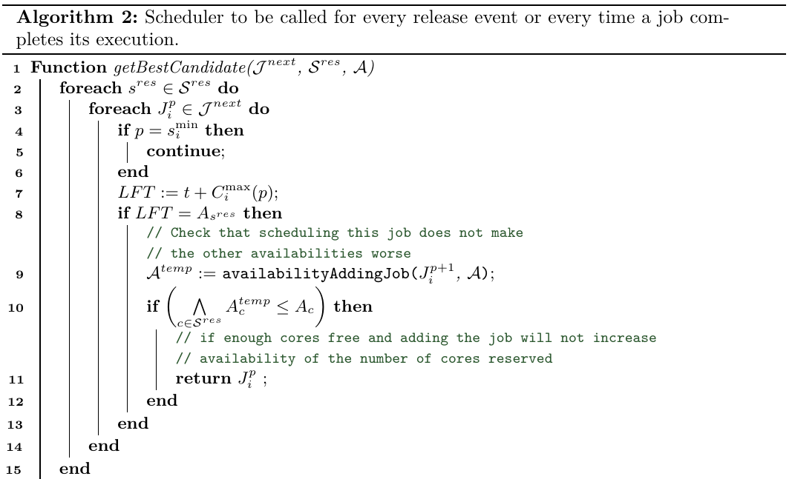
Algorithm change

Slide 7
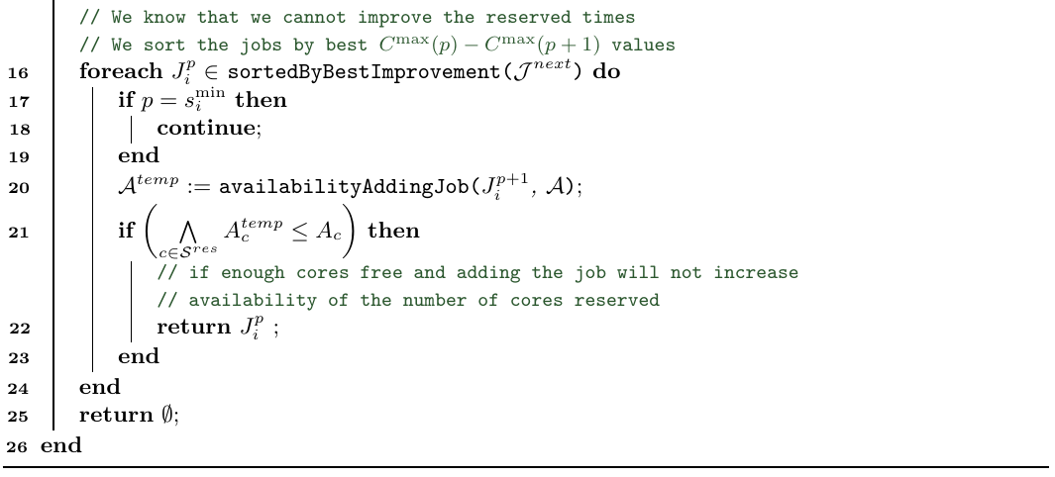
Algorithm change

Slide 8
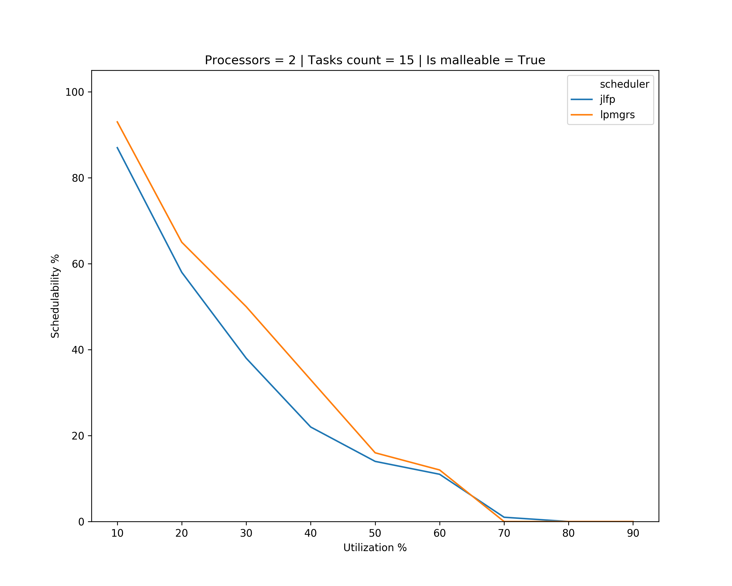
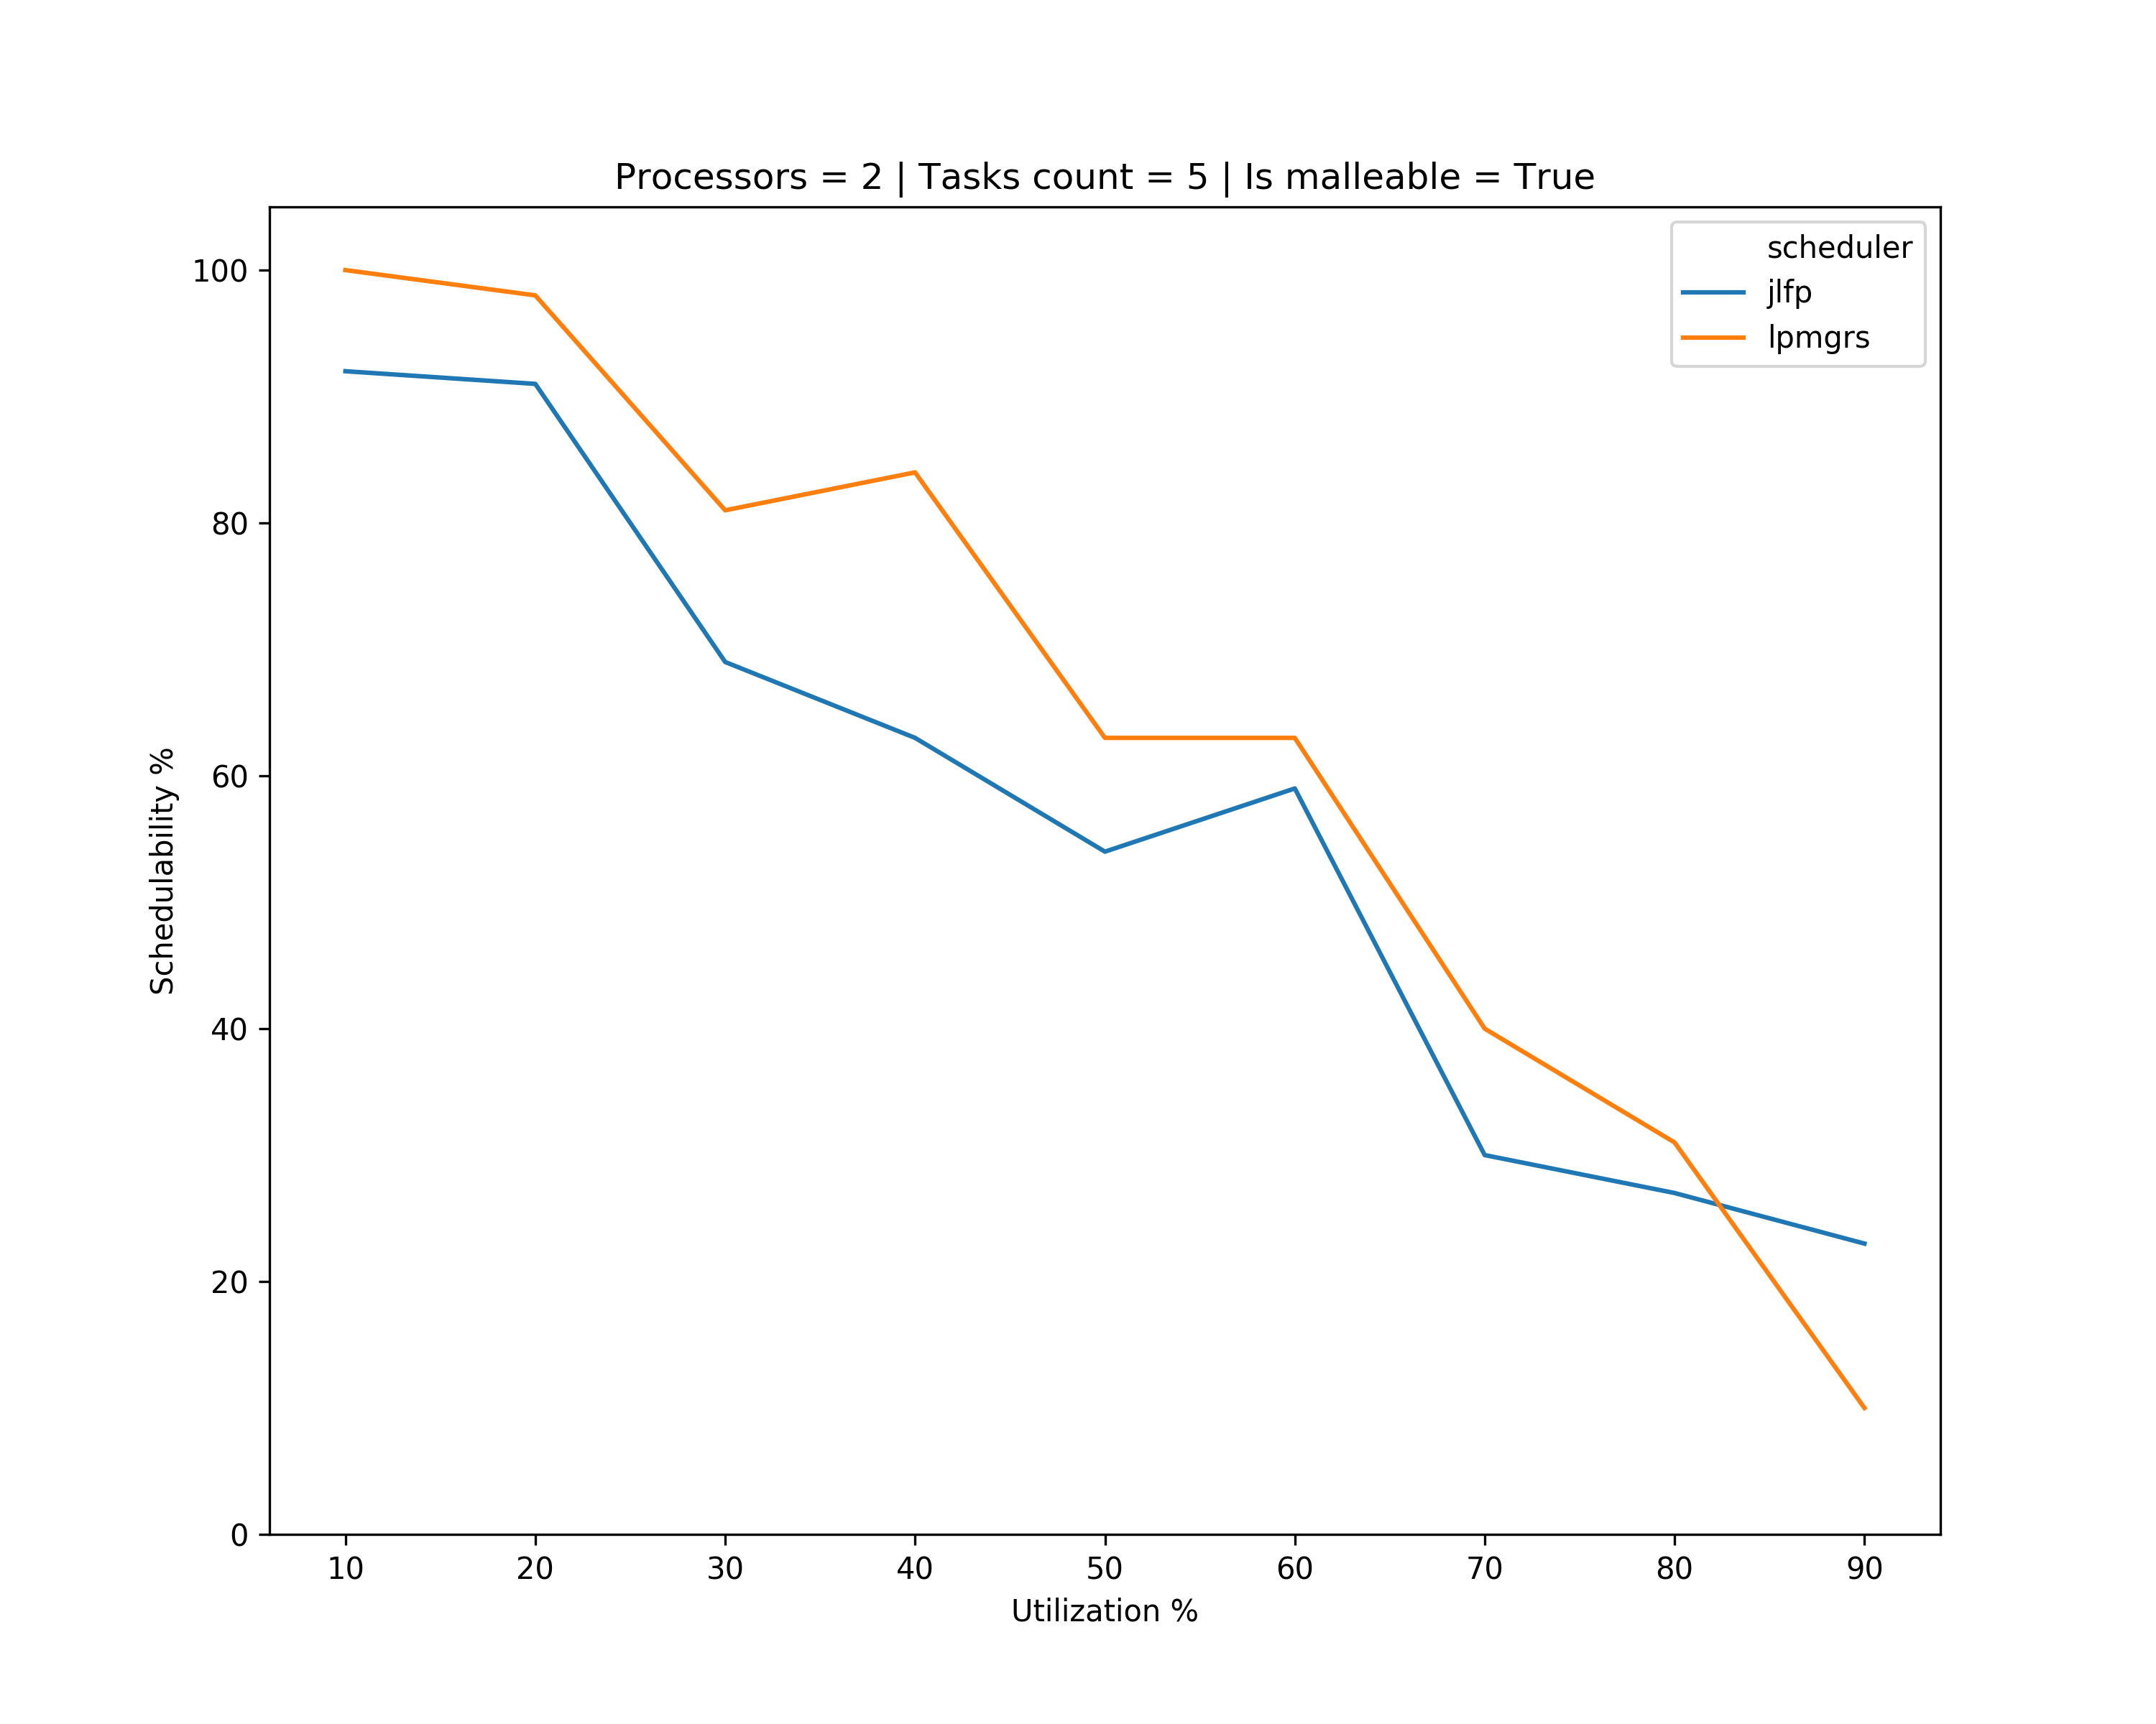
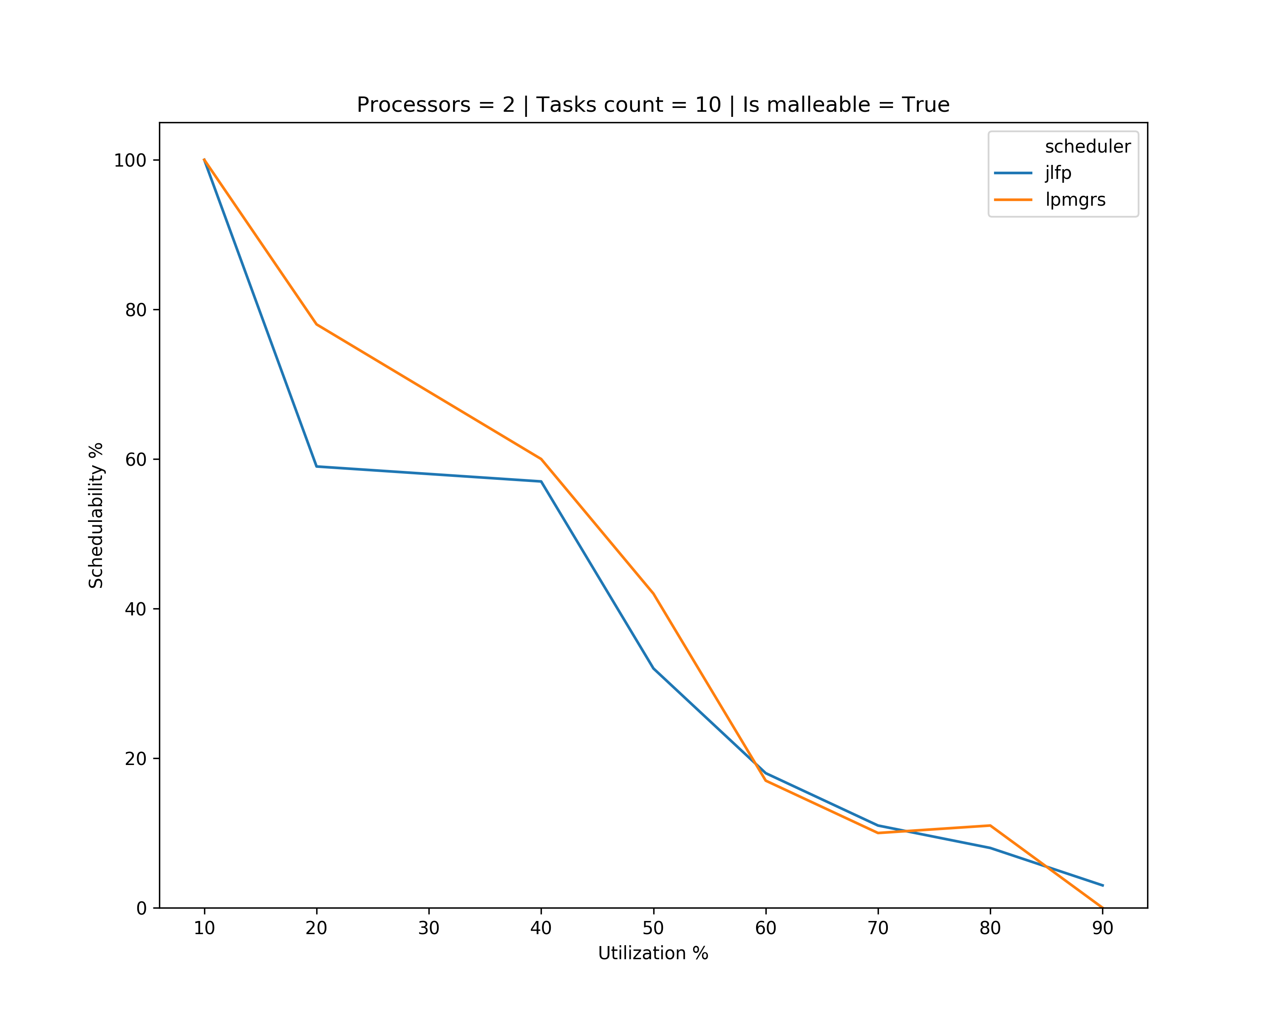
Results – single core min

Slide 9
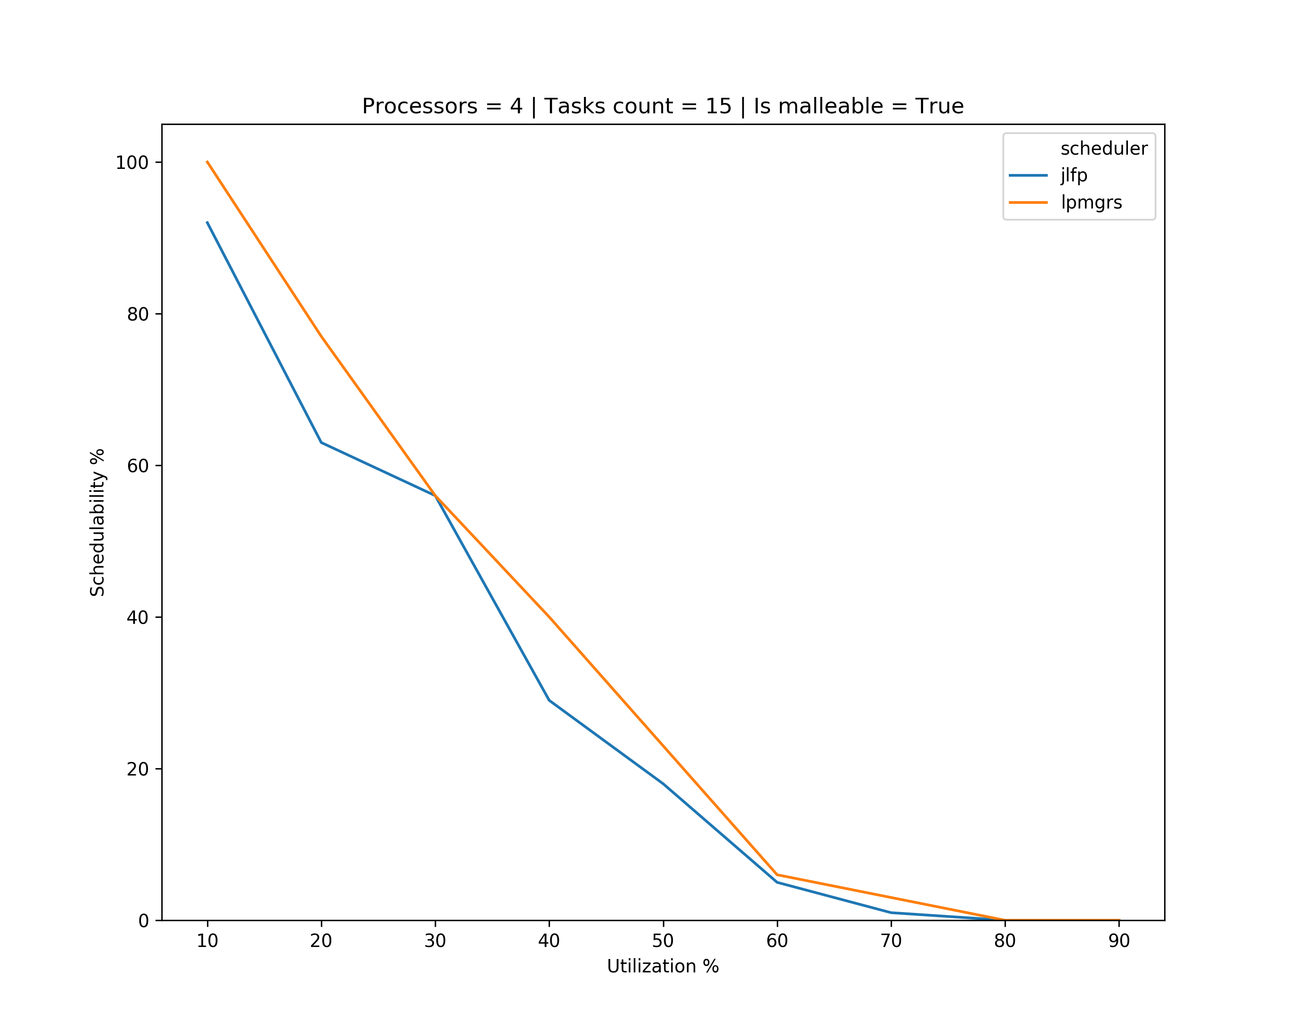
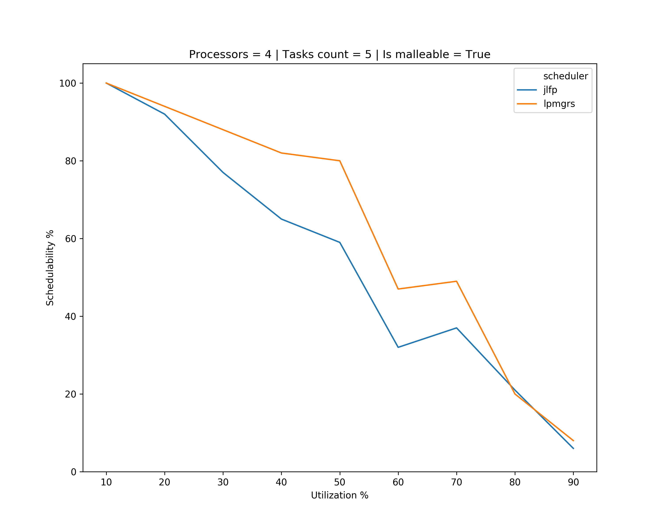
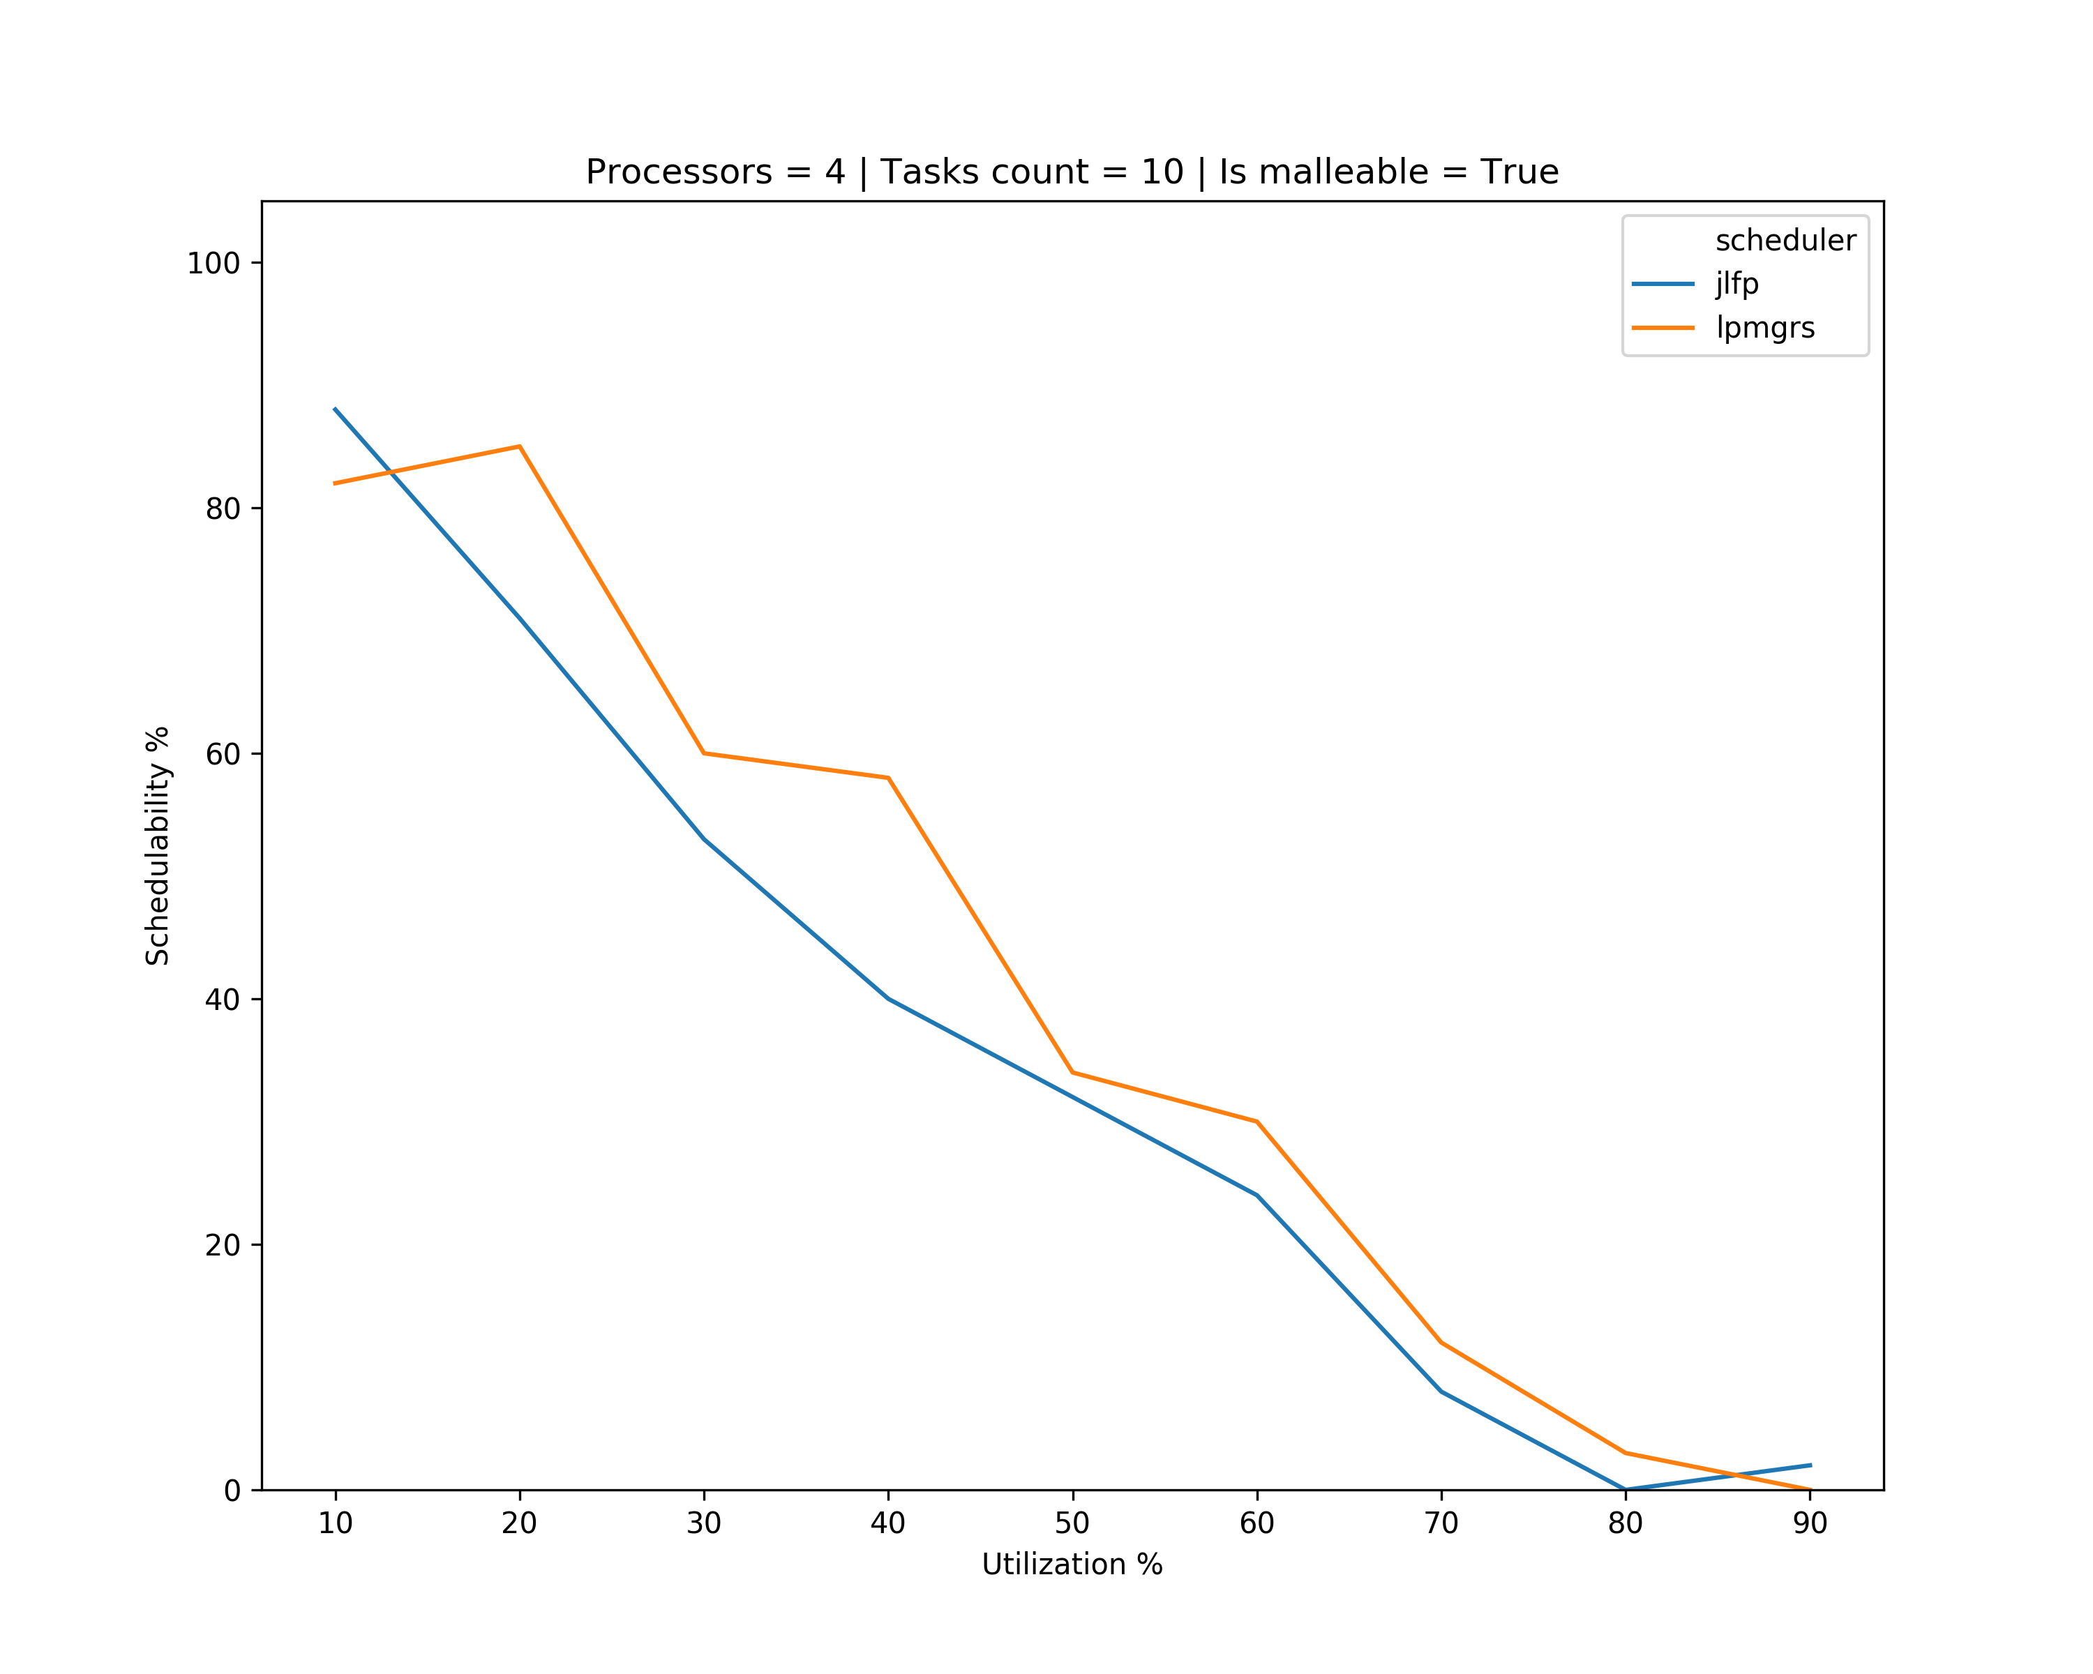
Results – single core min

Slide 10
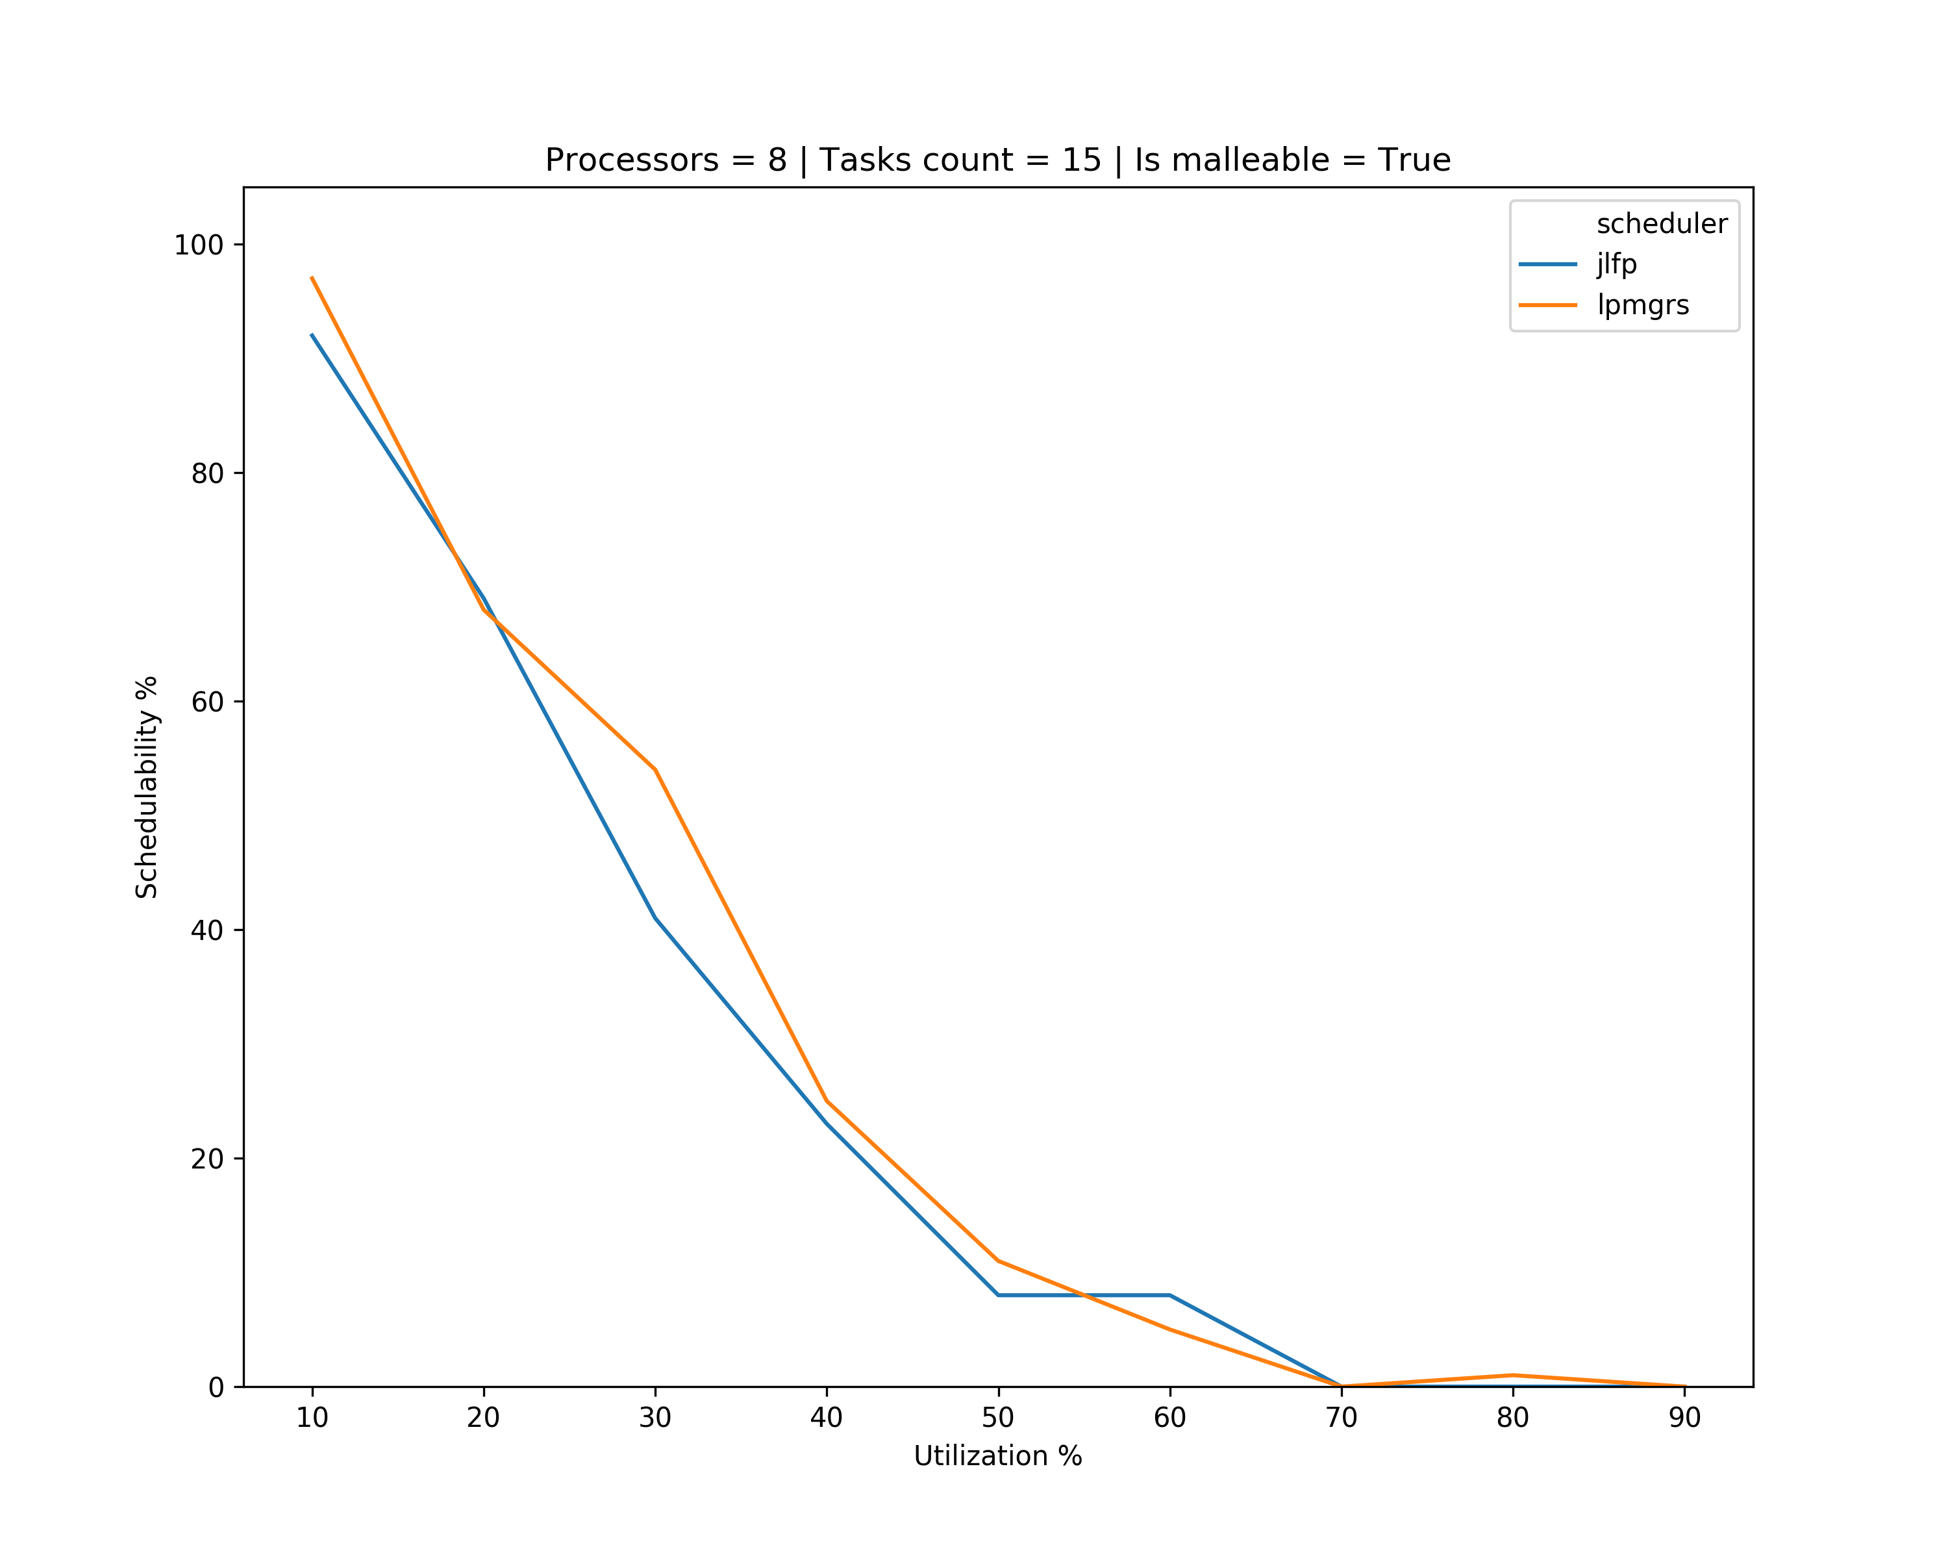
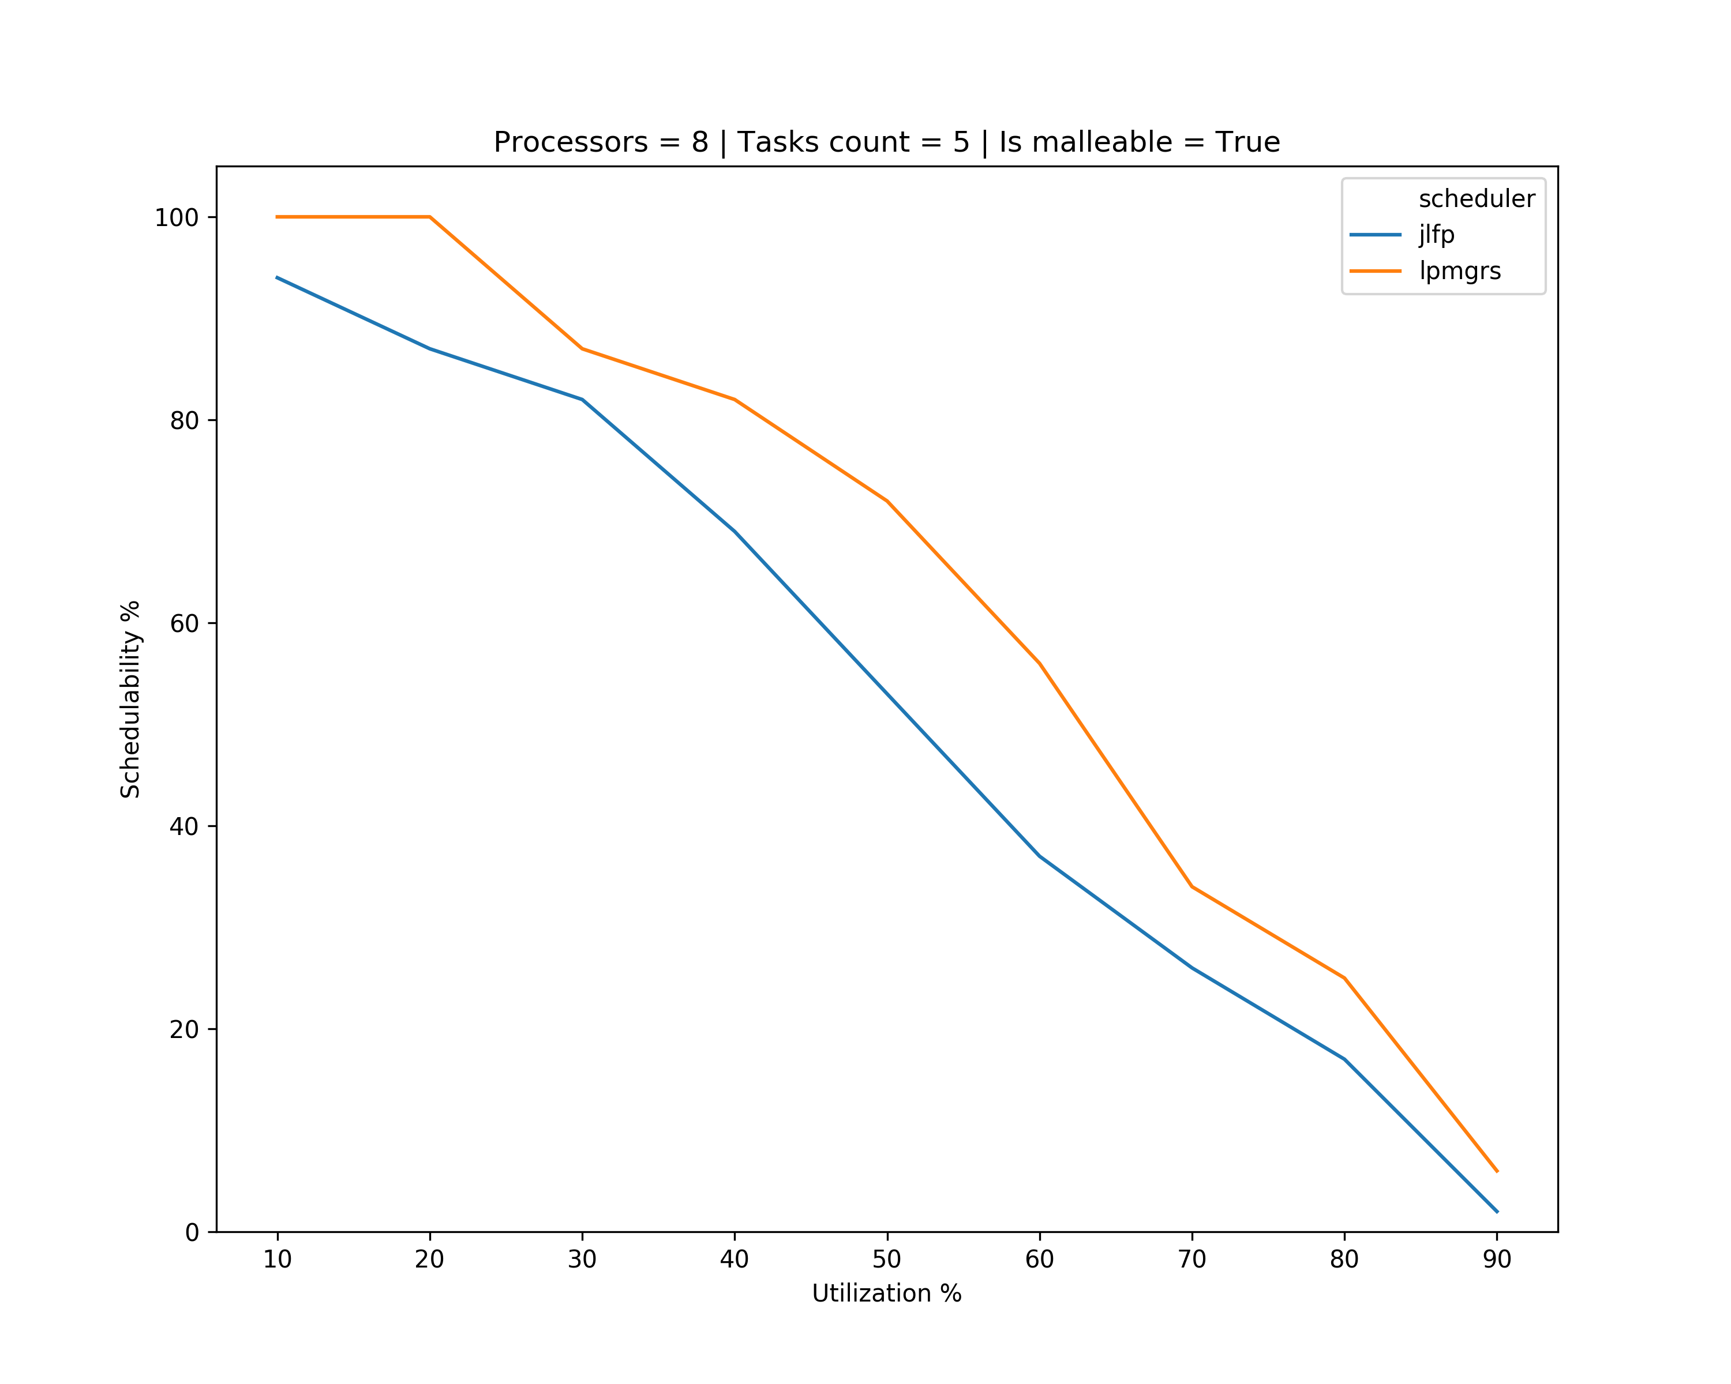
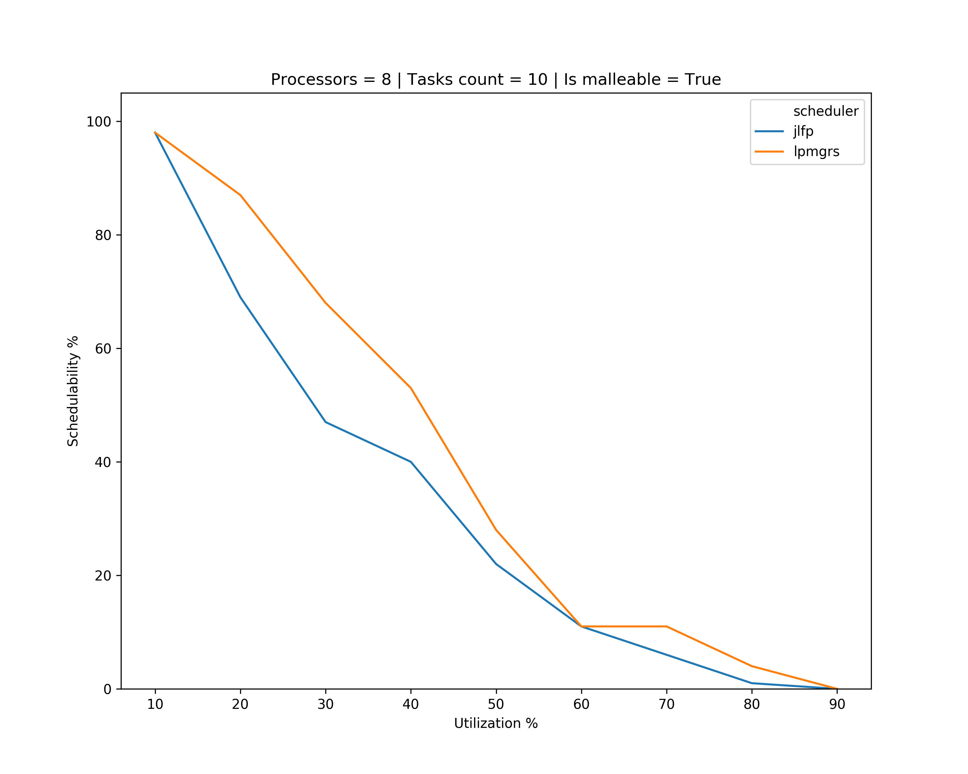
Results – single core min

Slide 11
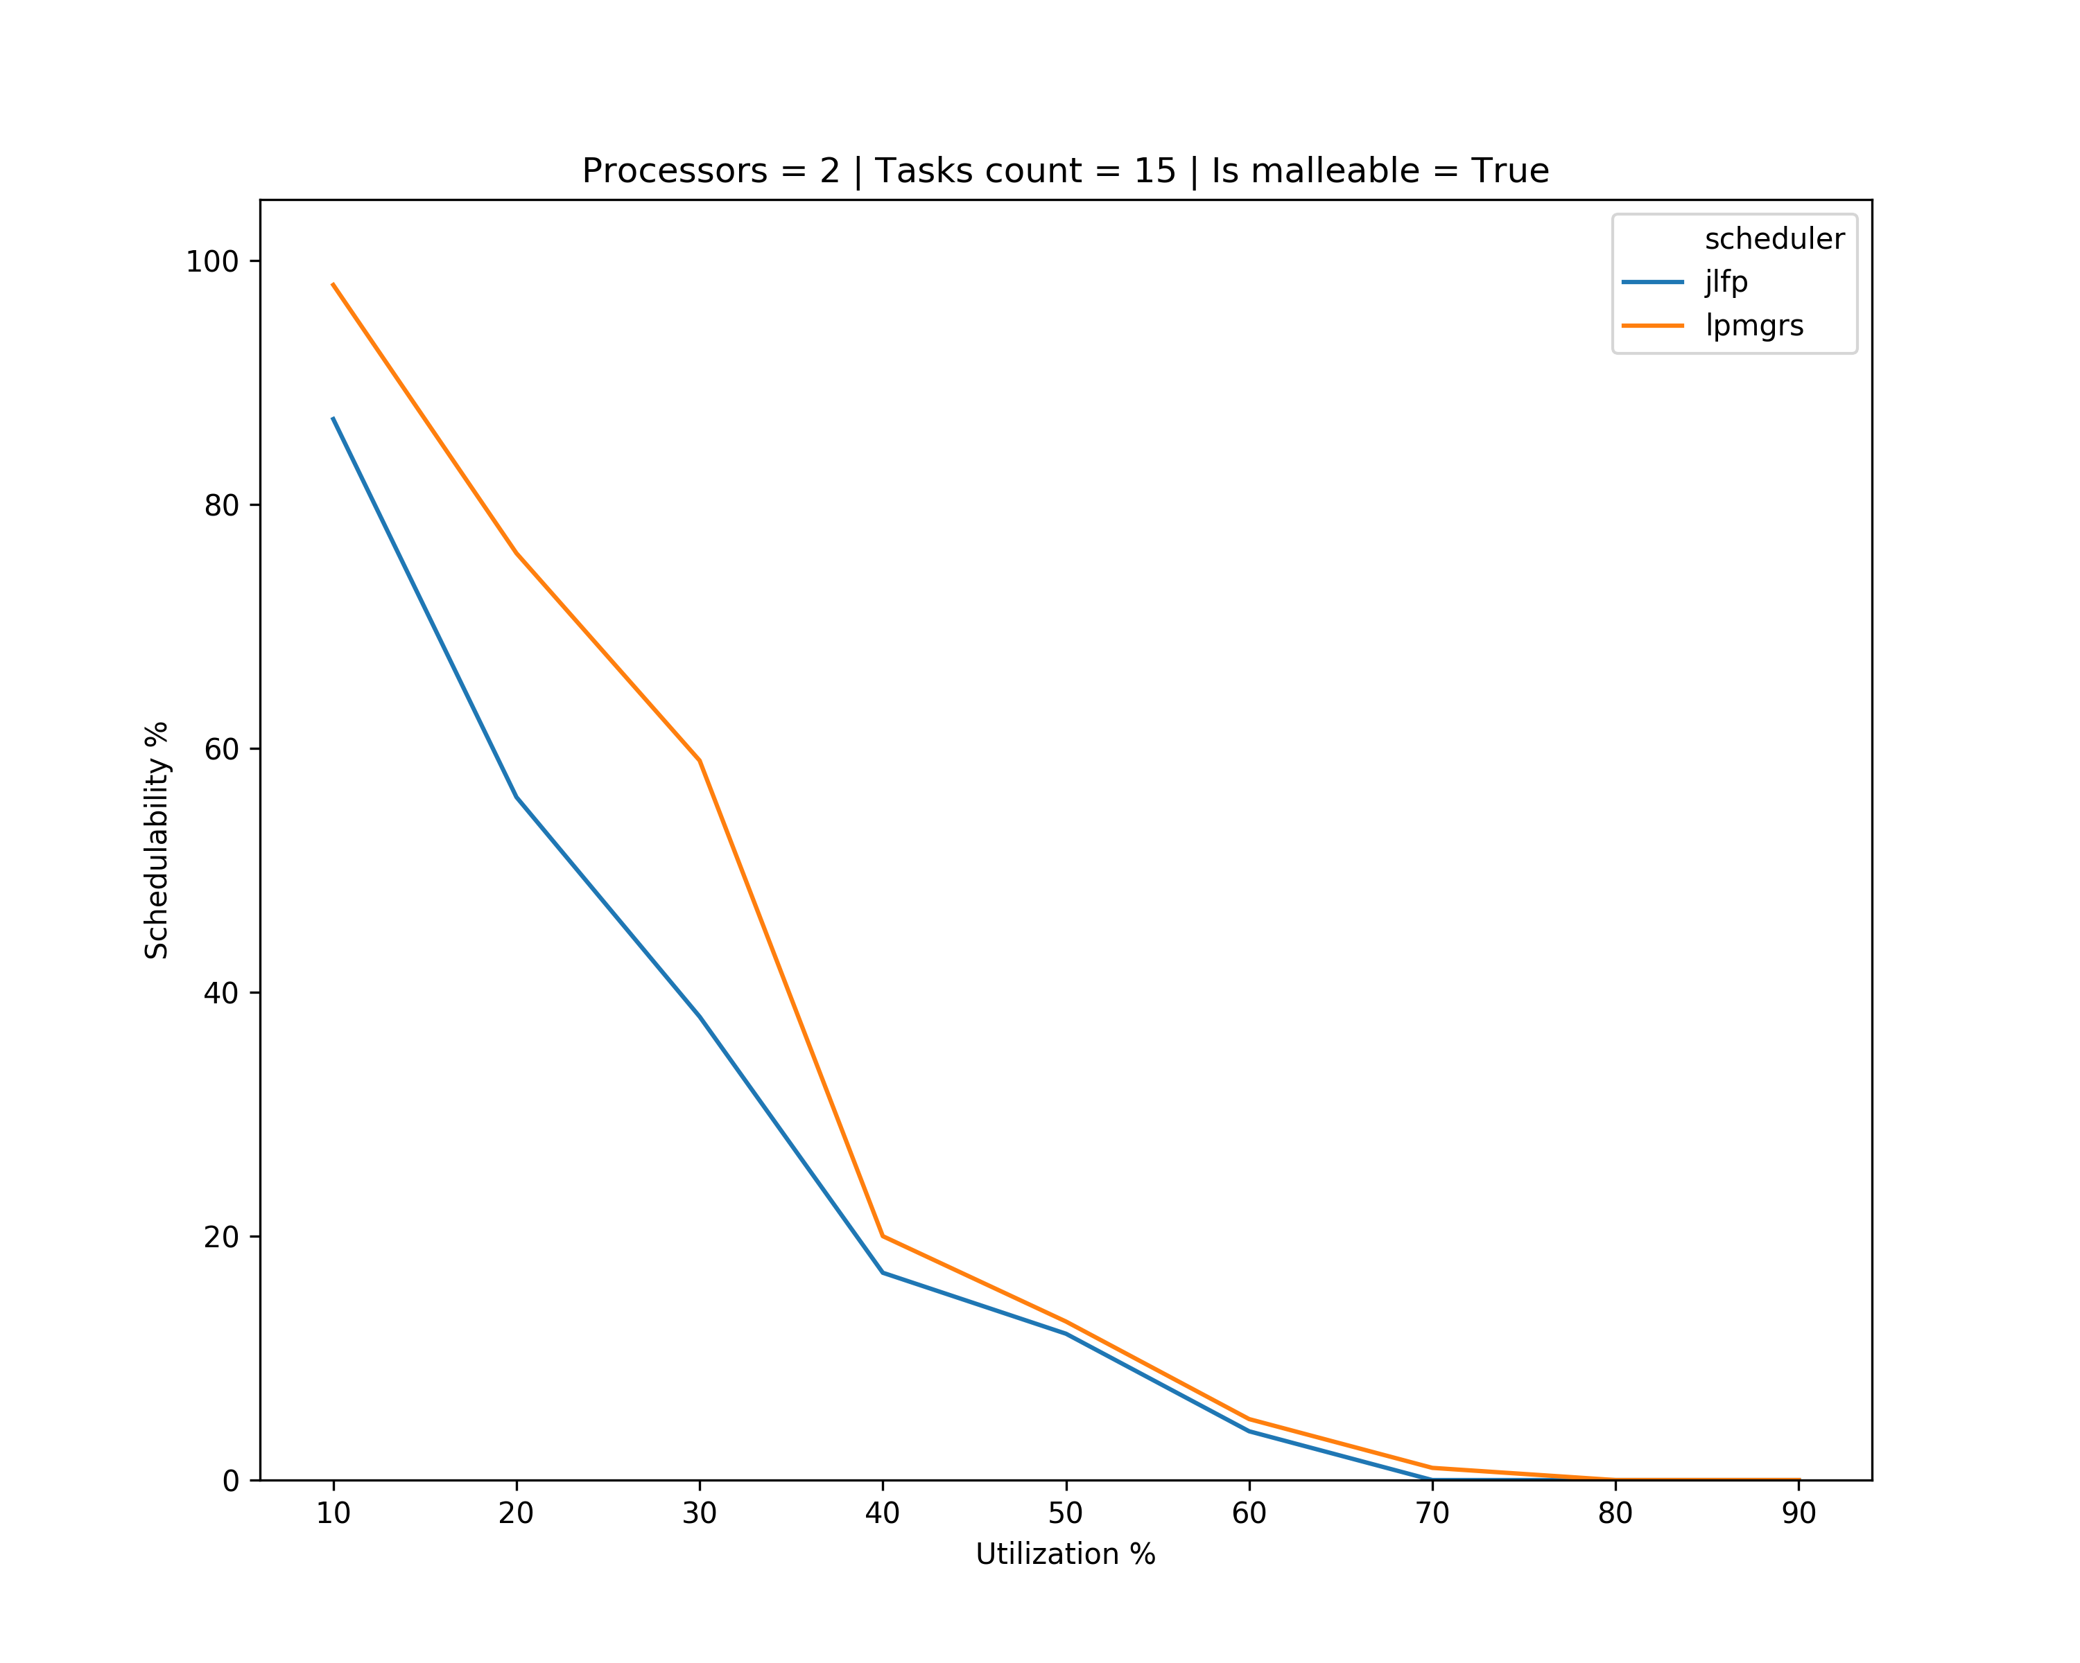
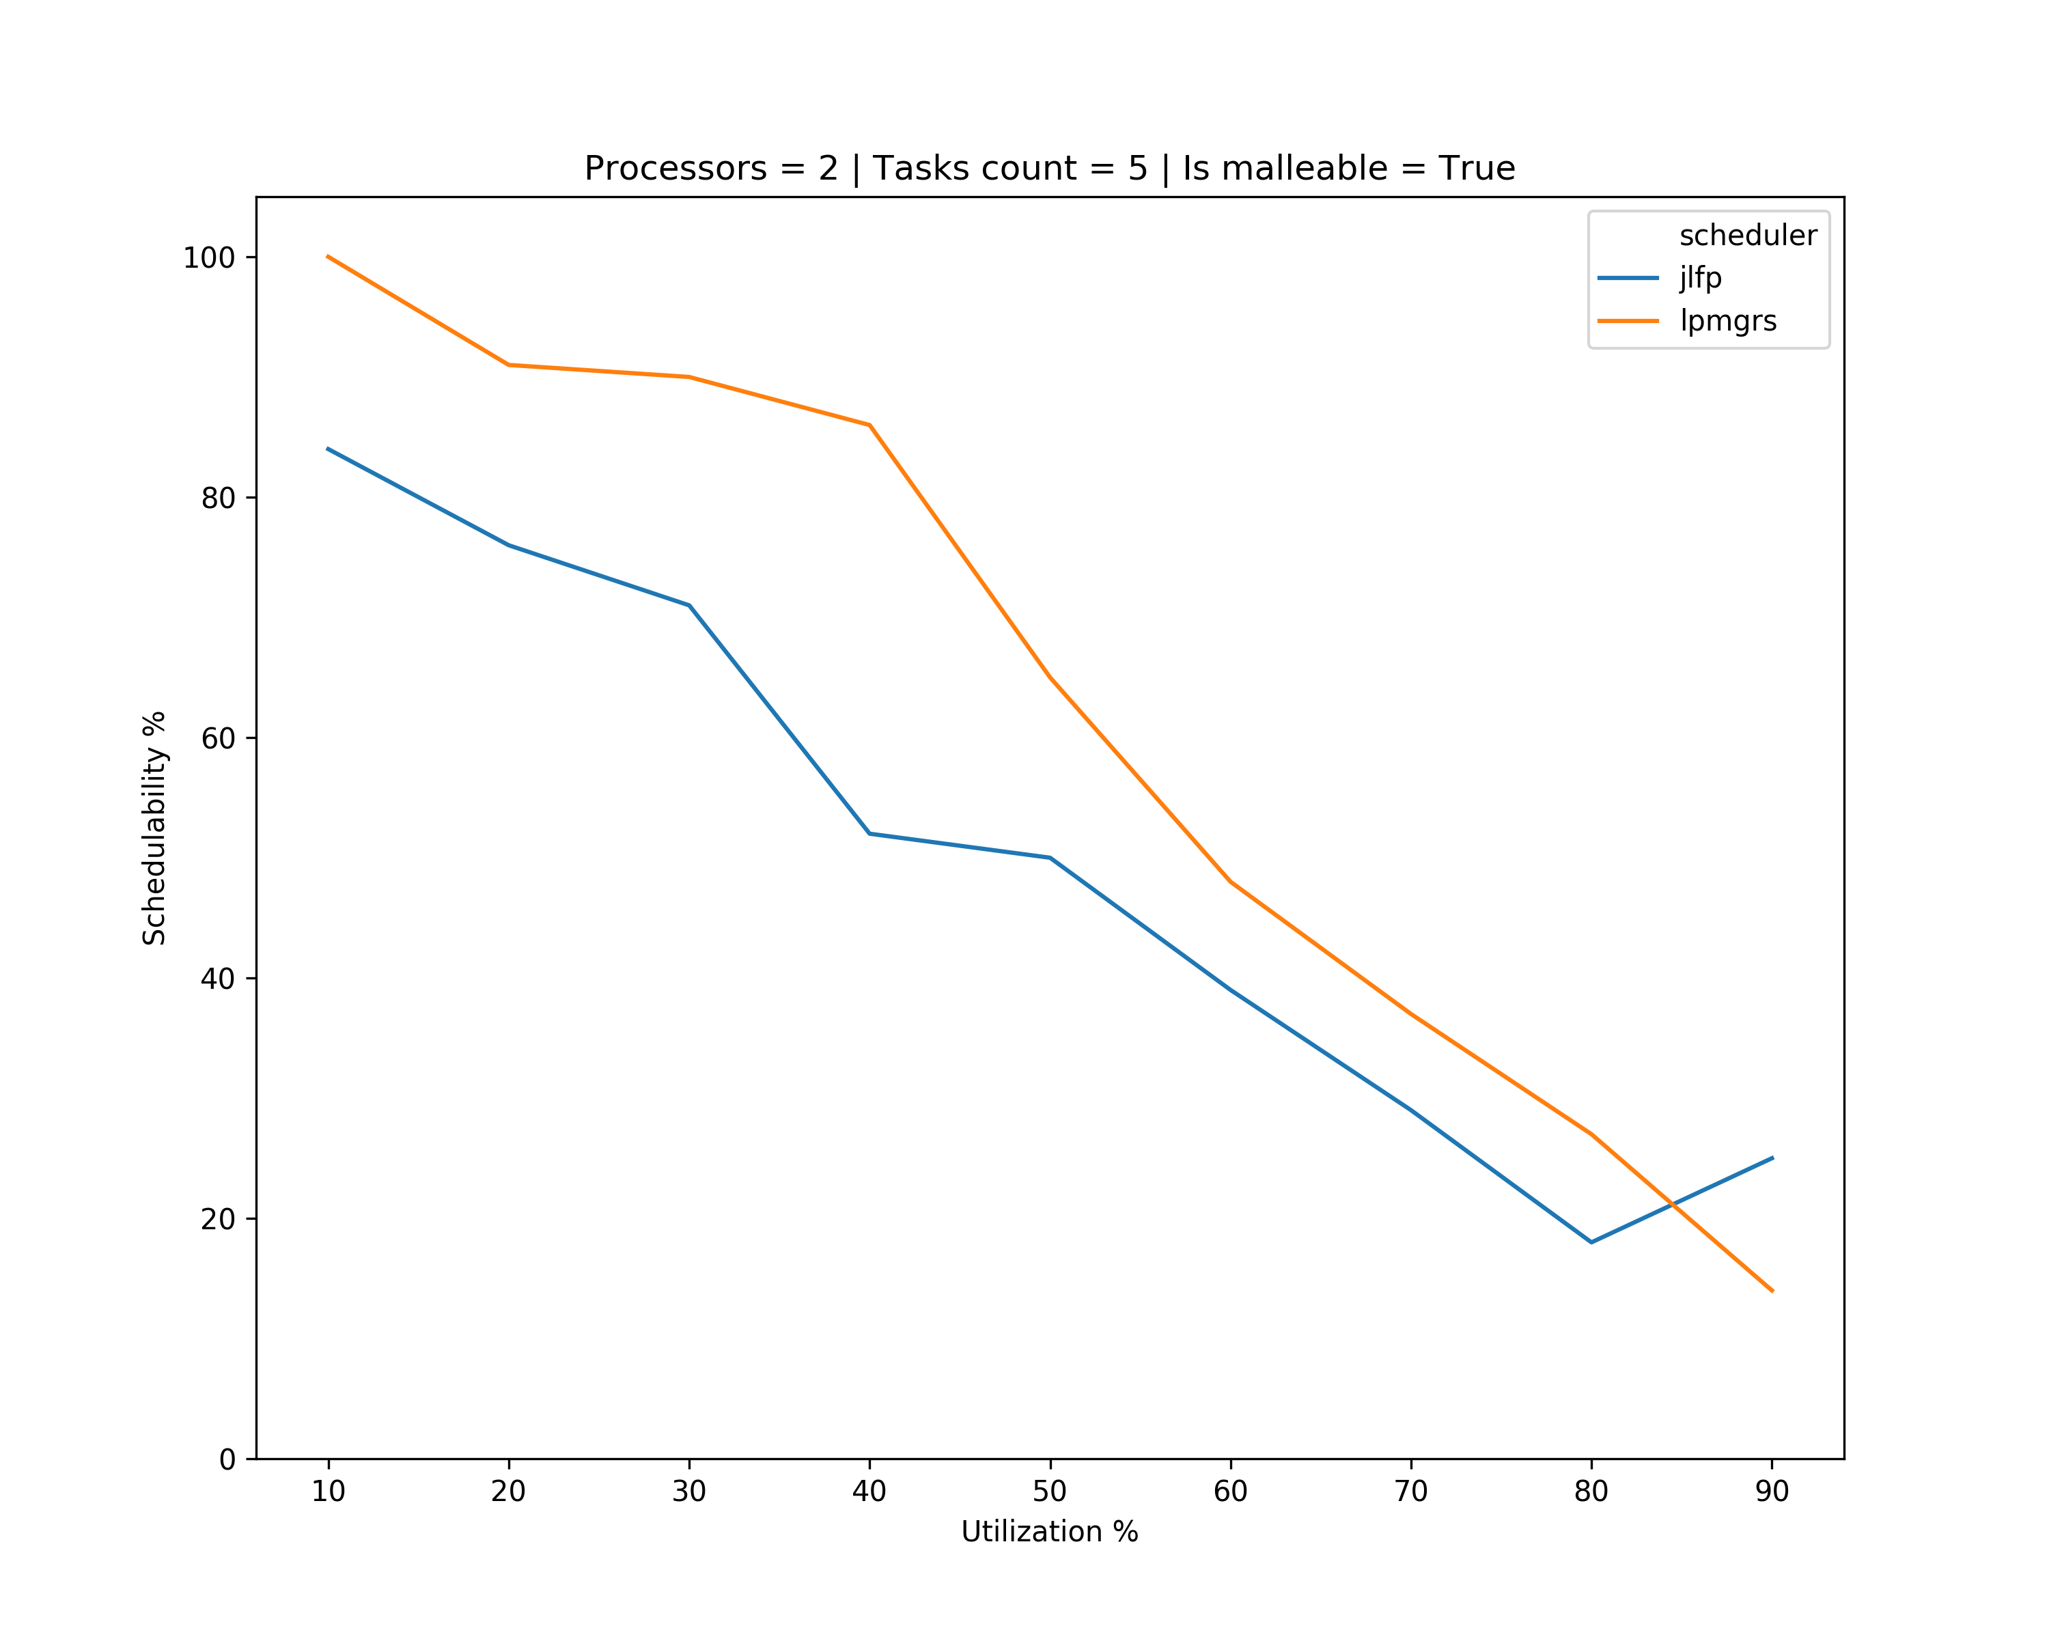
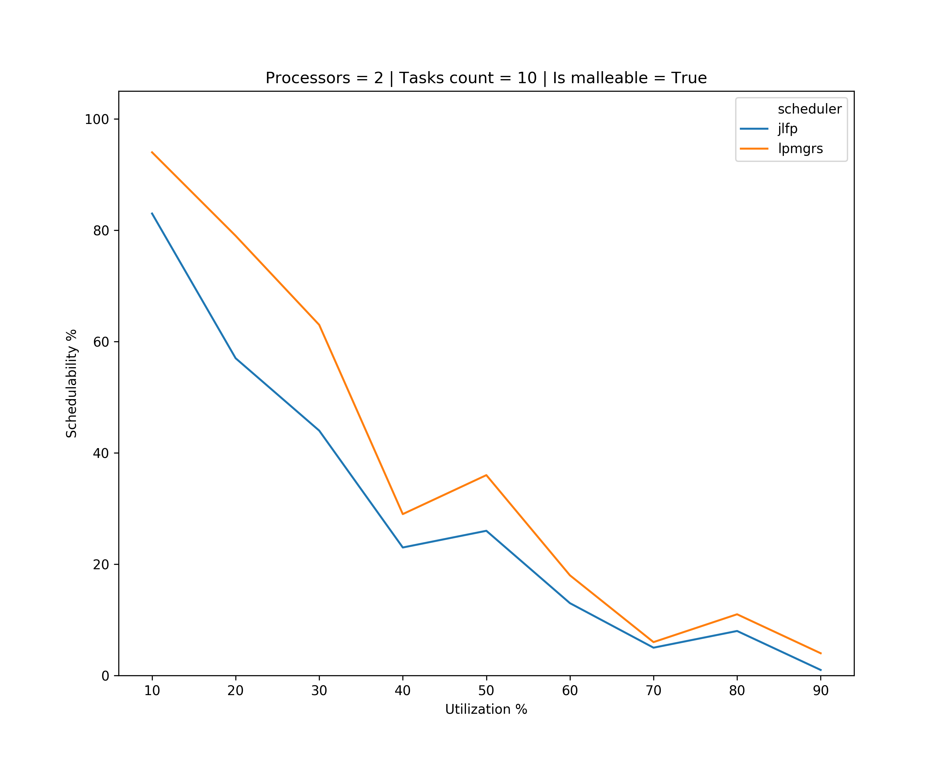
Results – single core max

Slide 12
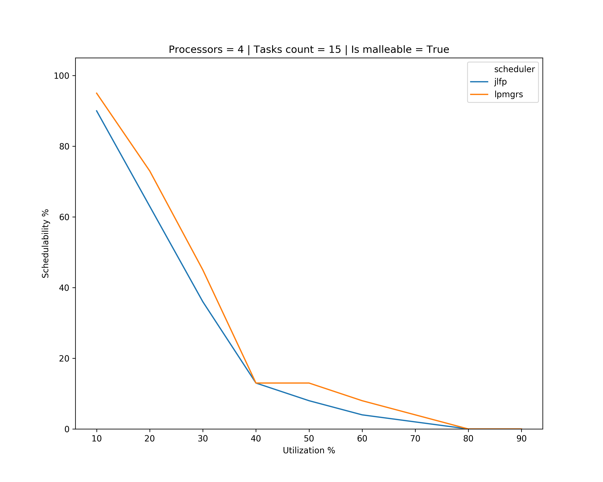
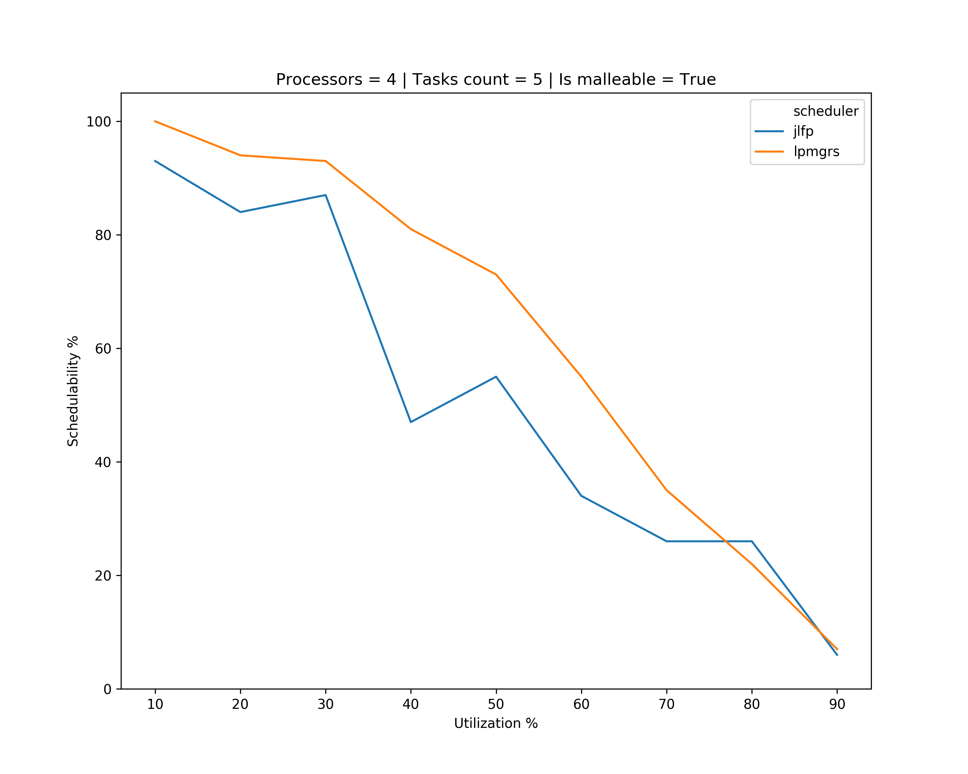
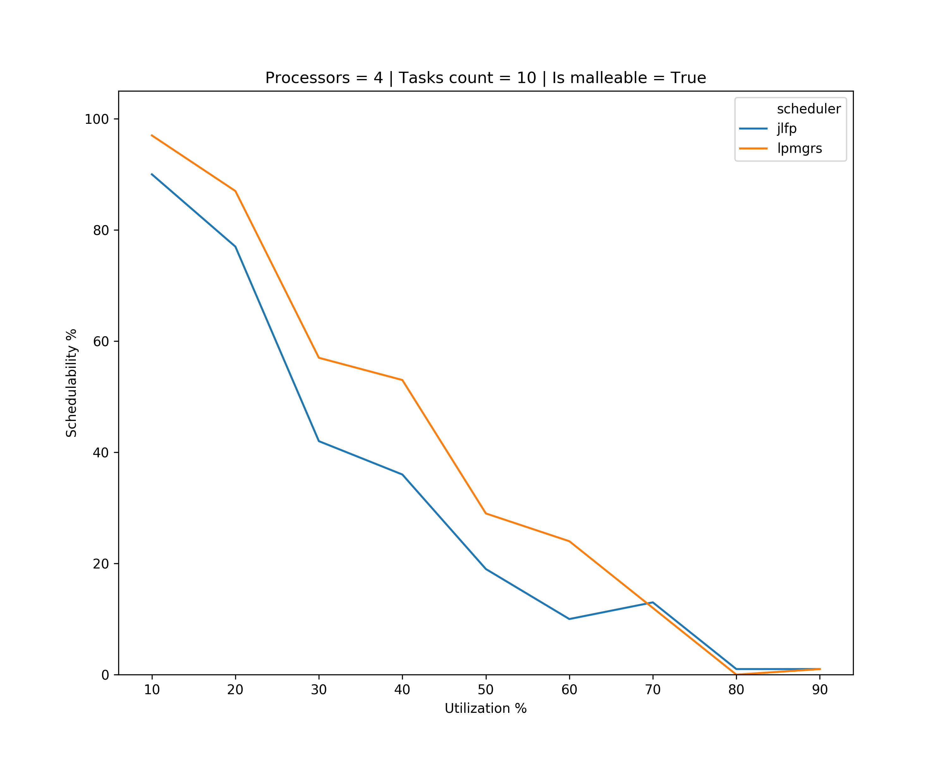
Results – single core max

Slide 13
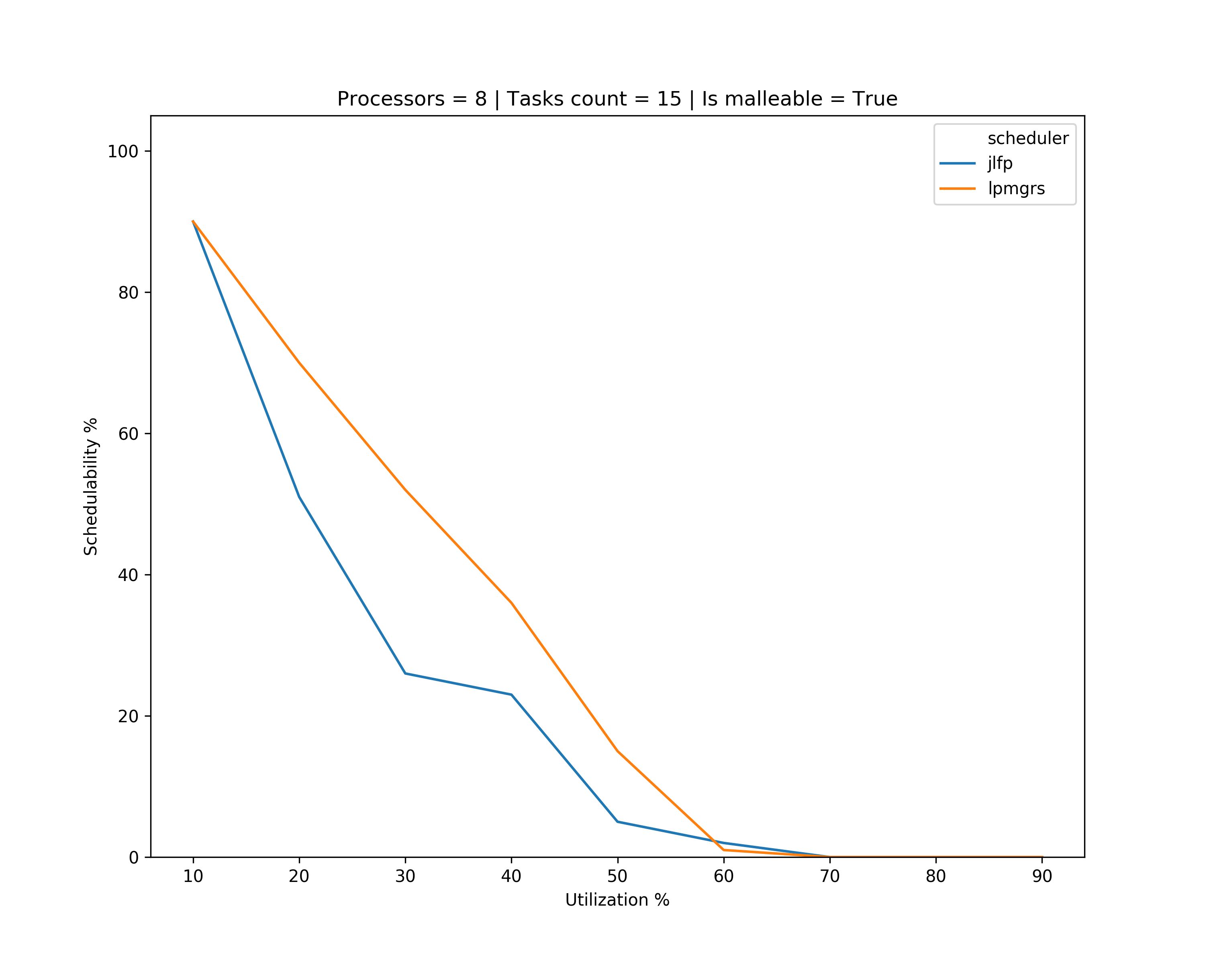
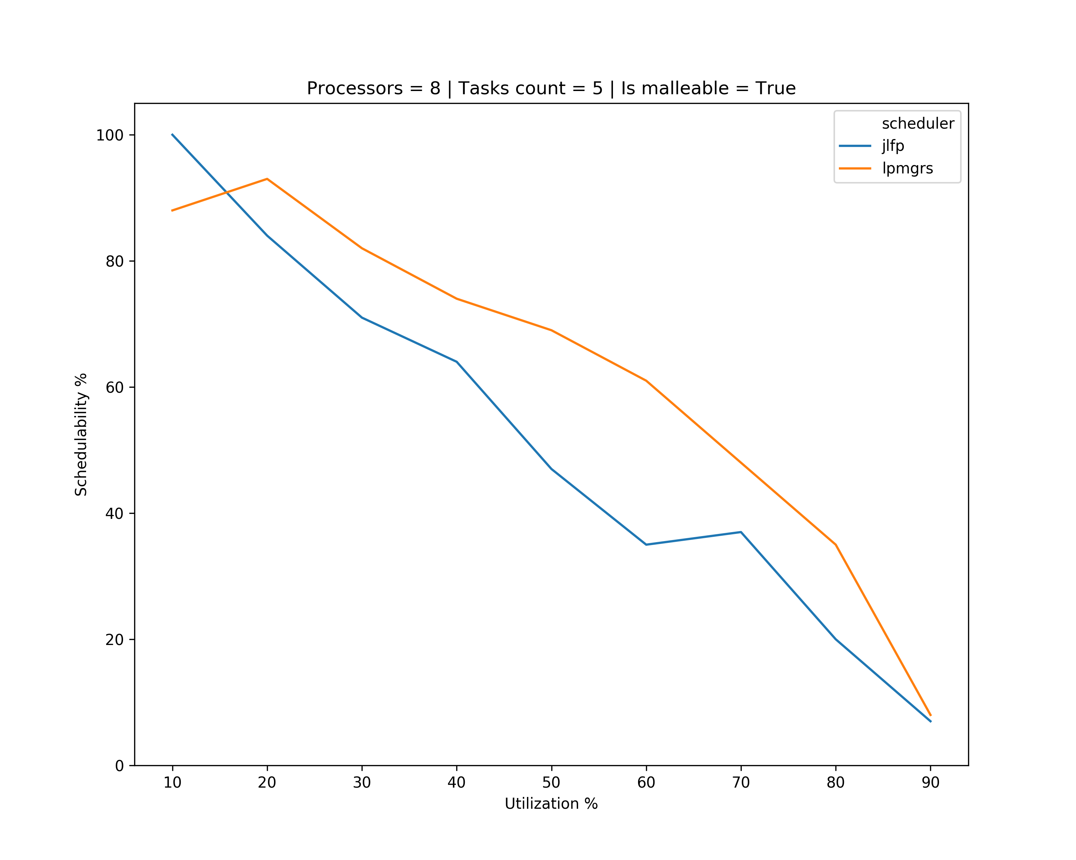
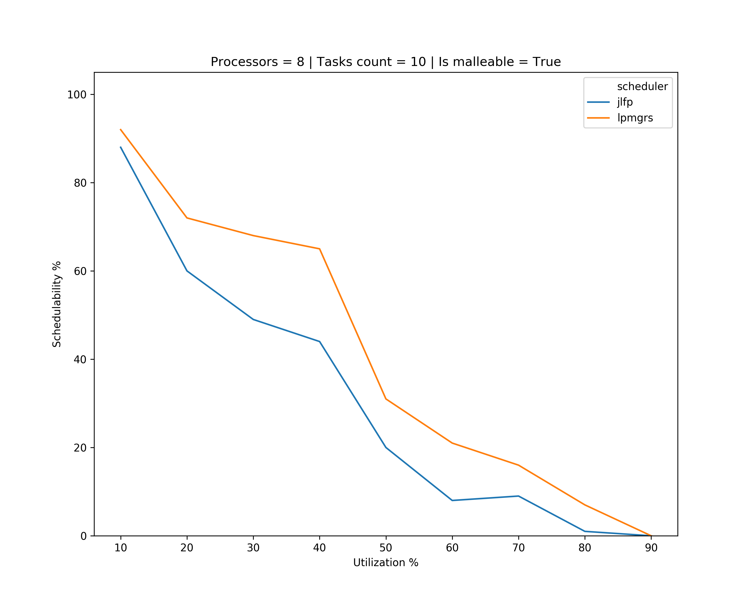
Results – single core max

Slide 14
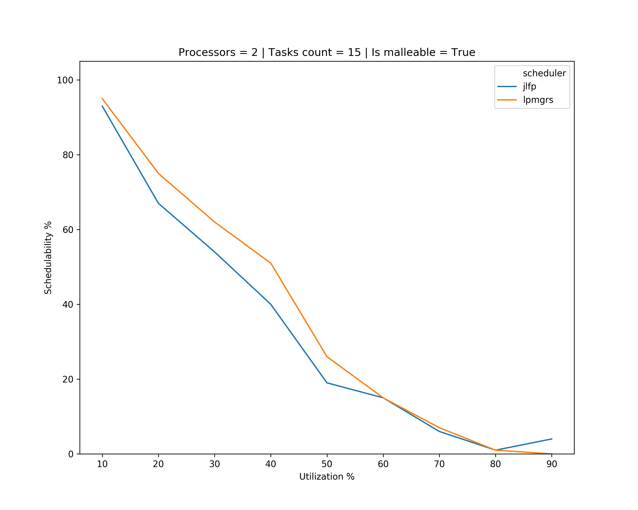
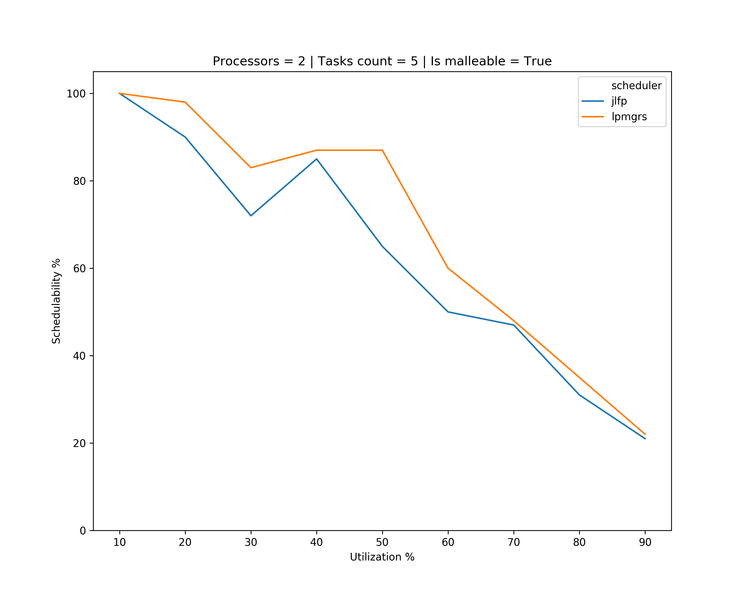
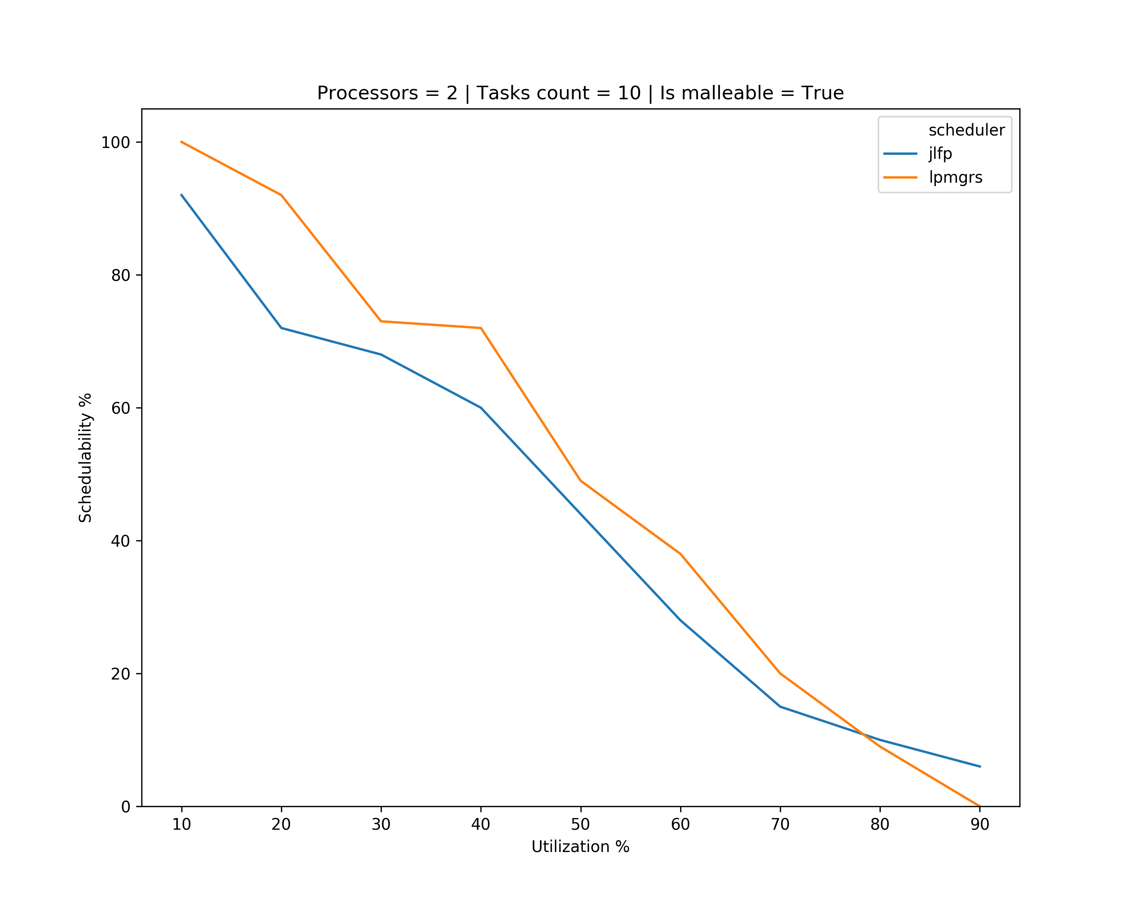
Results – minimum min

Slide 15
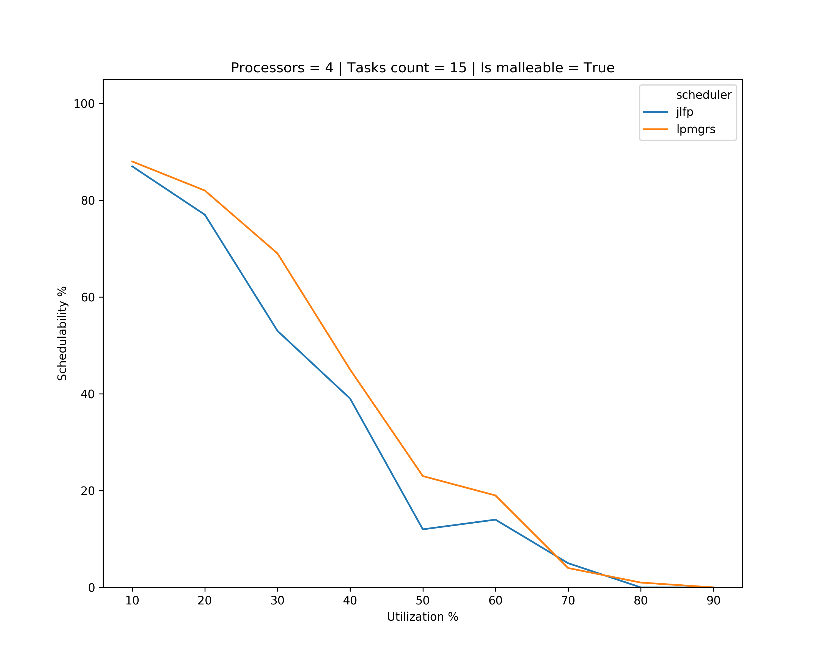
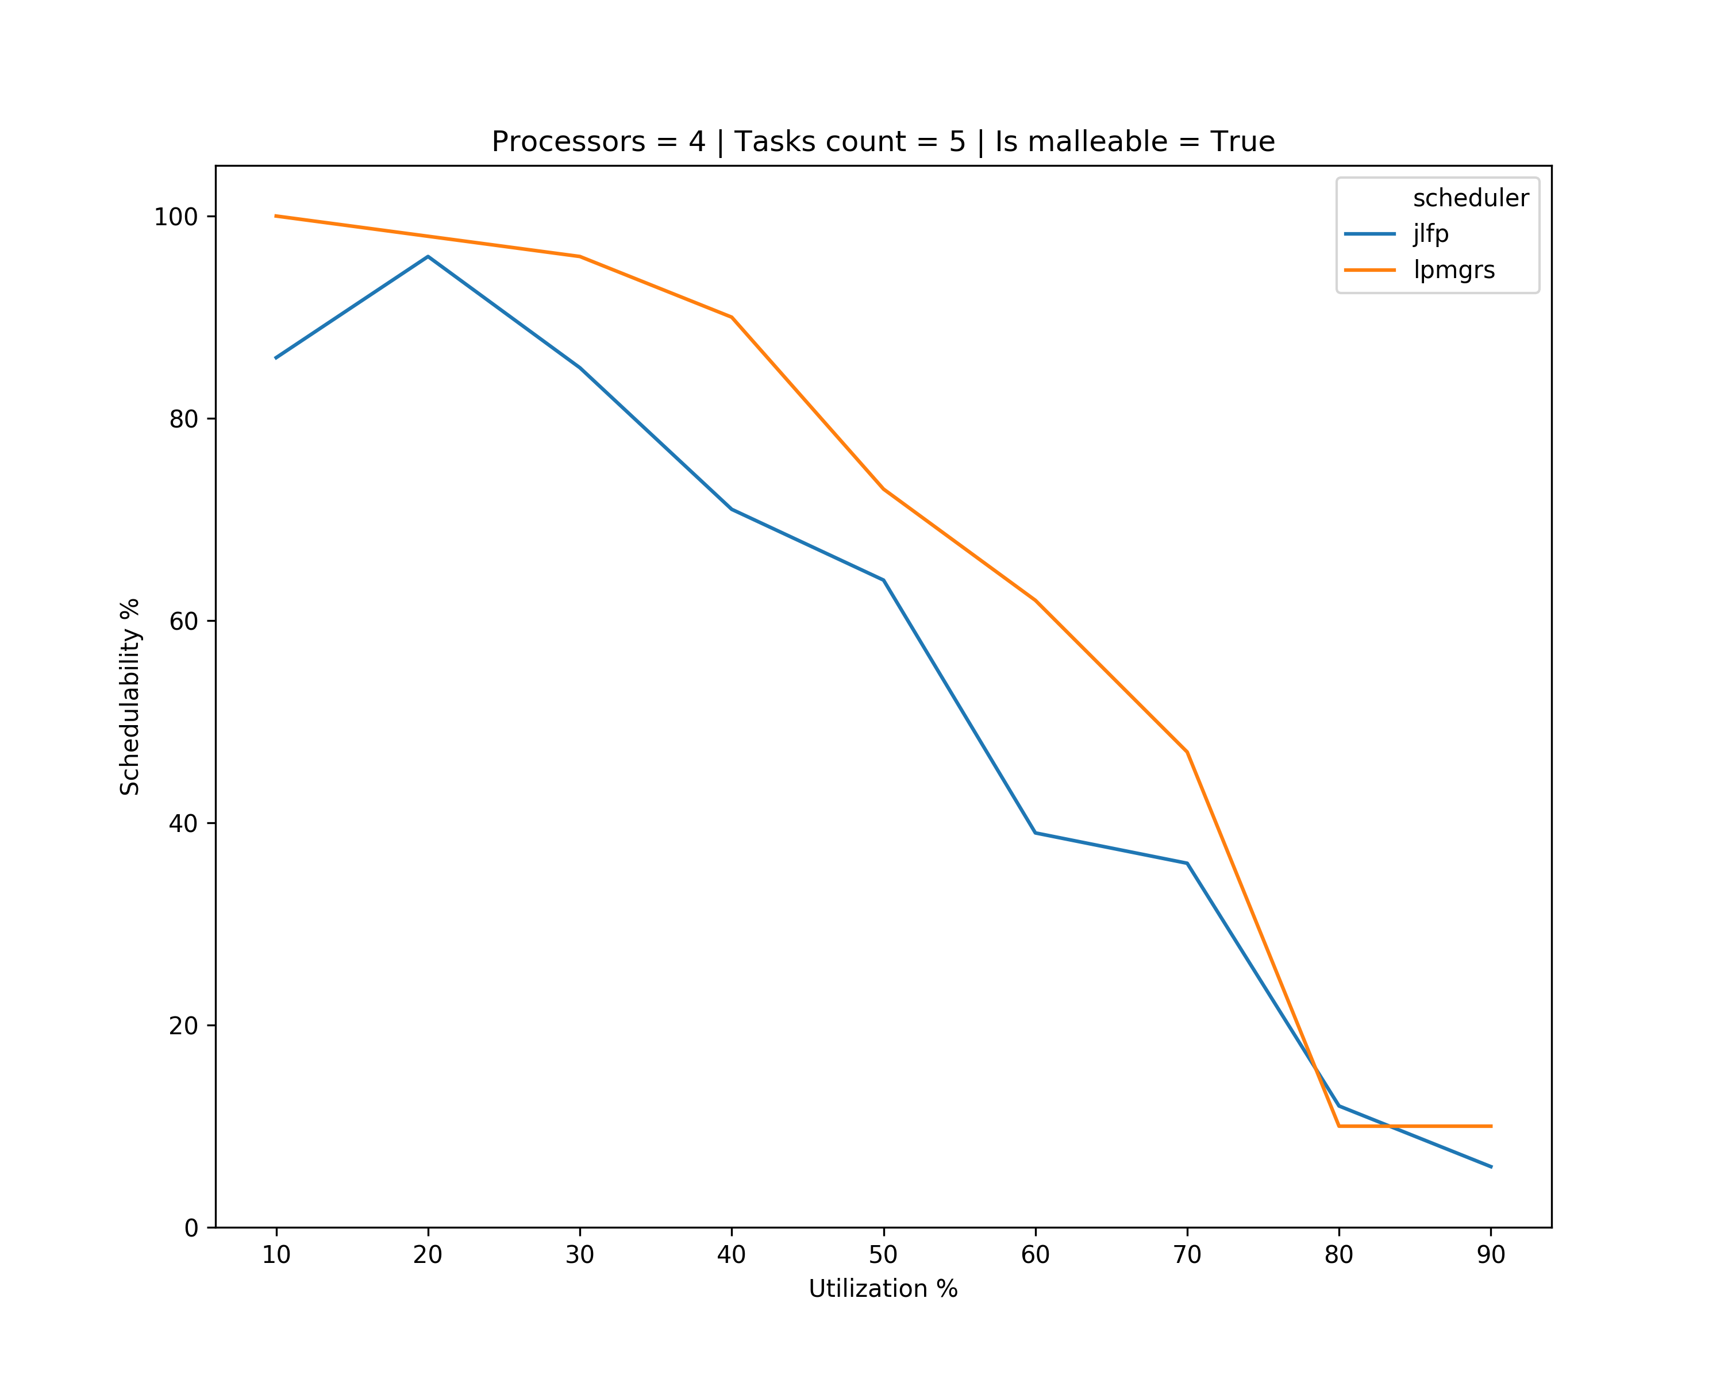
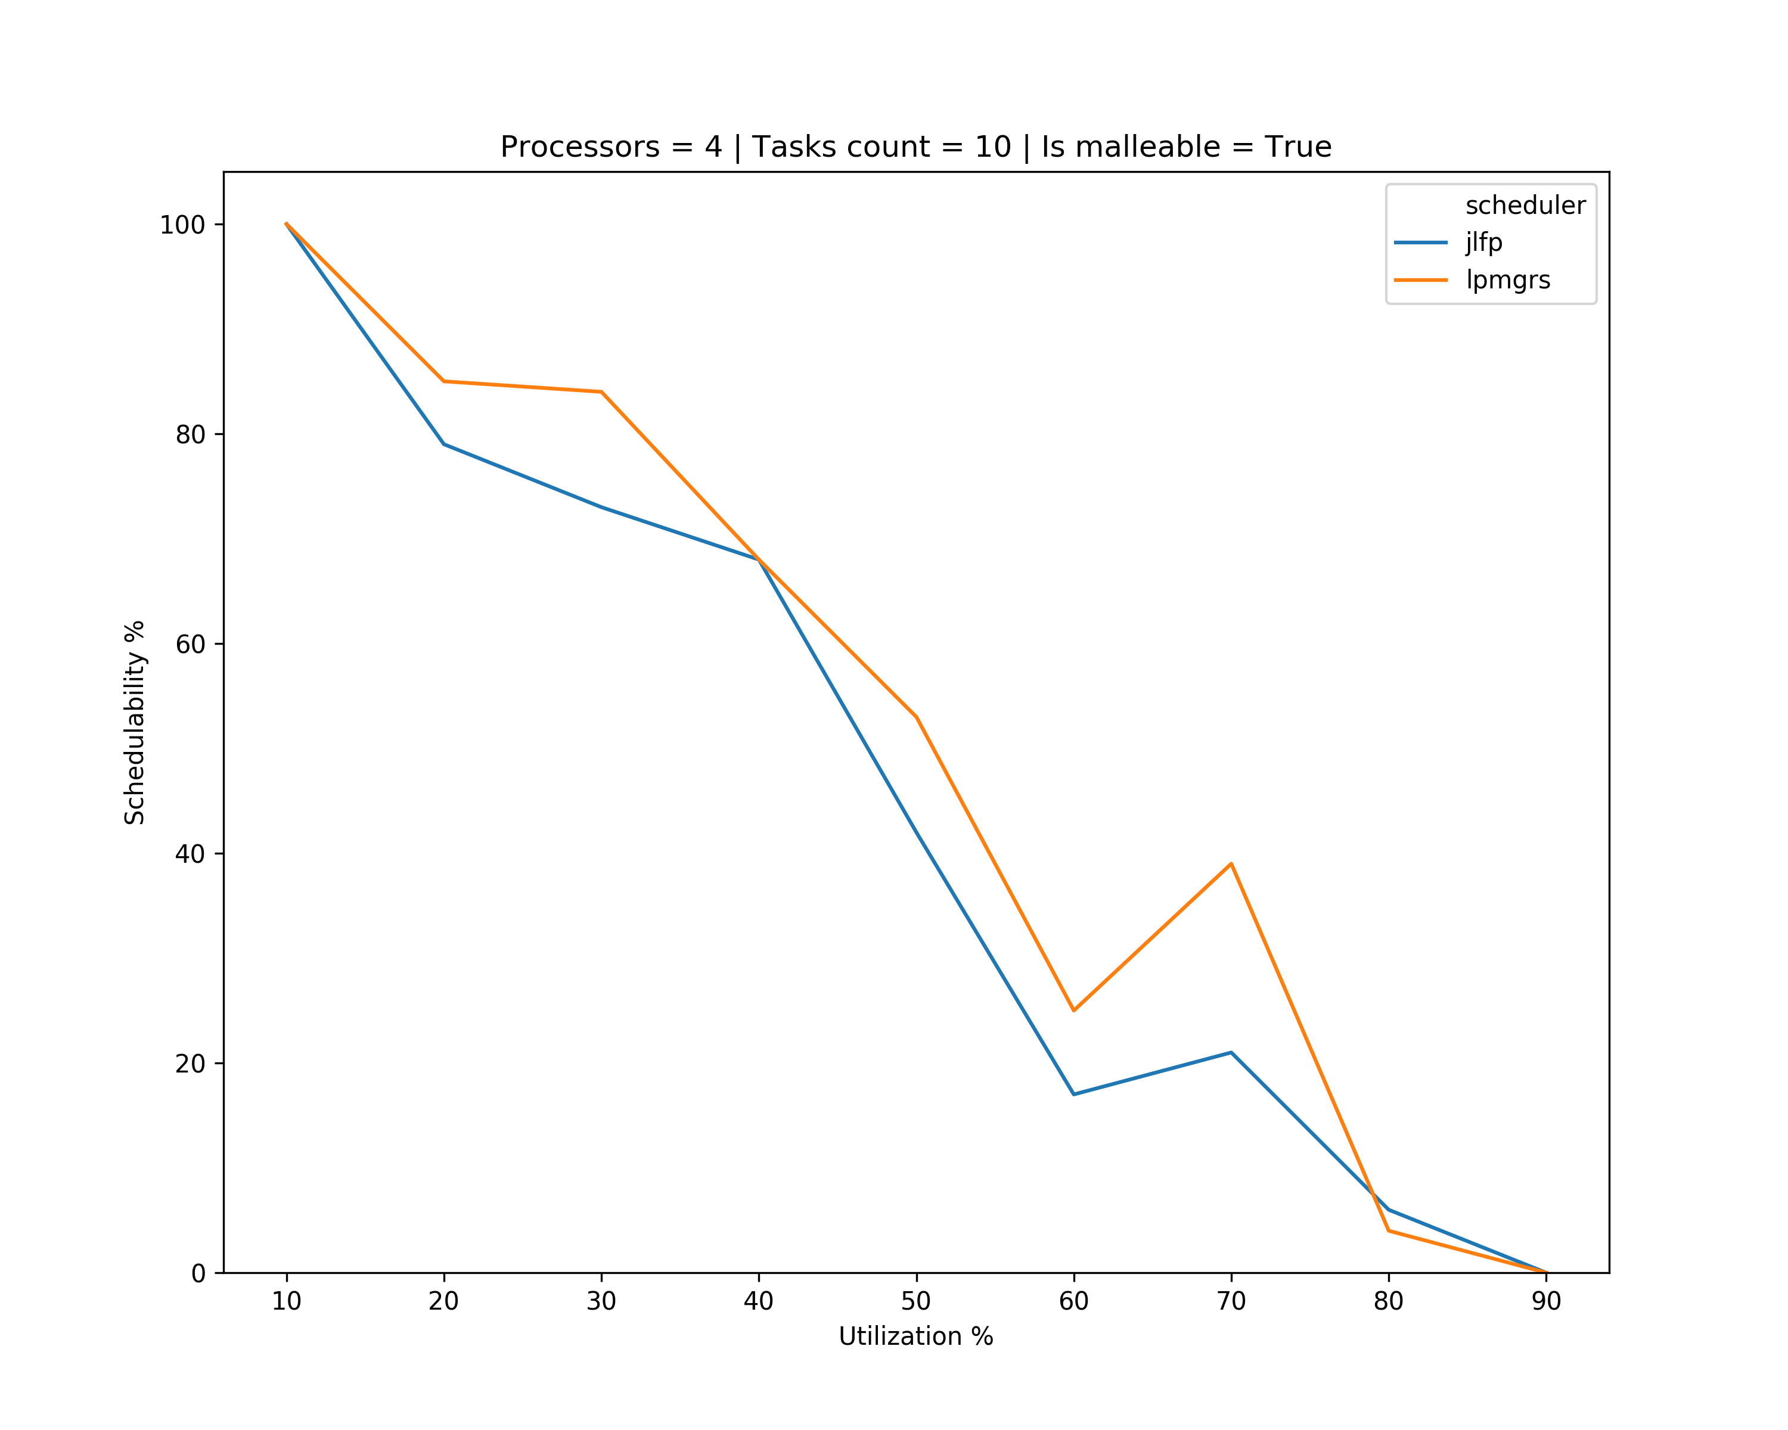
Results – minimum min

Slide 16
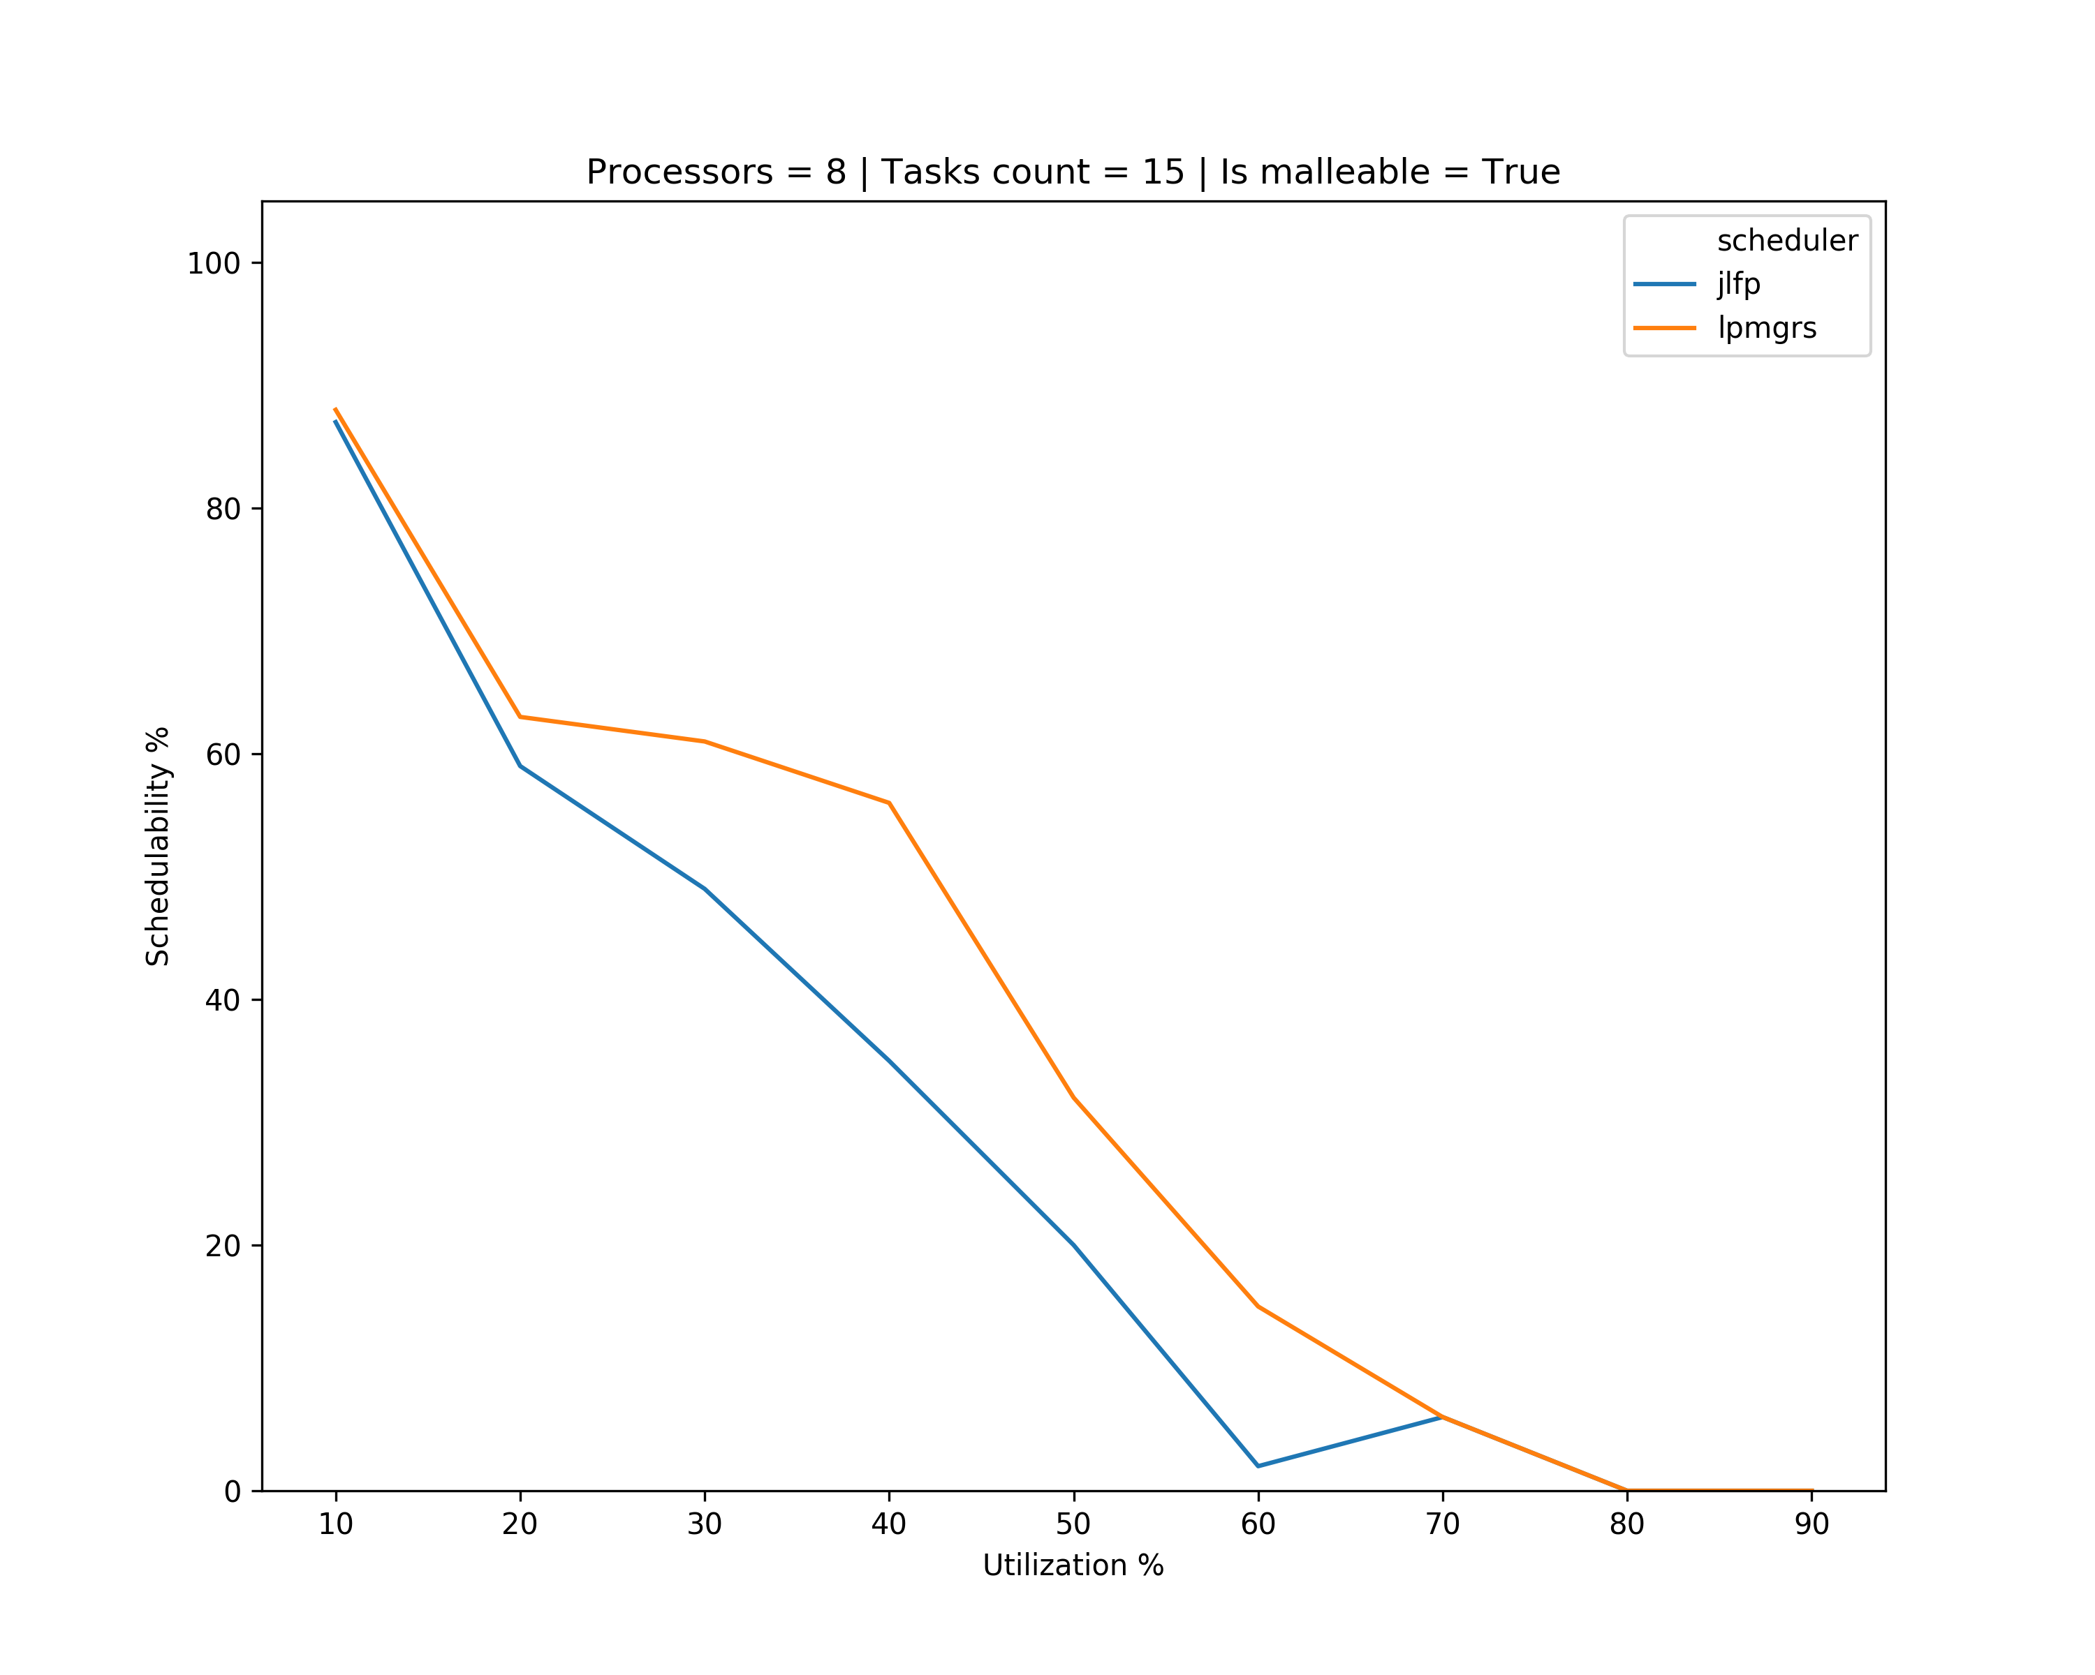
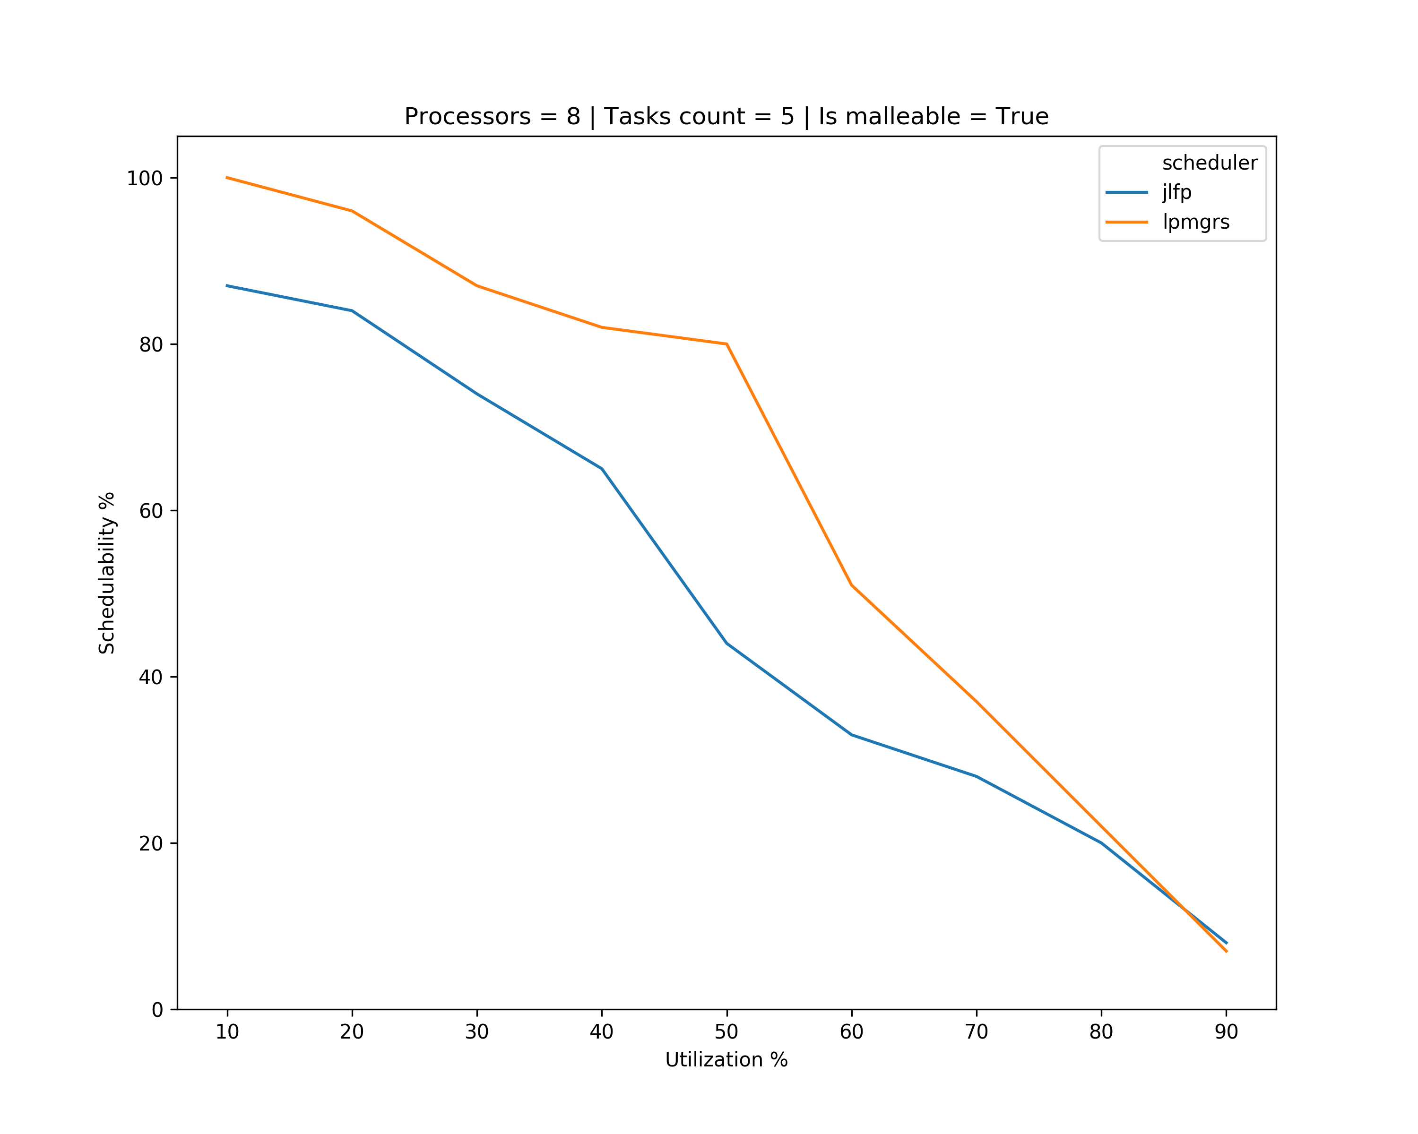
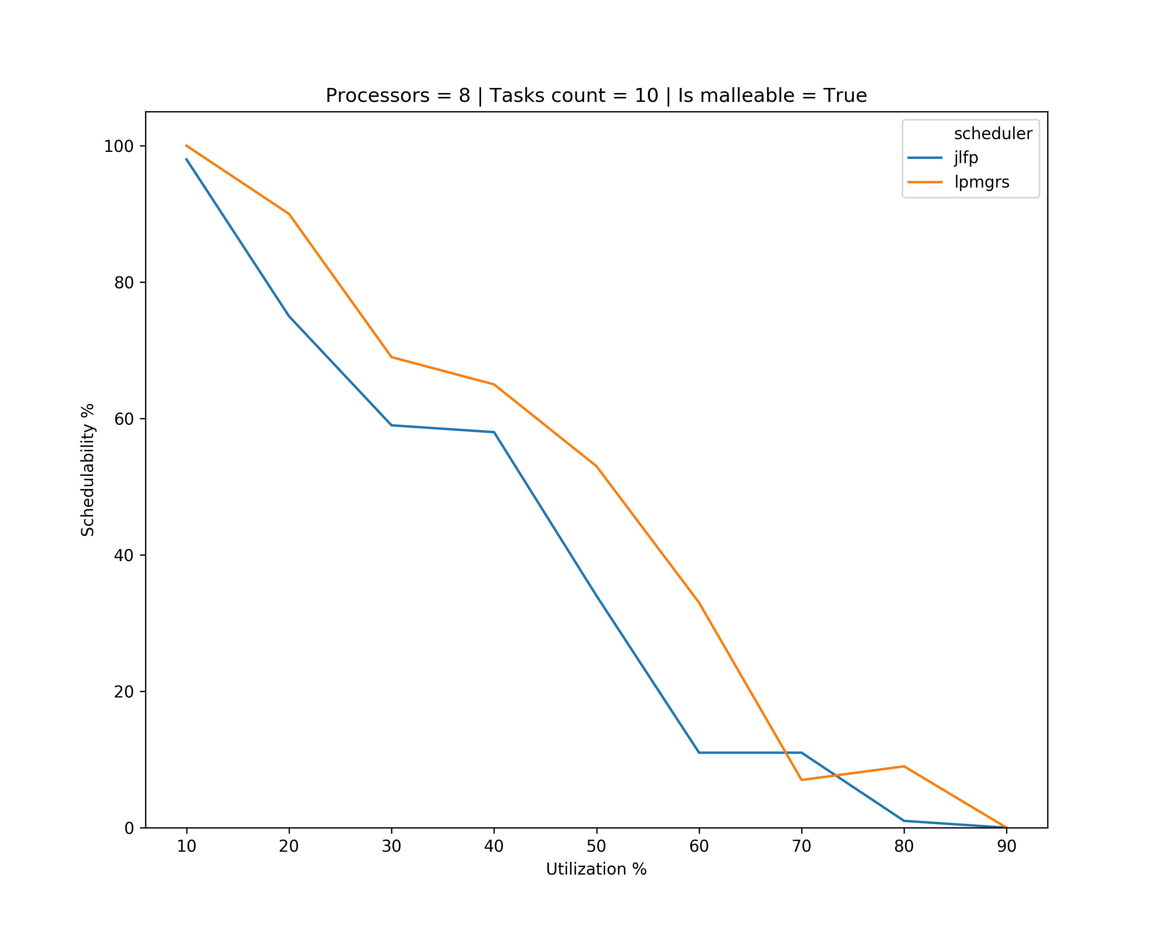
Results – minimum min

Slide 17
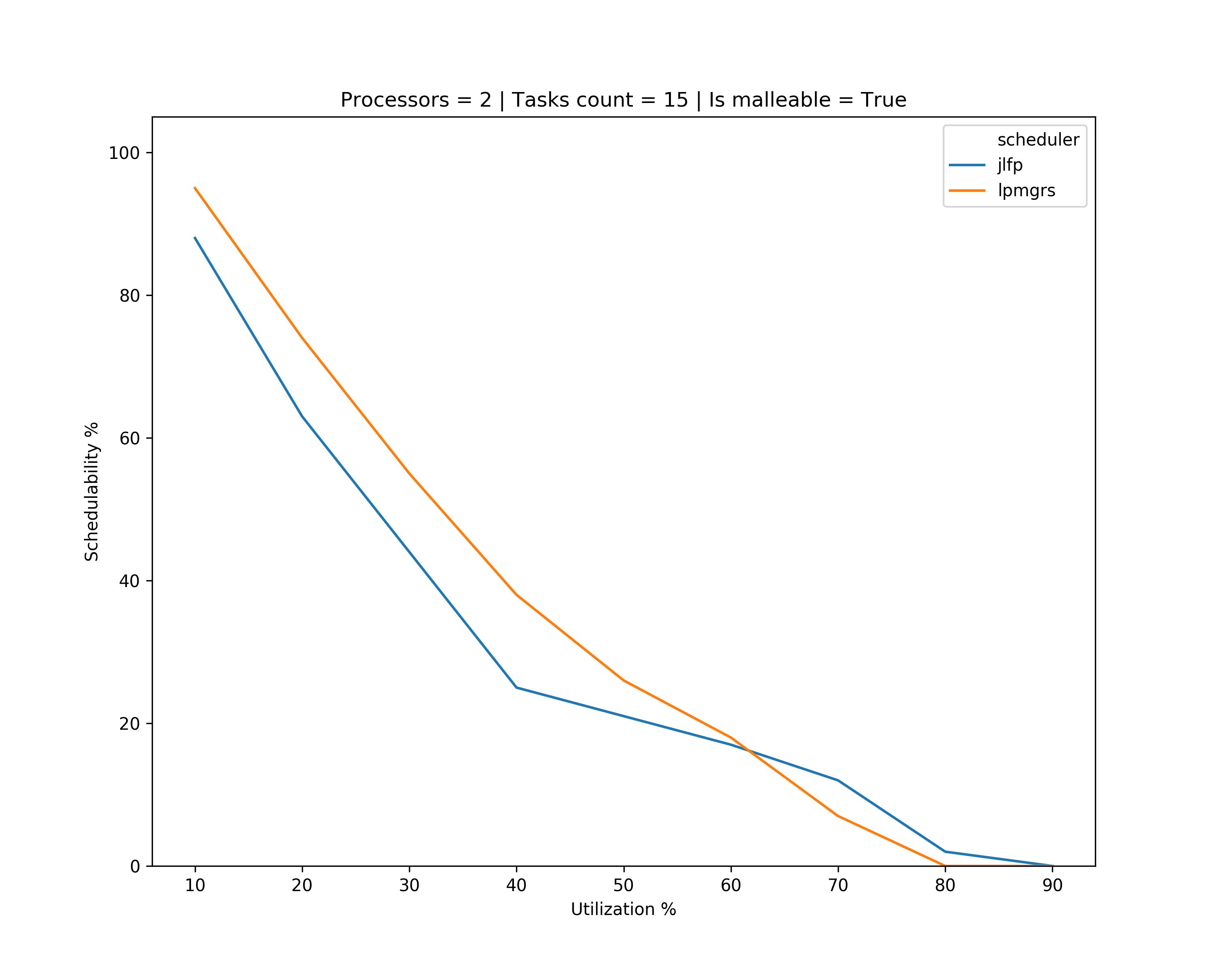
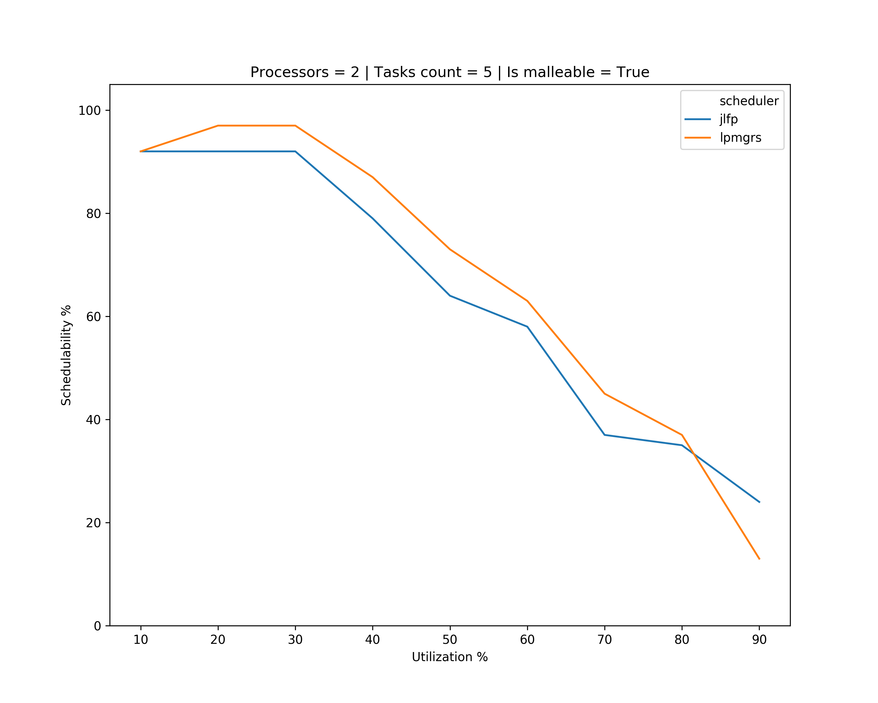
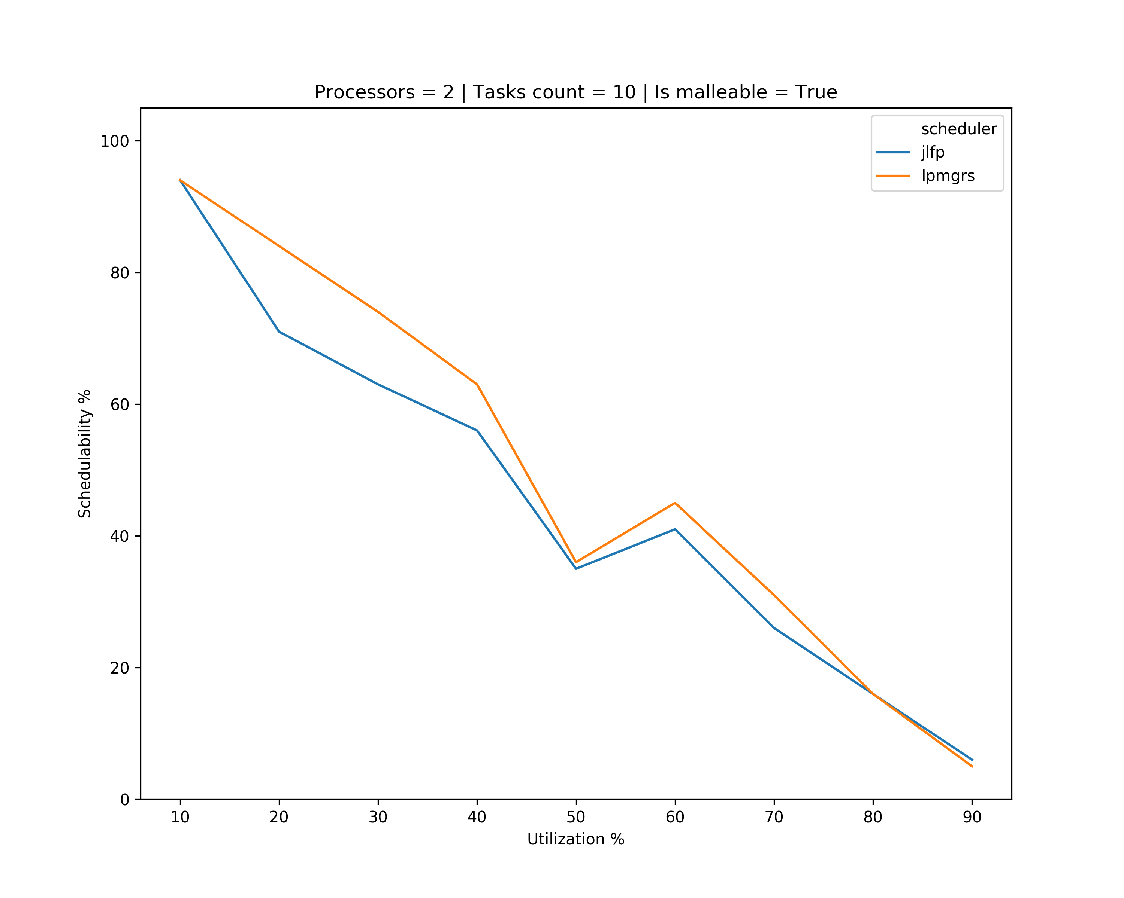
Results – minimum max

Slide 18
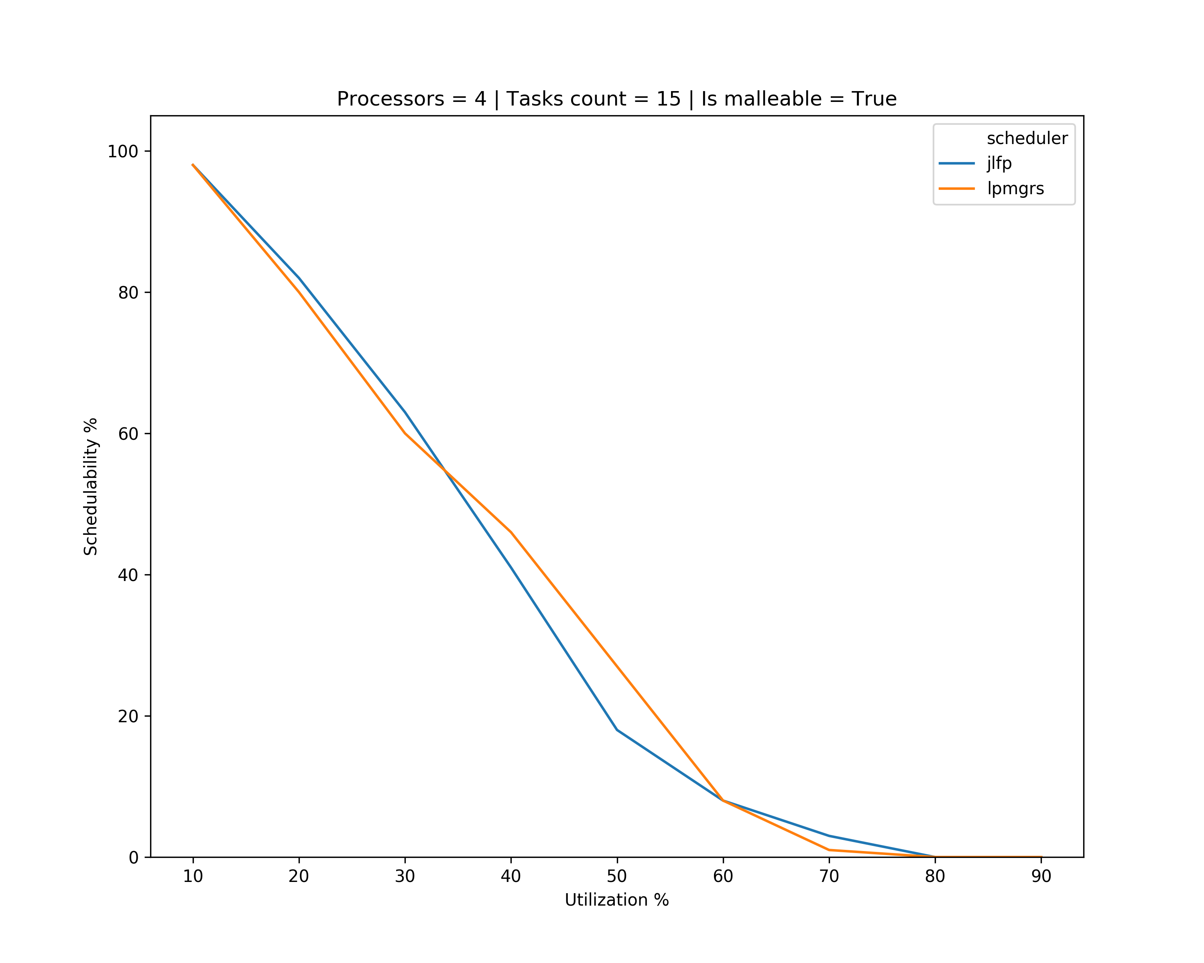
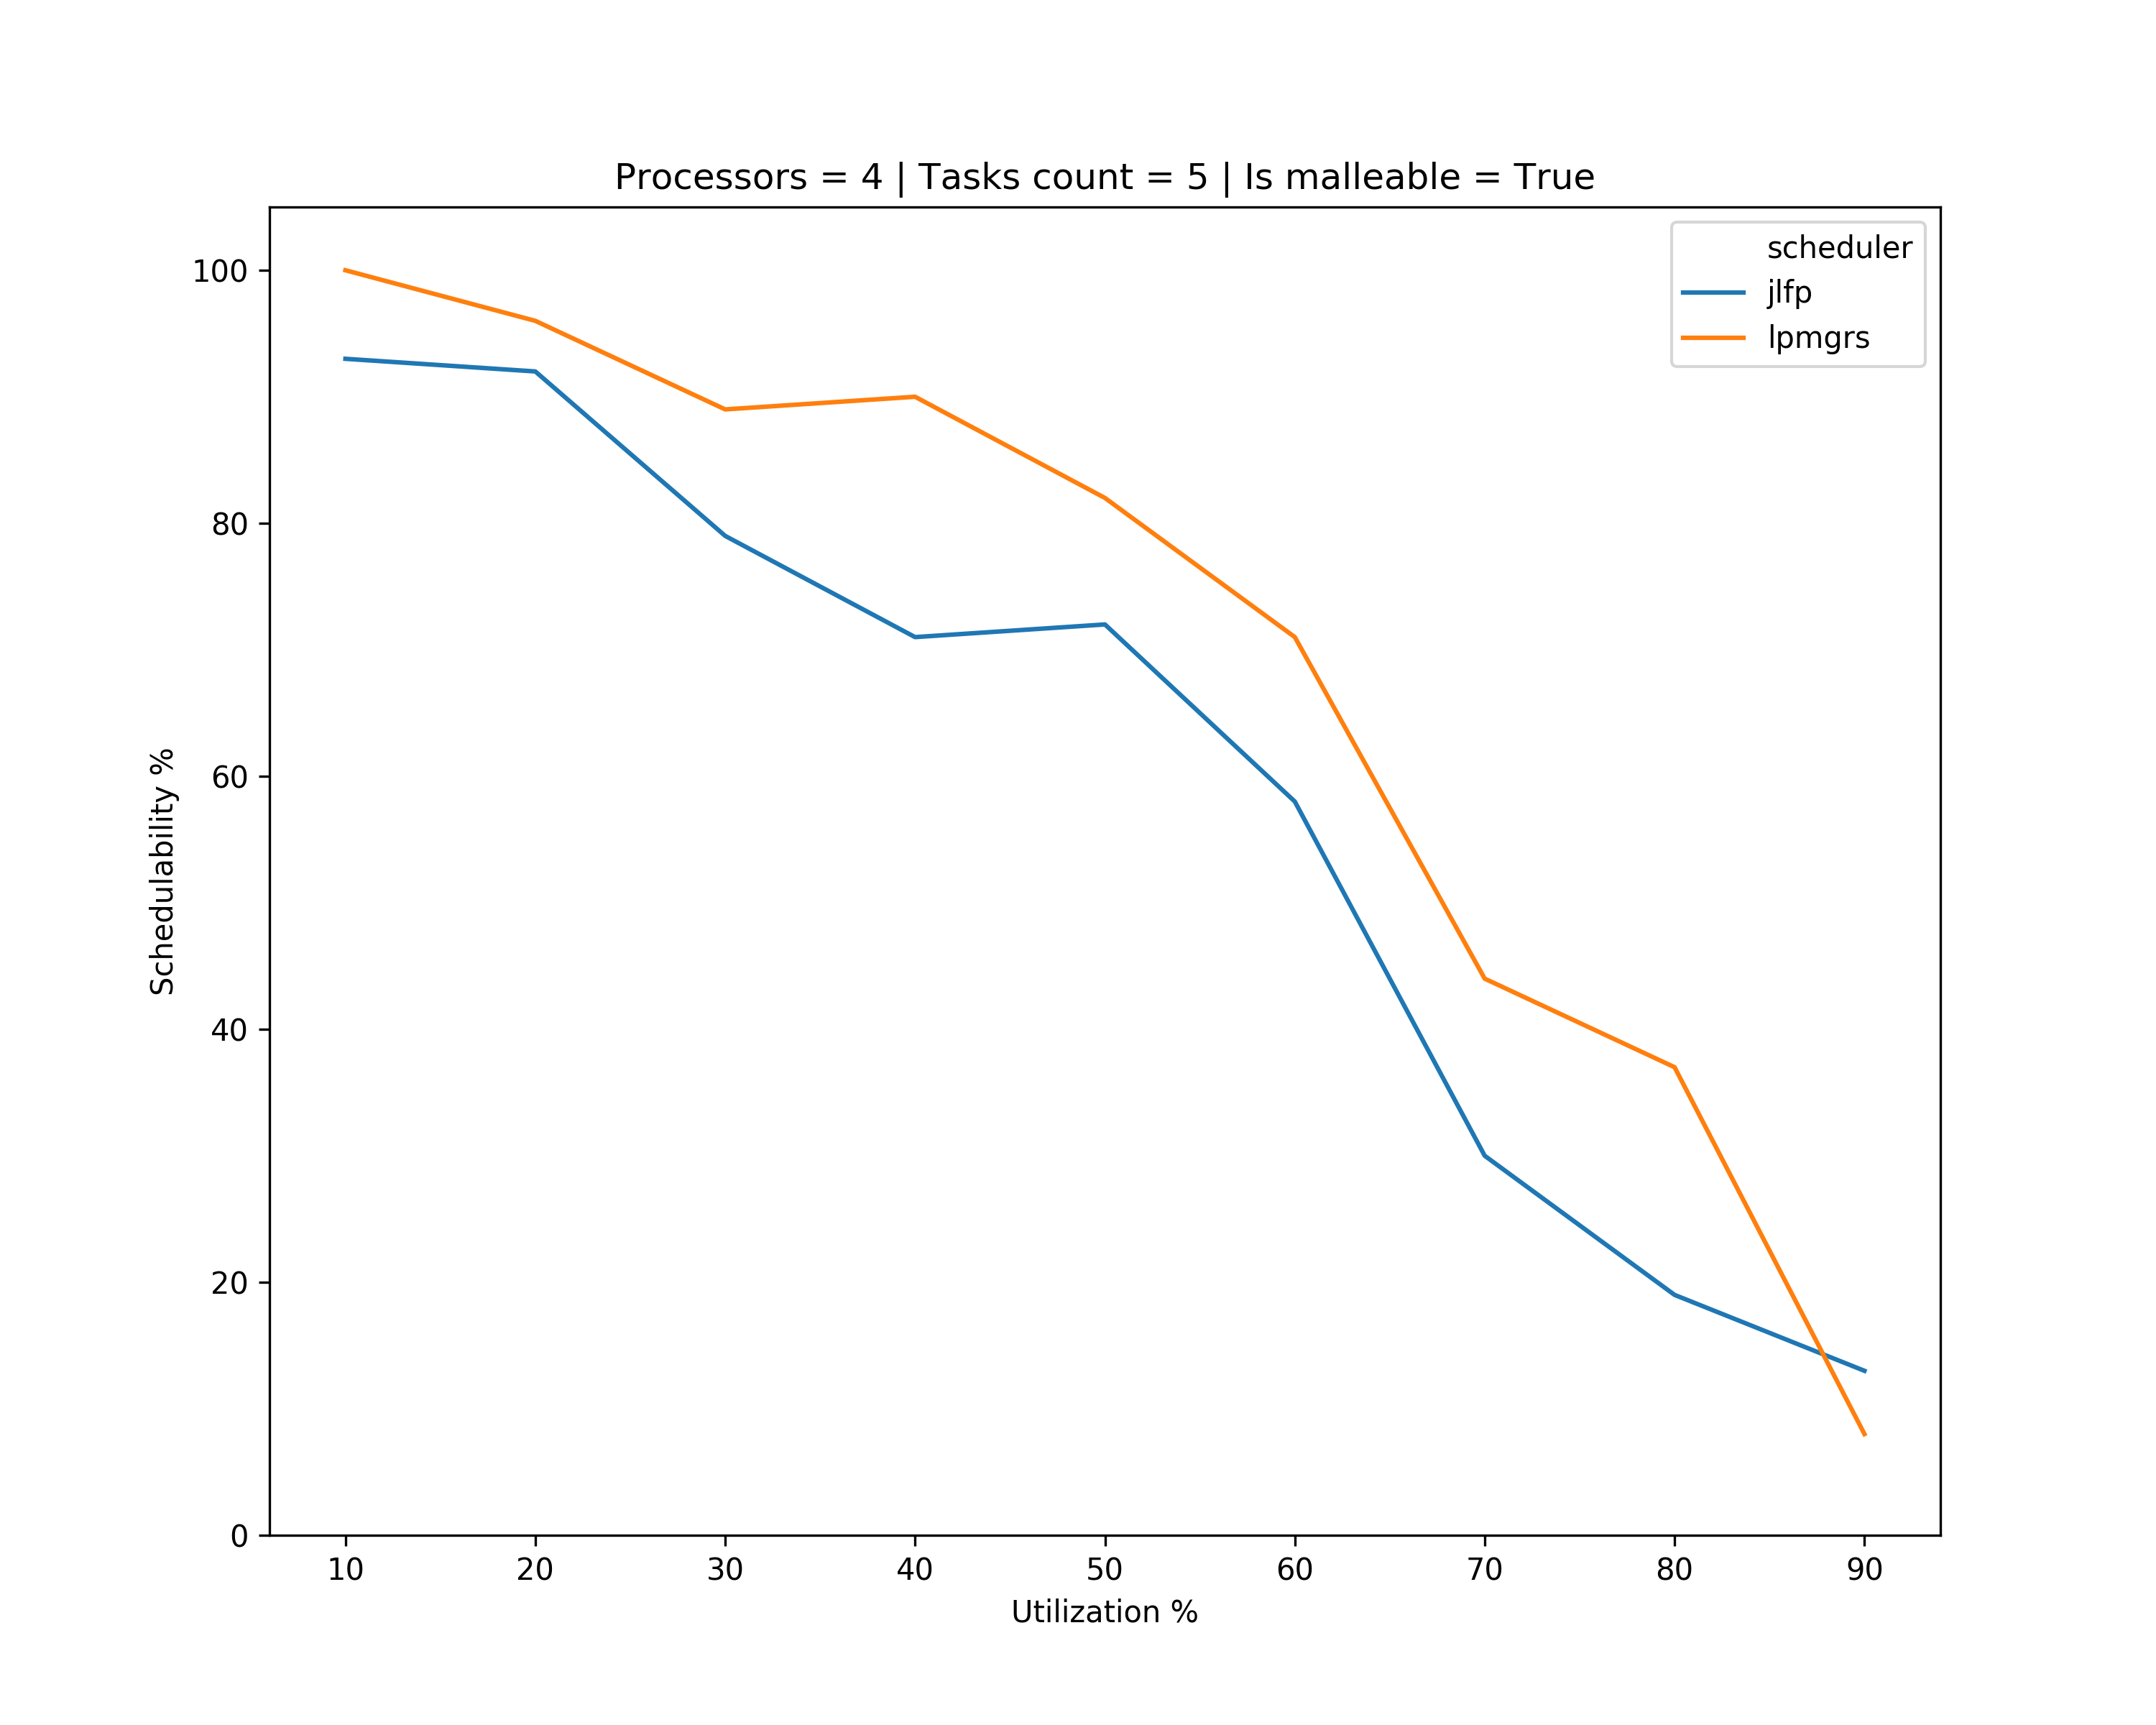
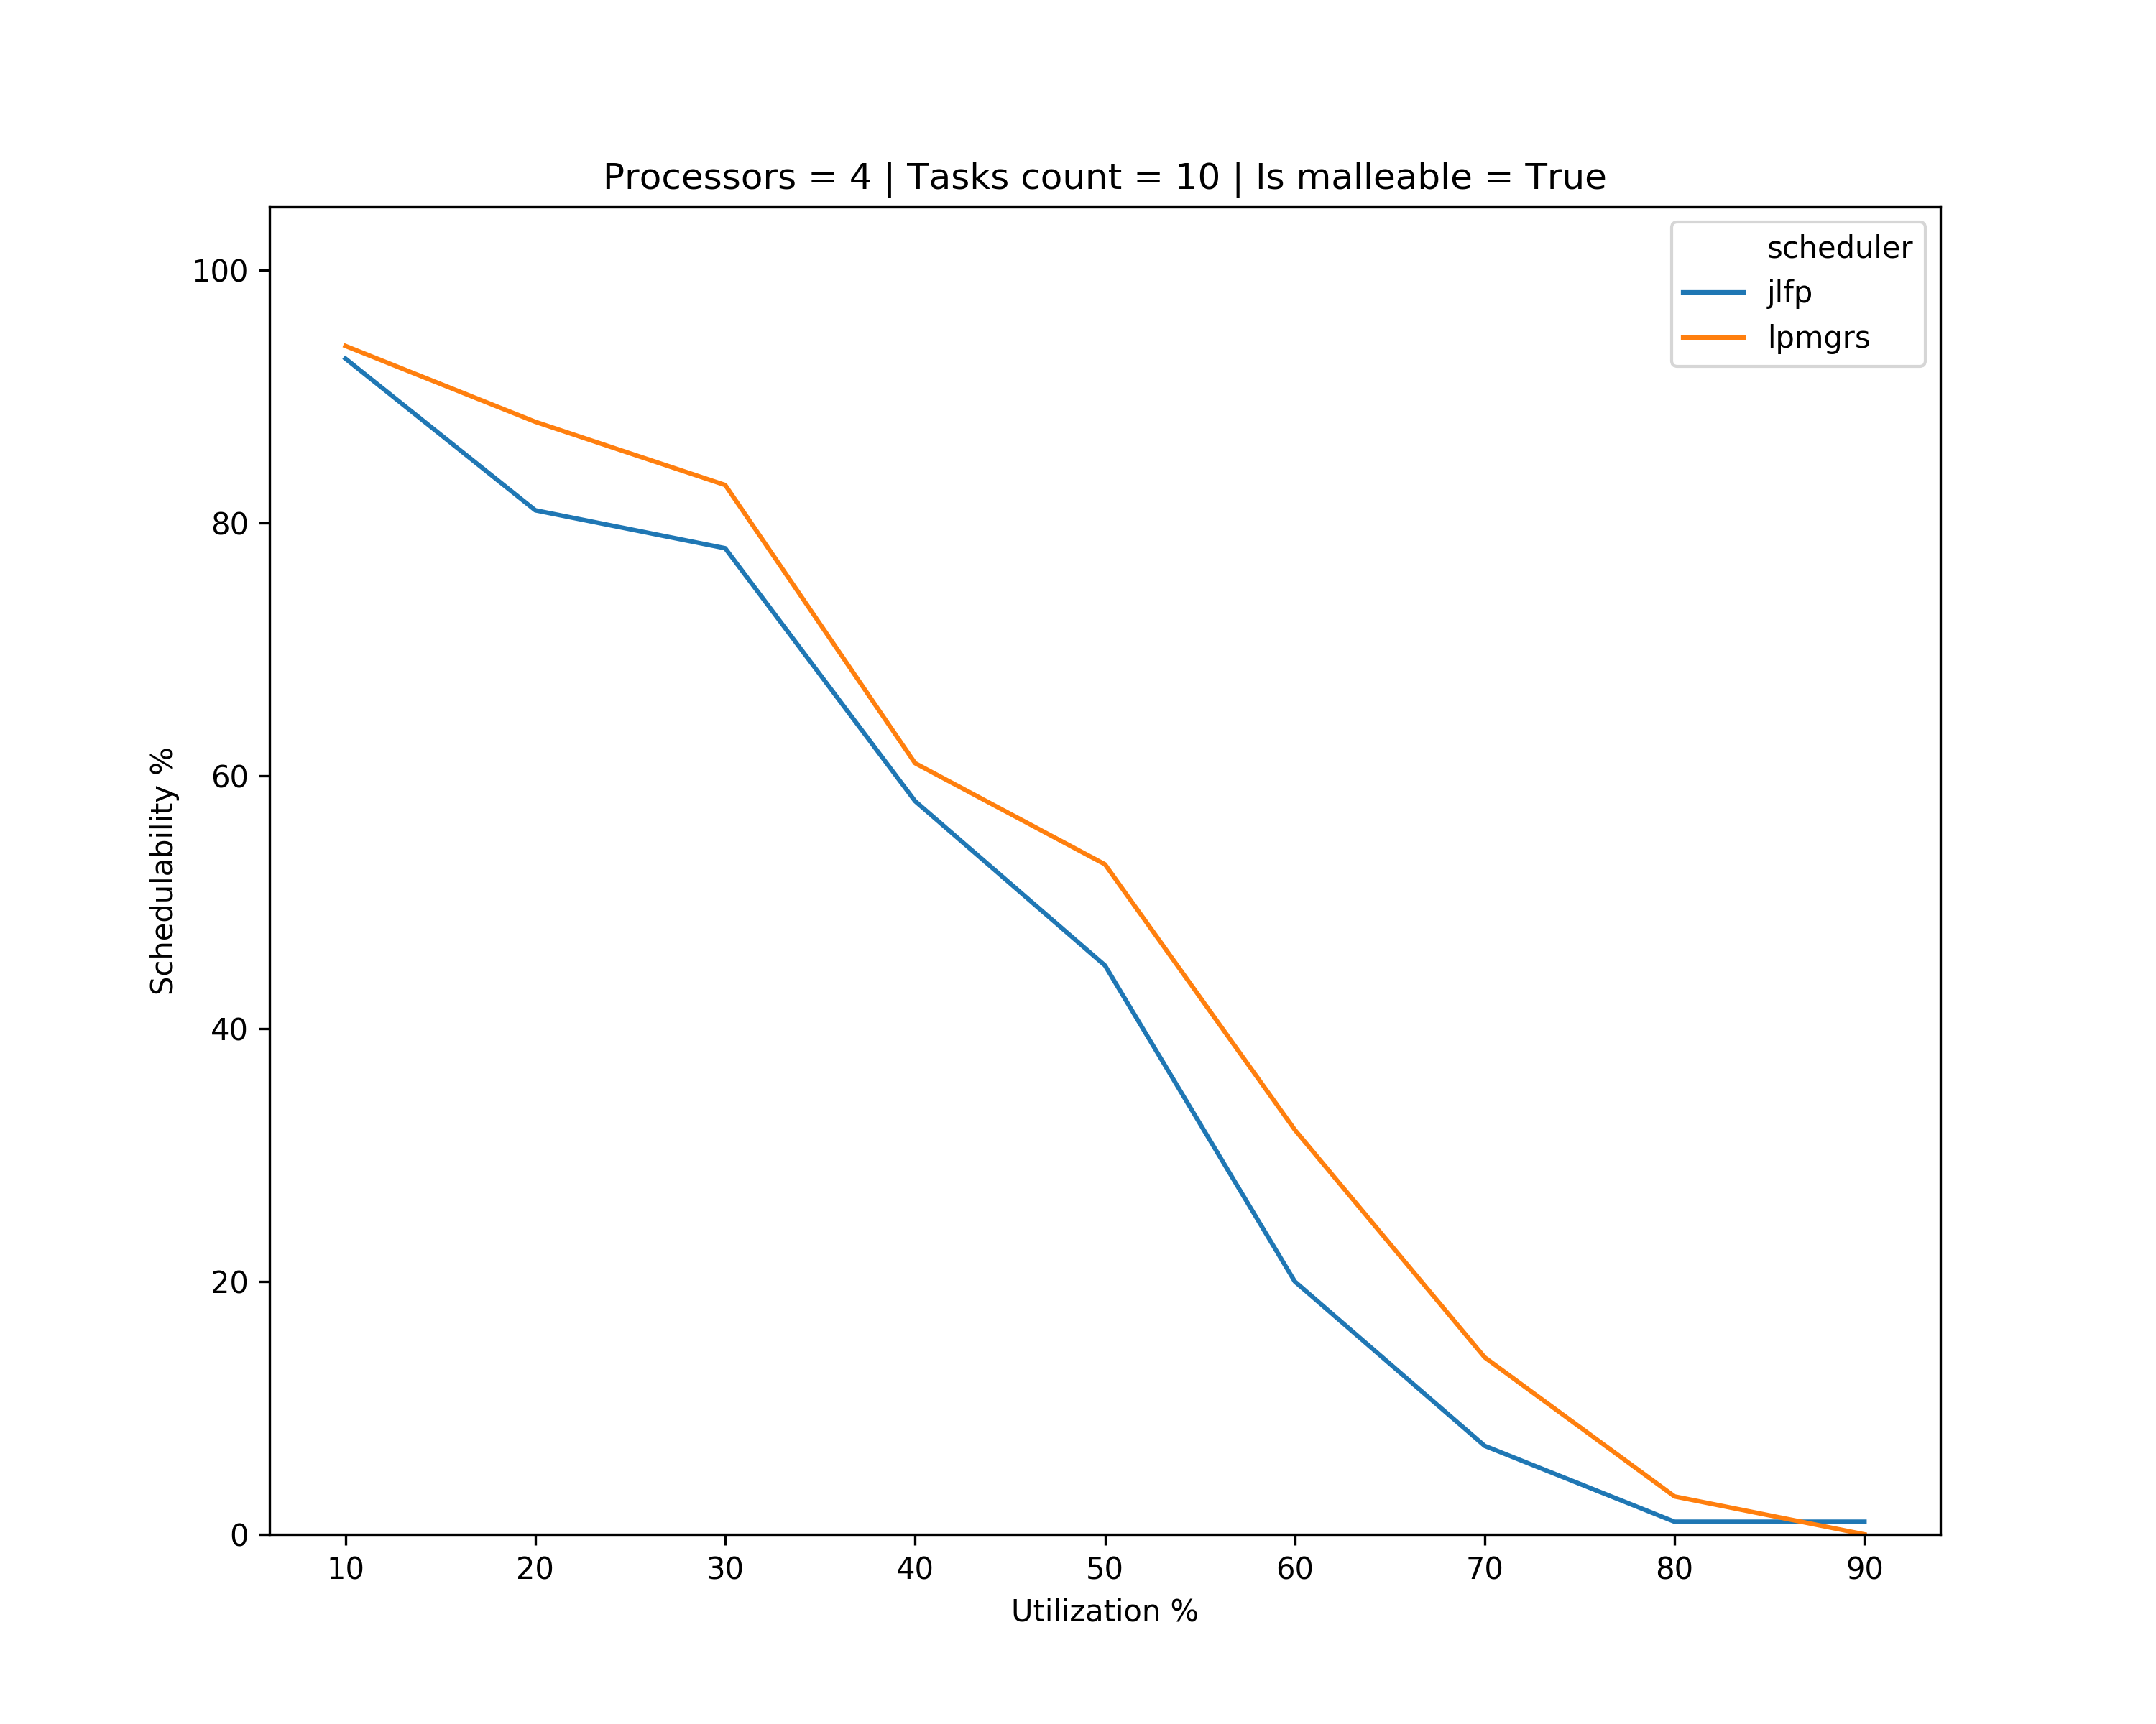
Results – minimum max

Slide 19
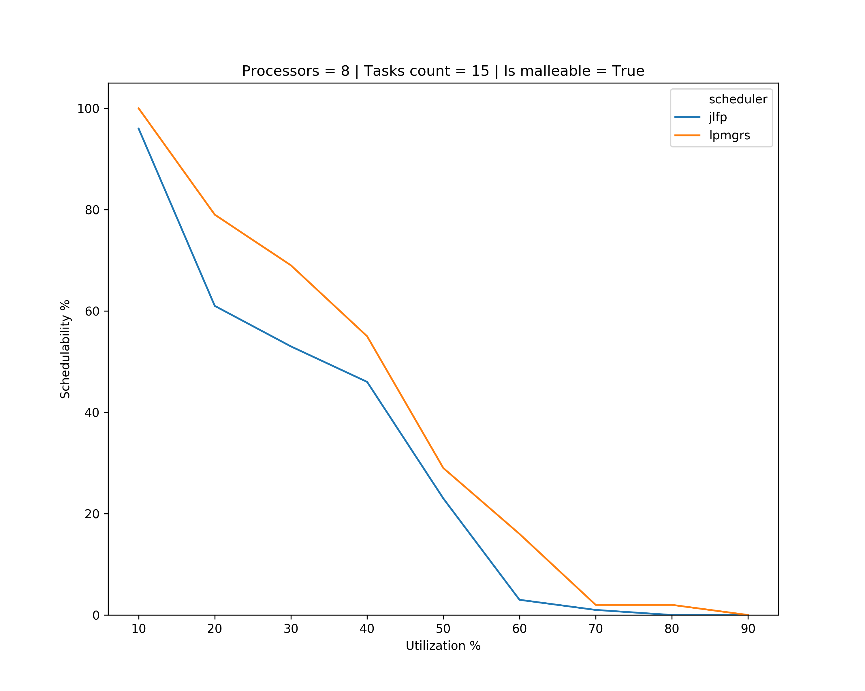
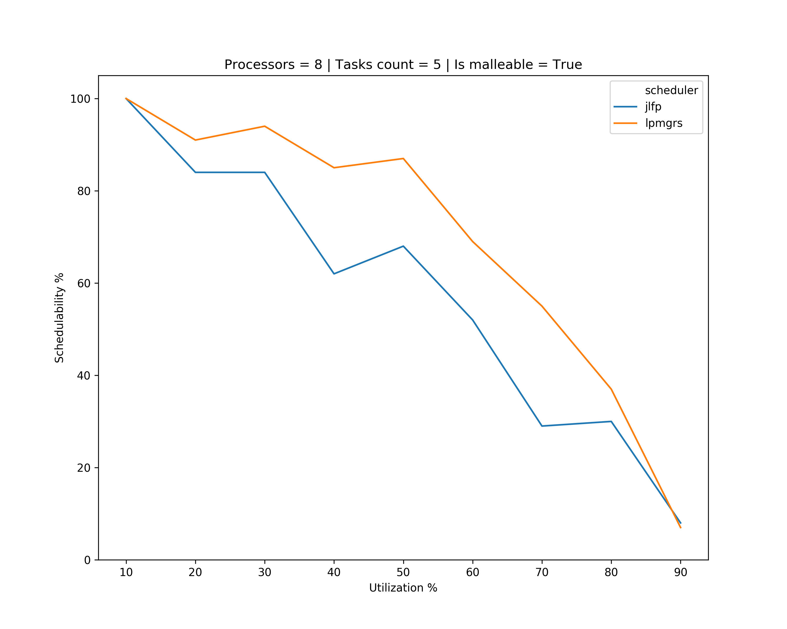
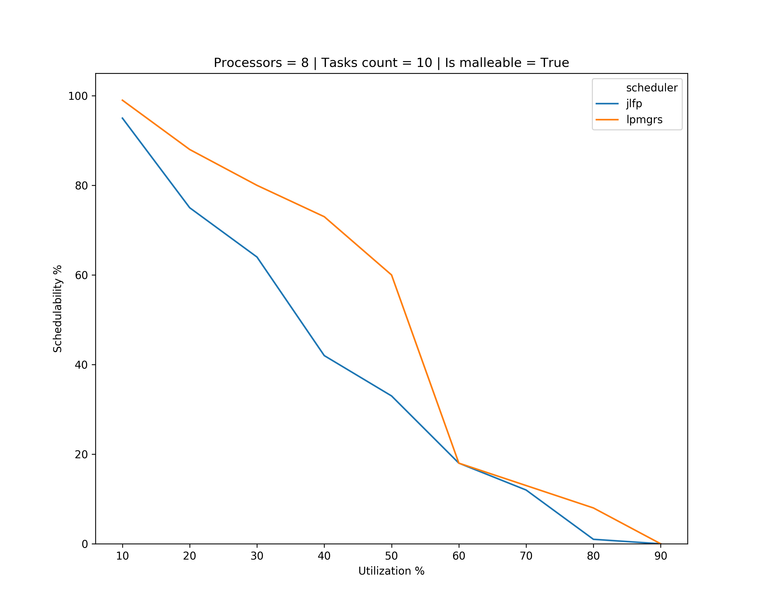
Results – minimum max

Slide 20
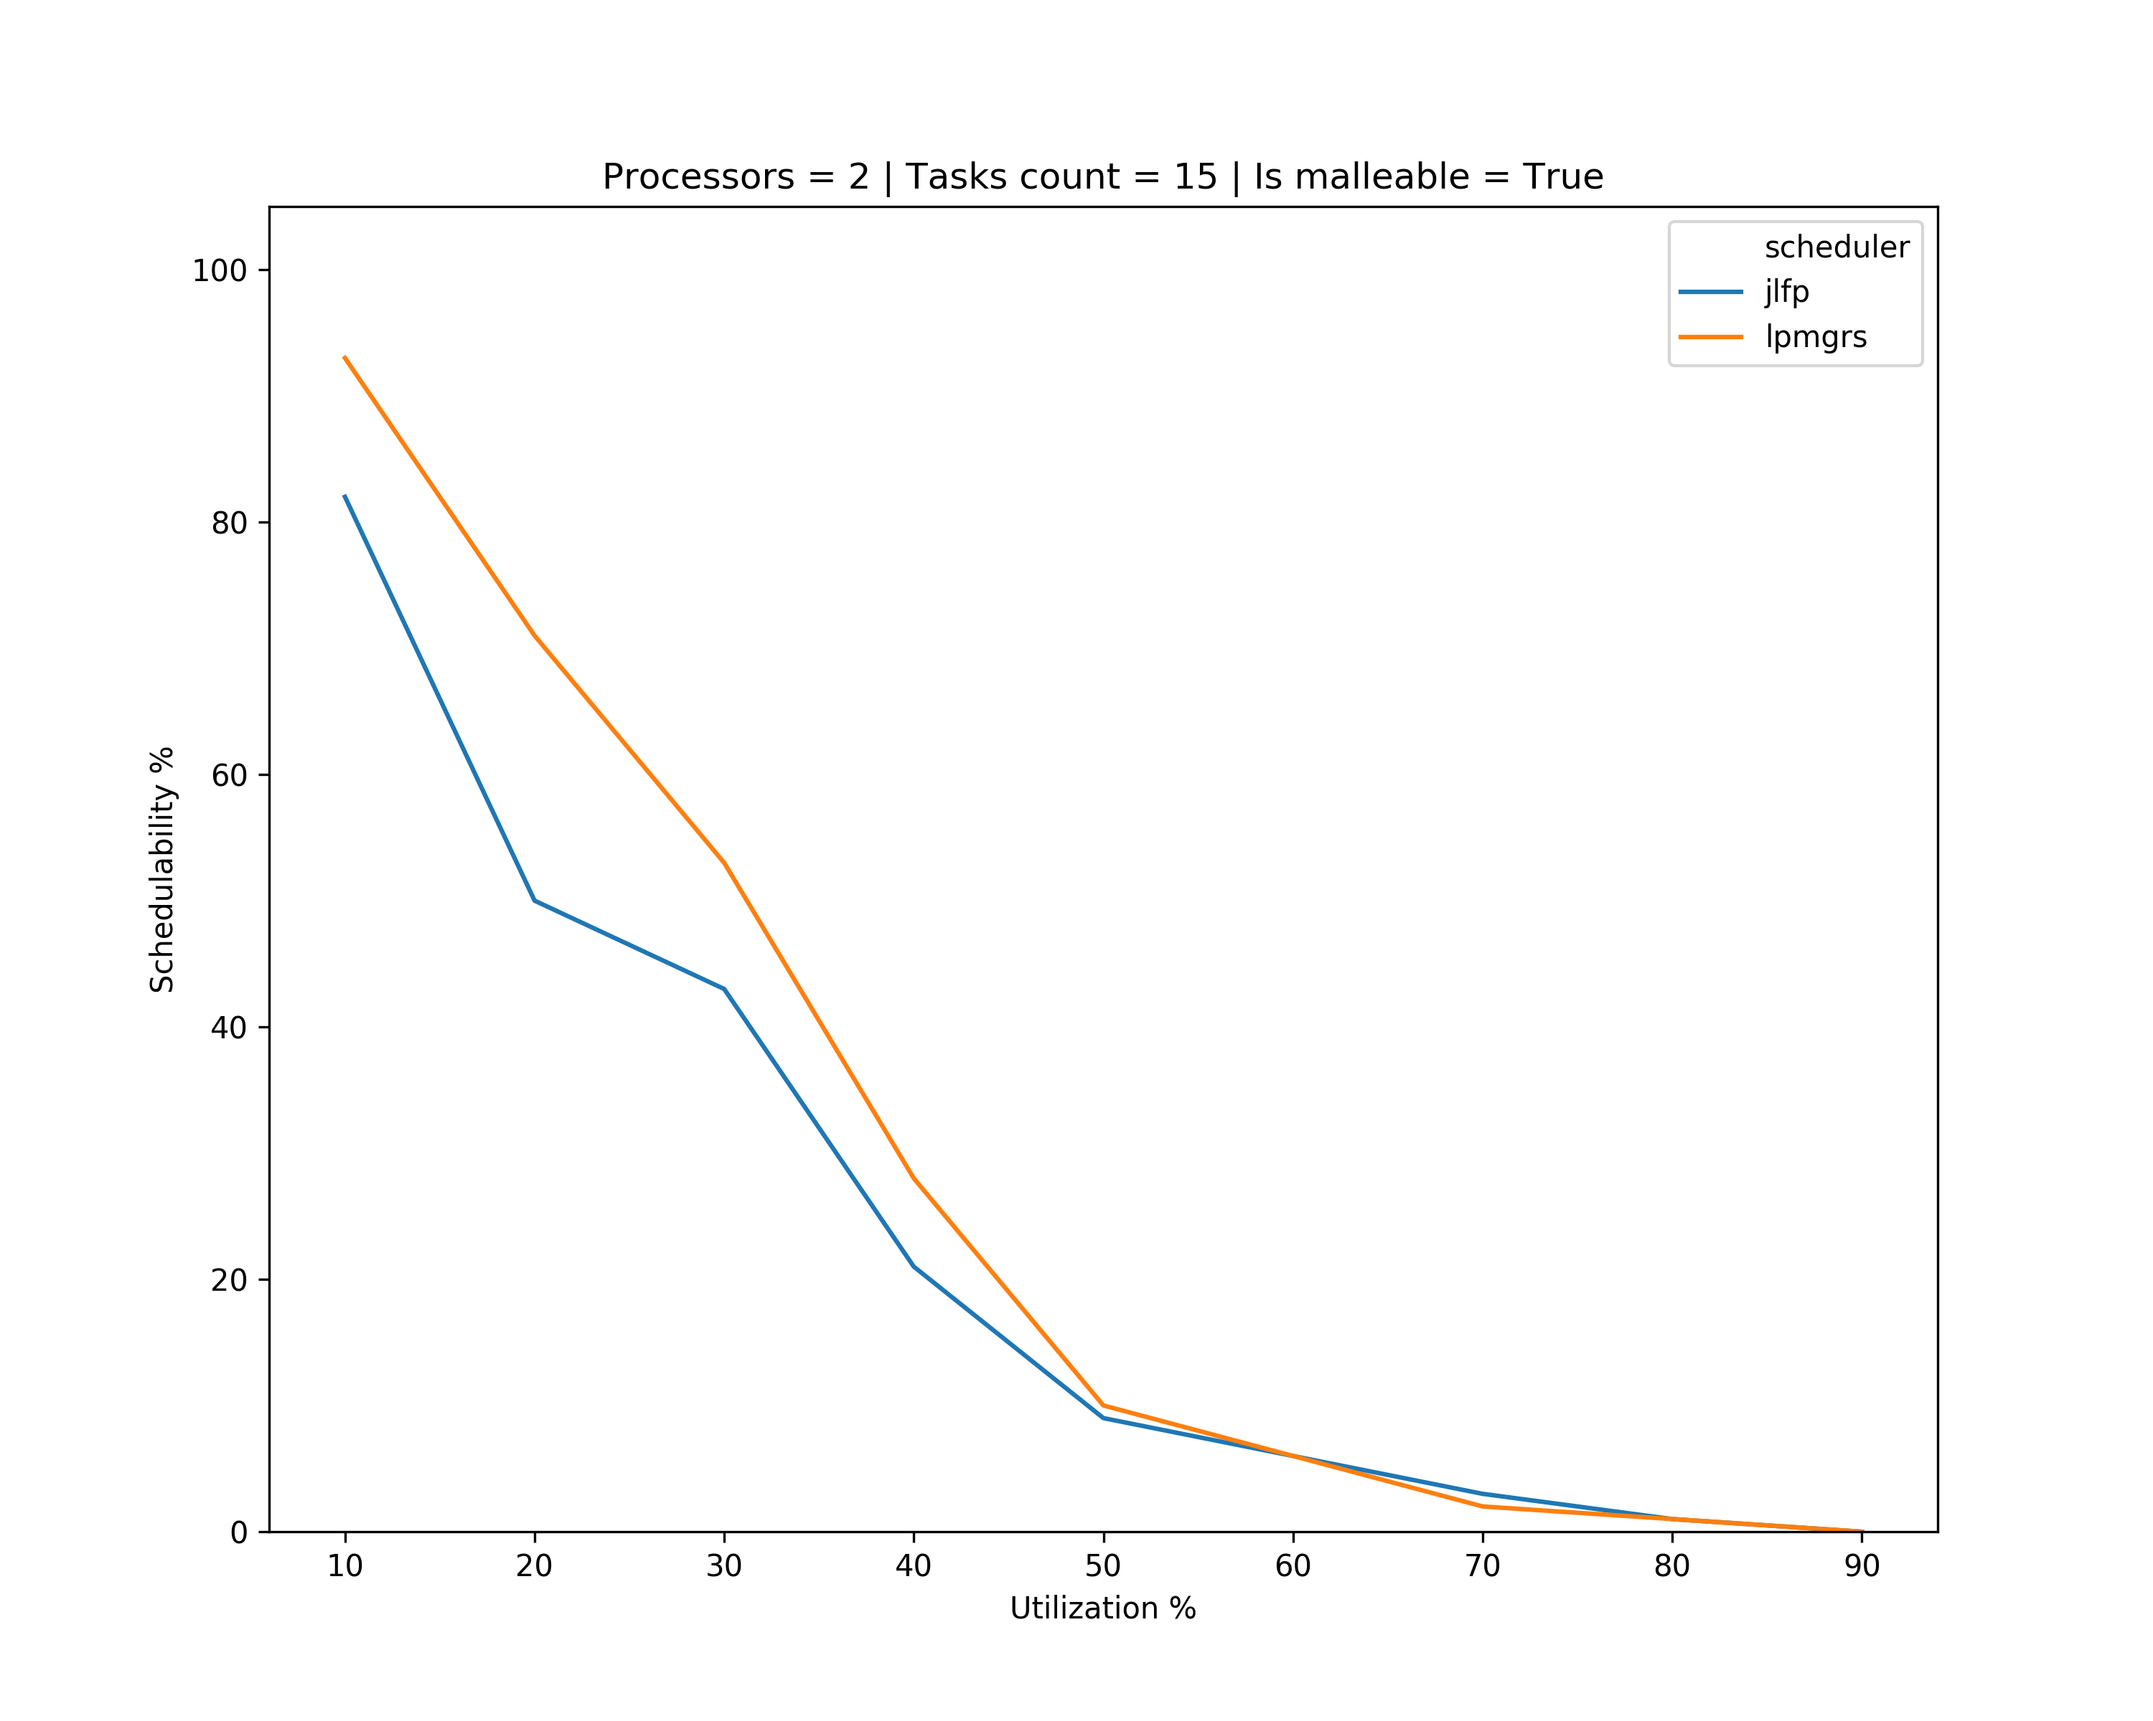
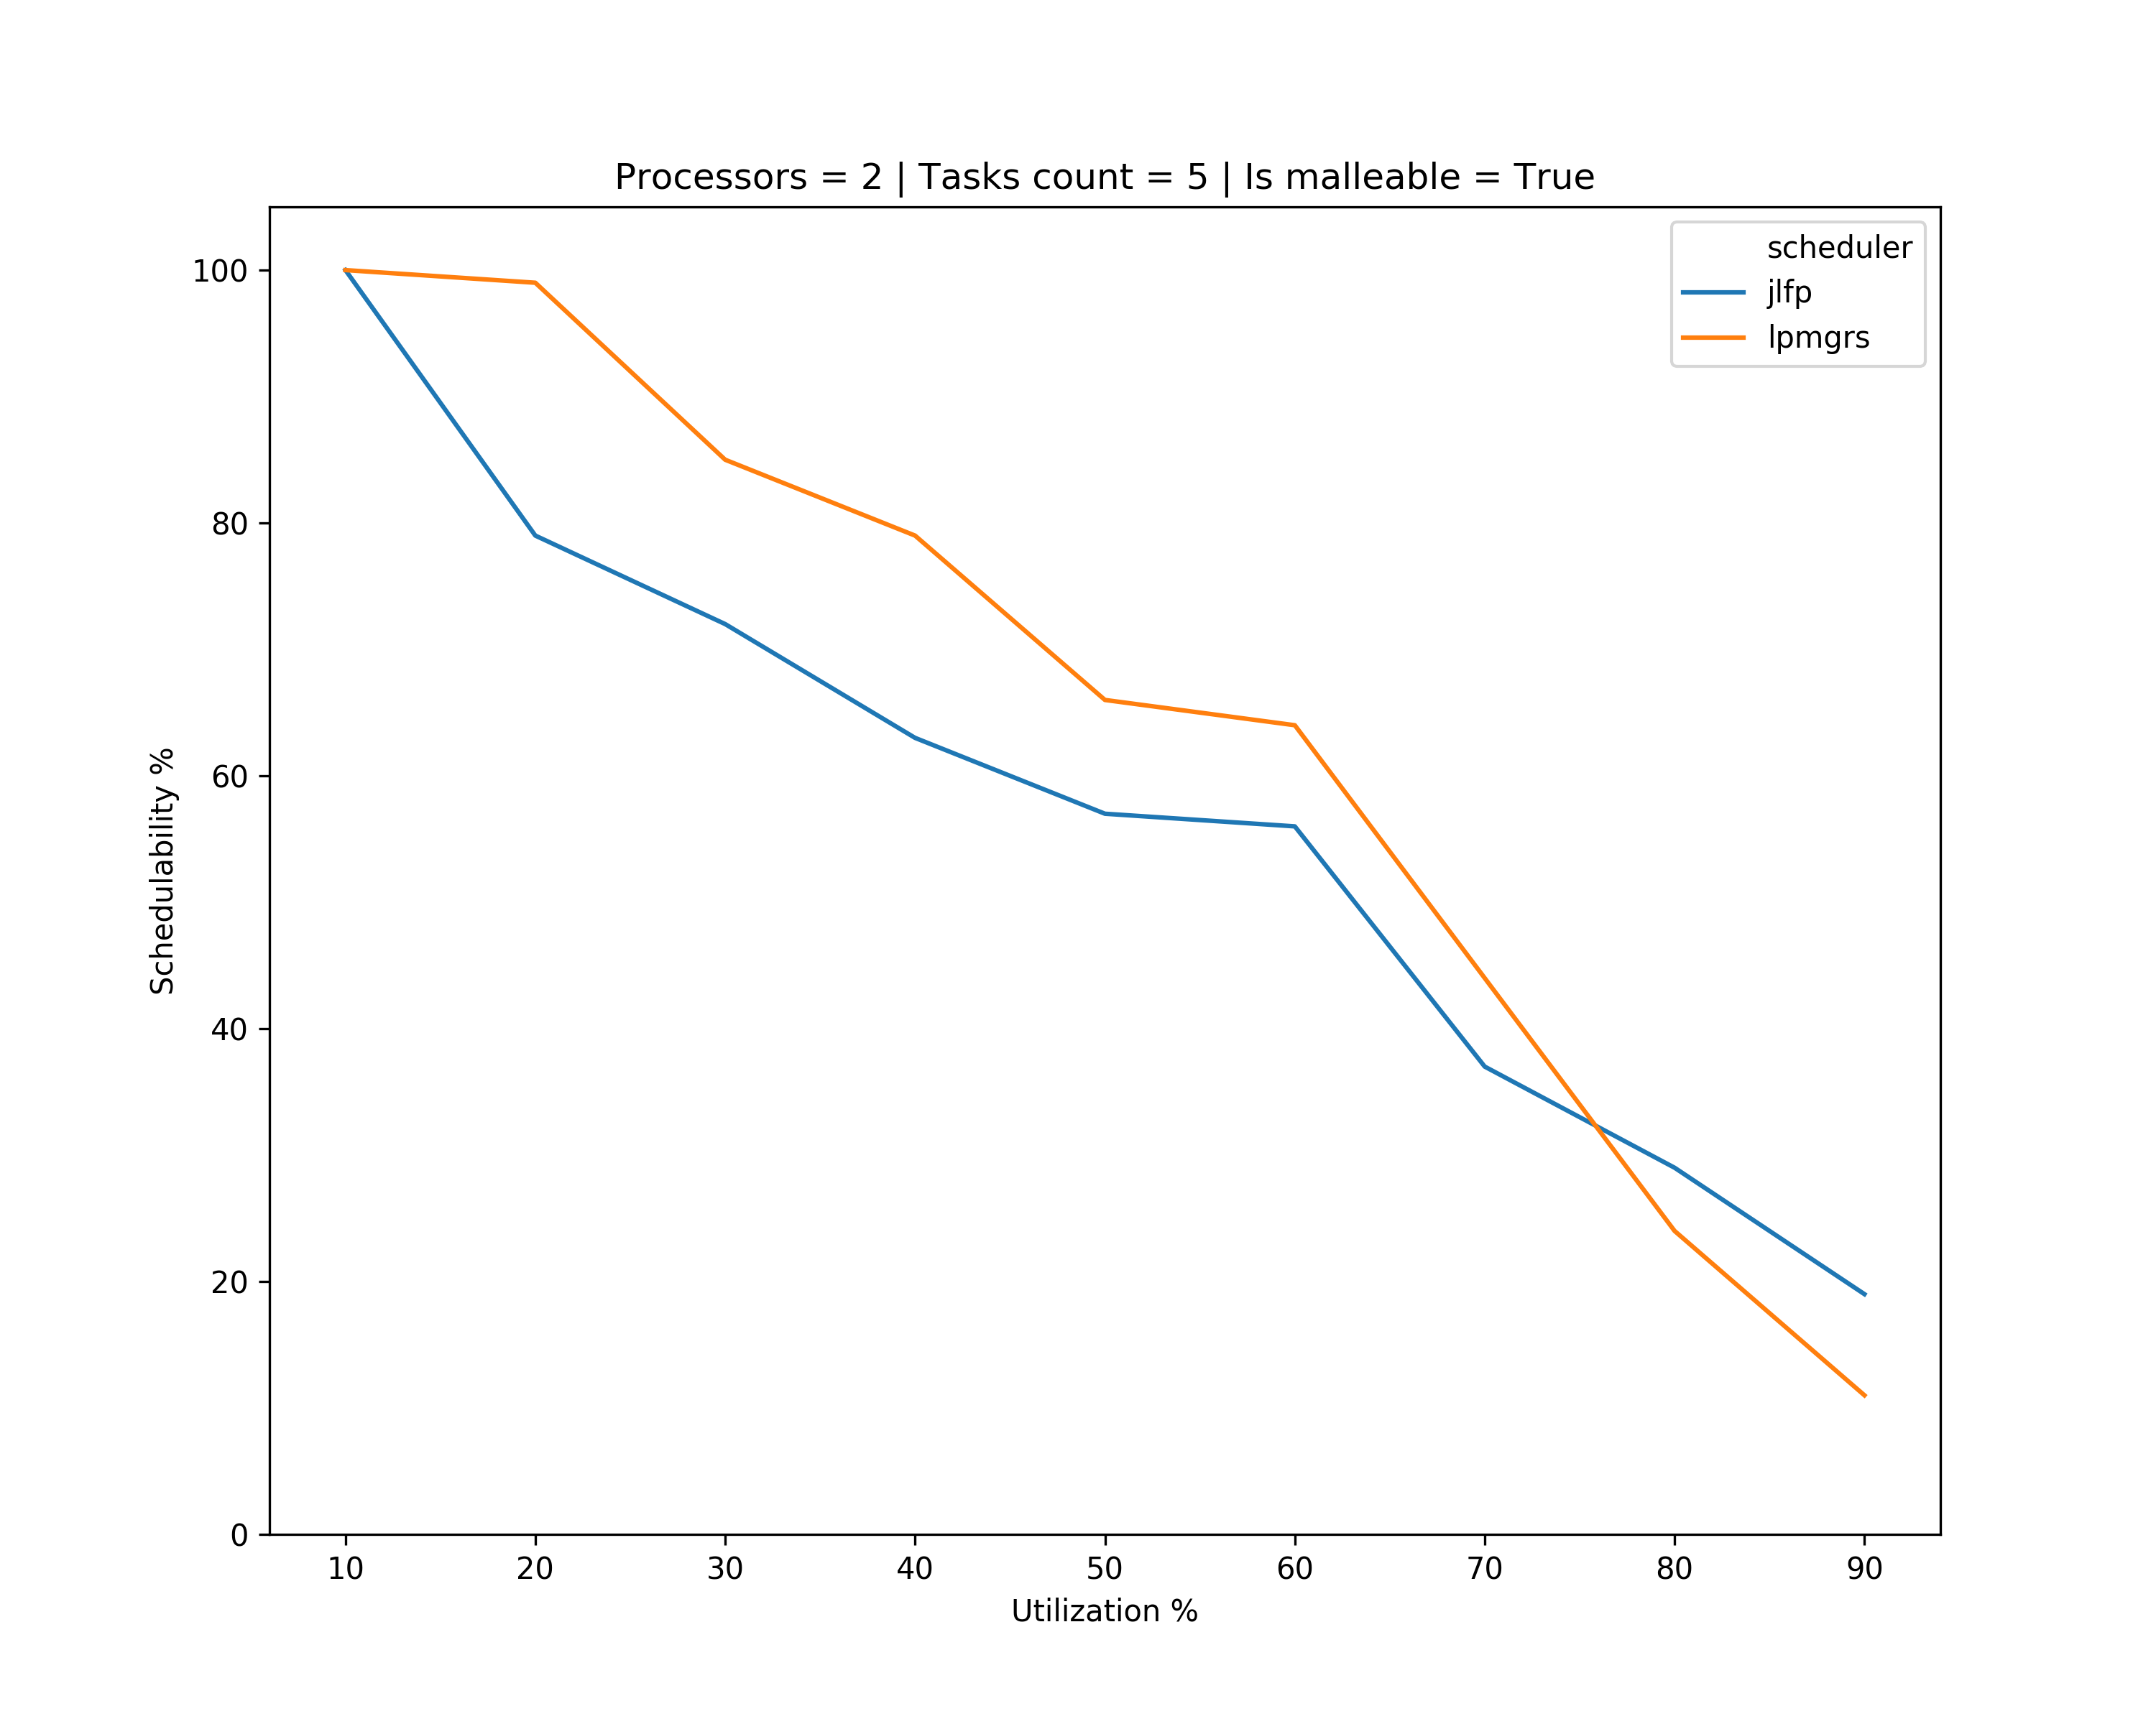
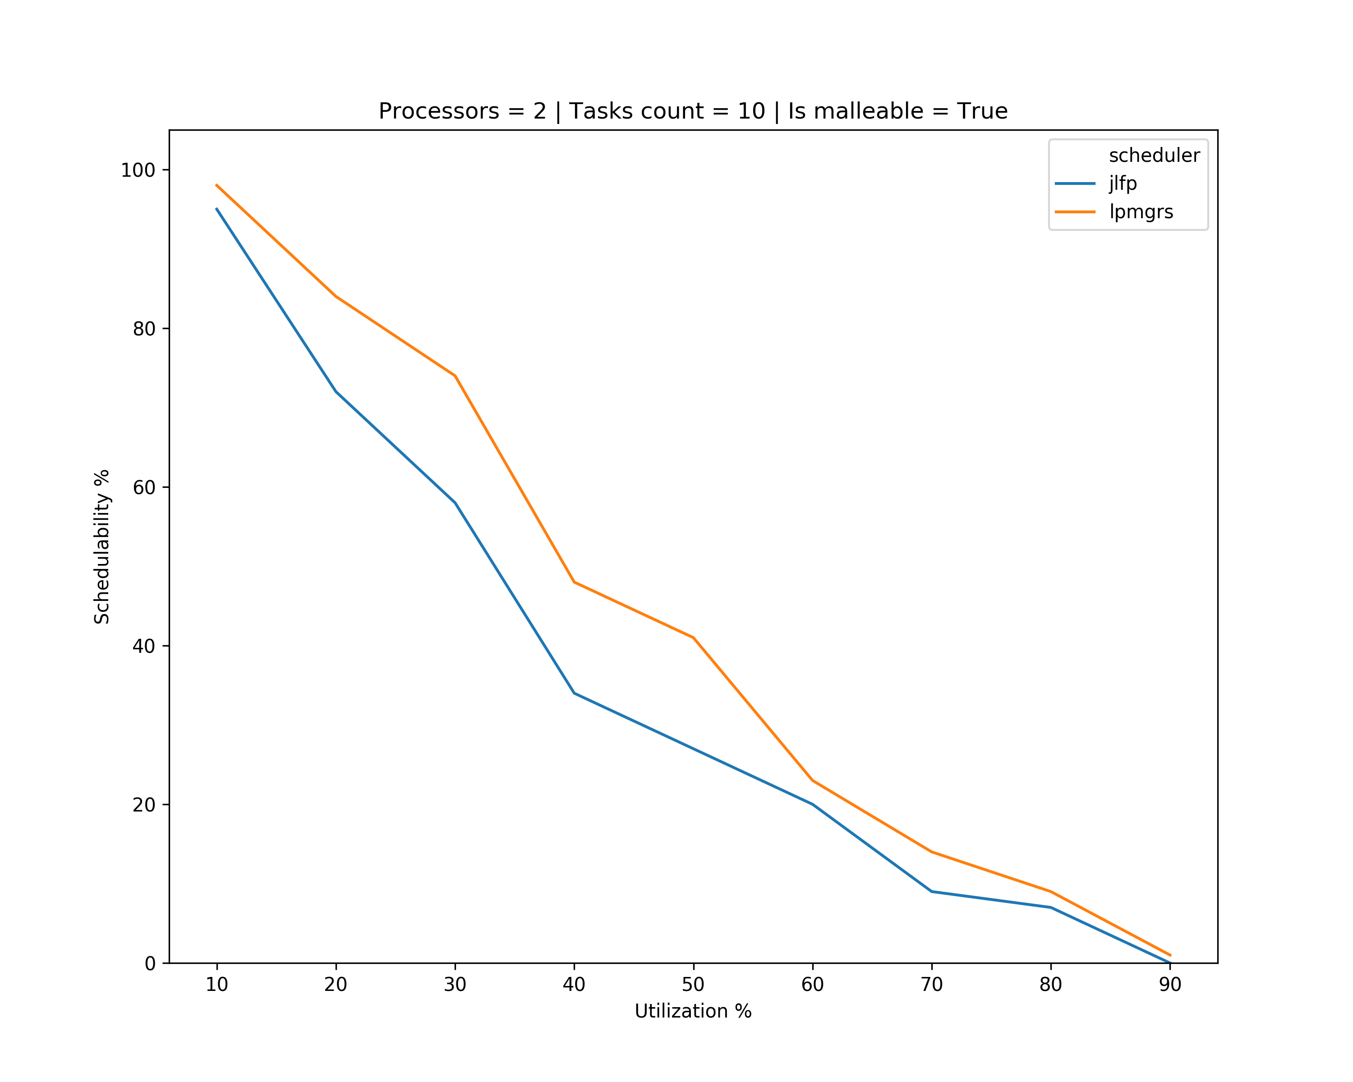
Results – multicore

Slide 21
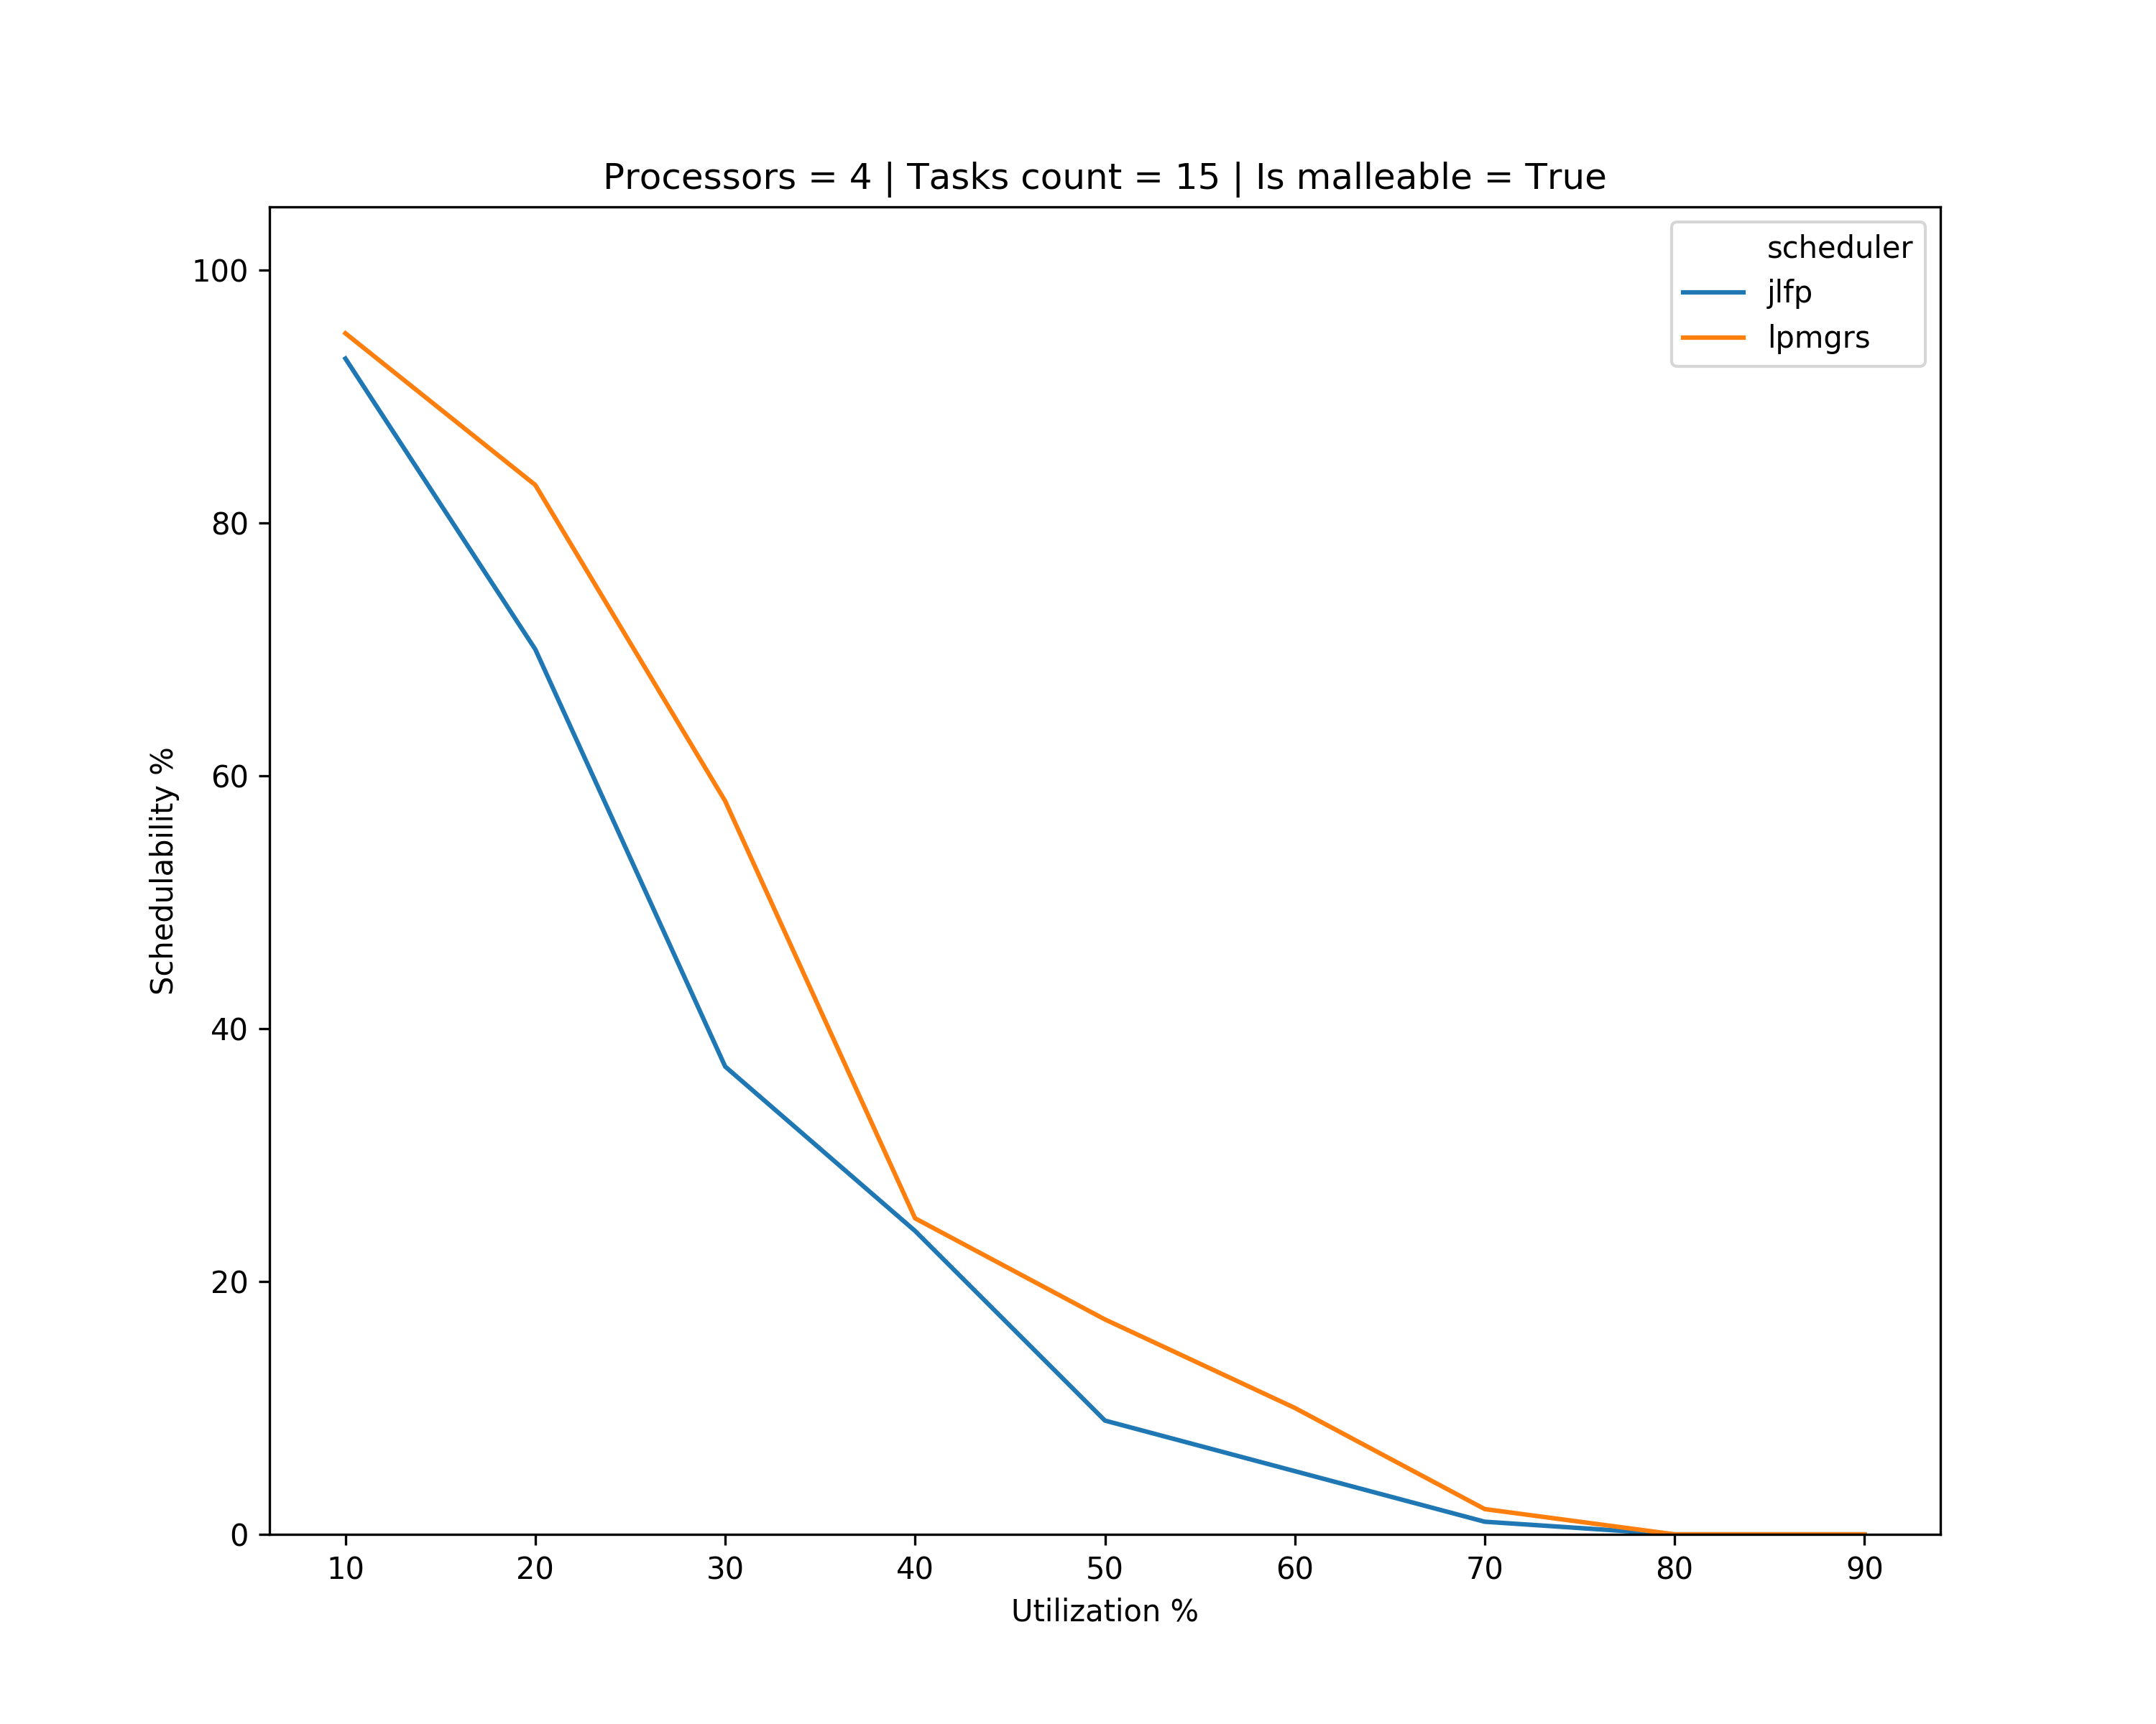
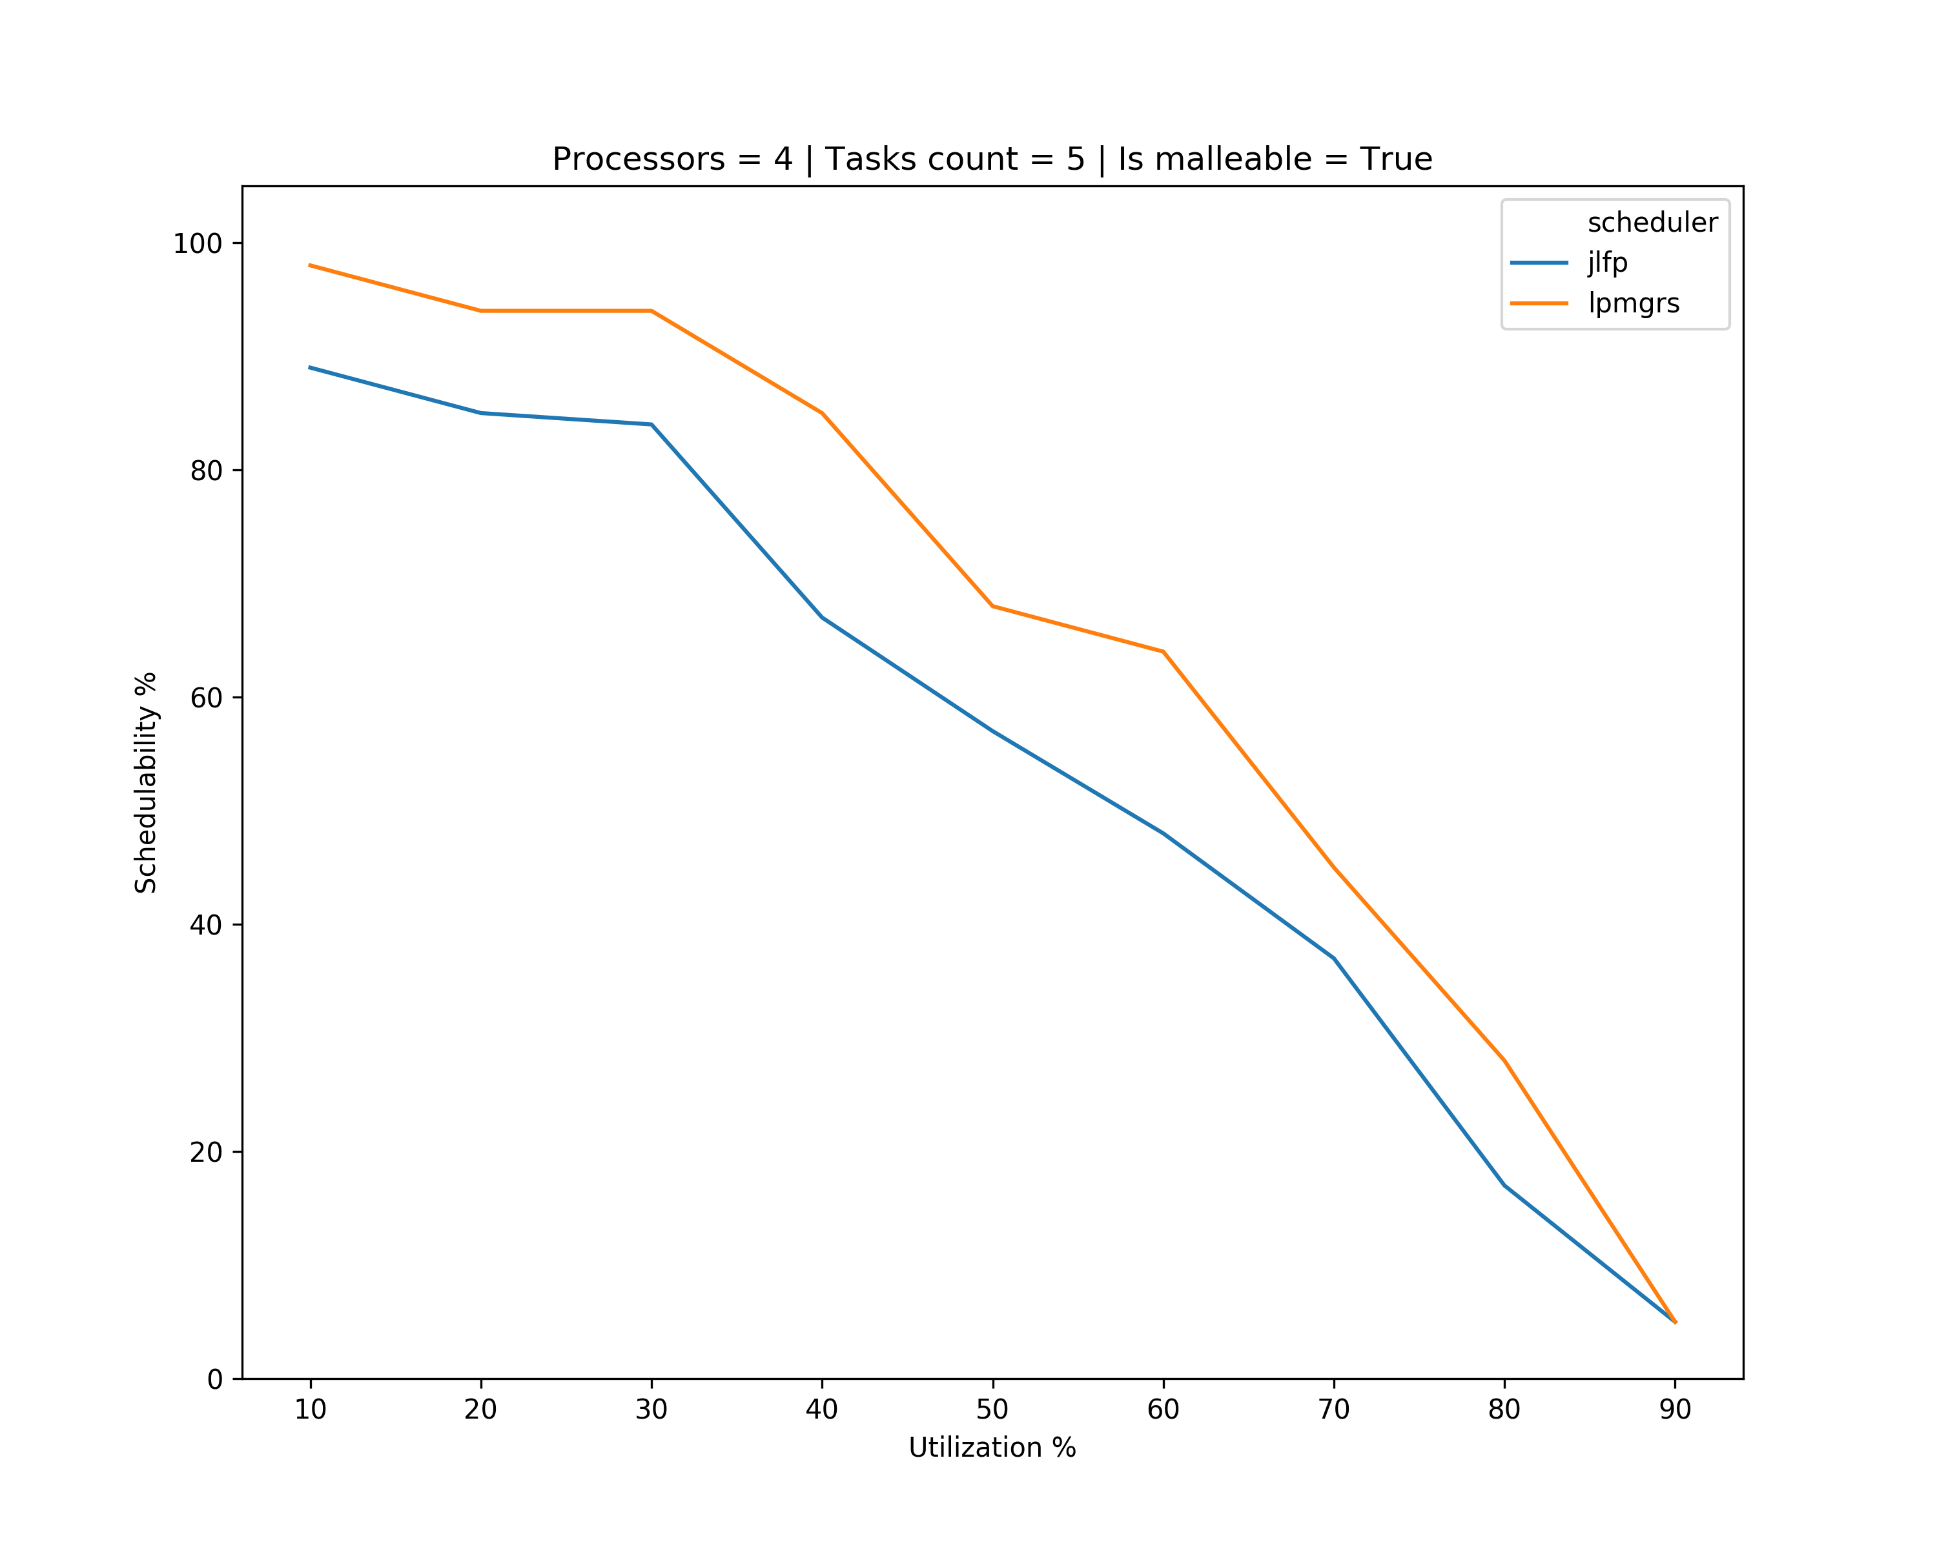
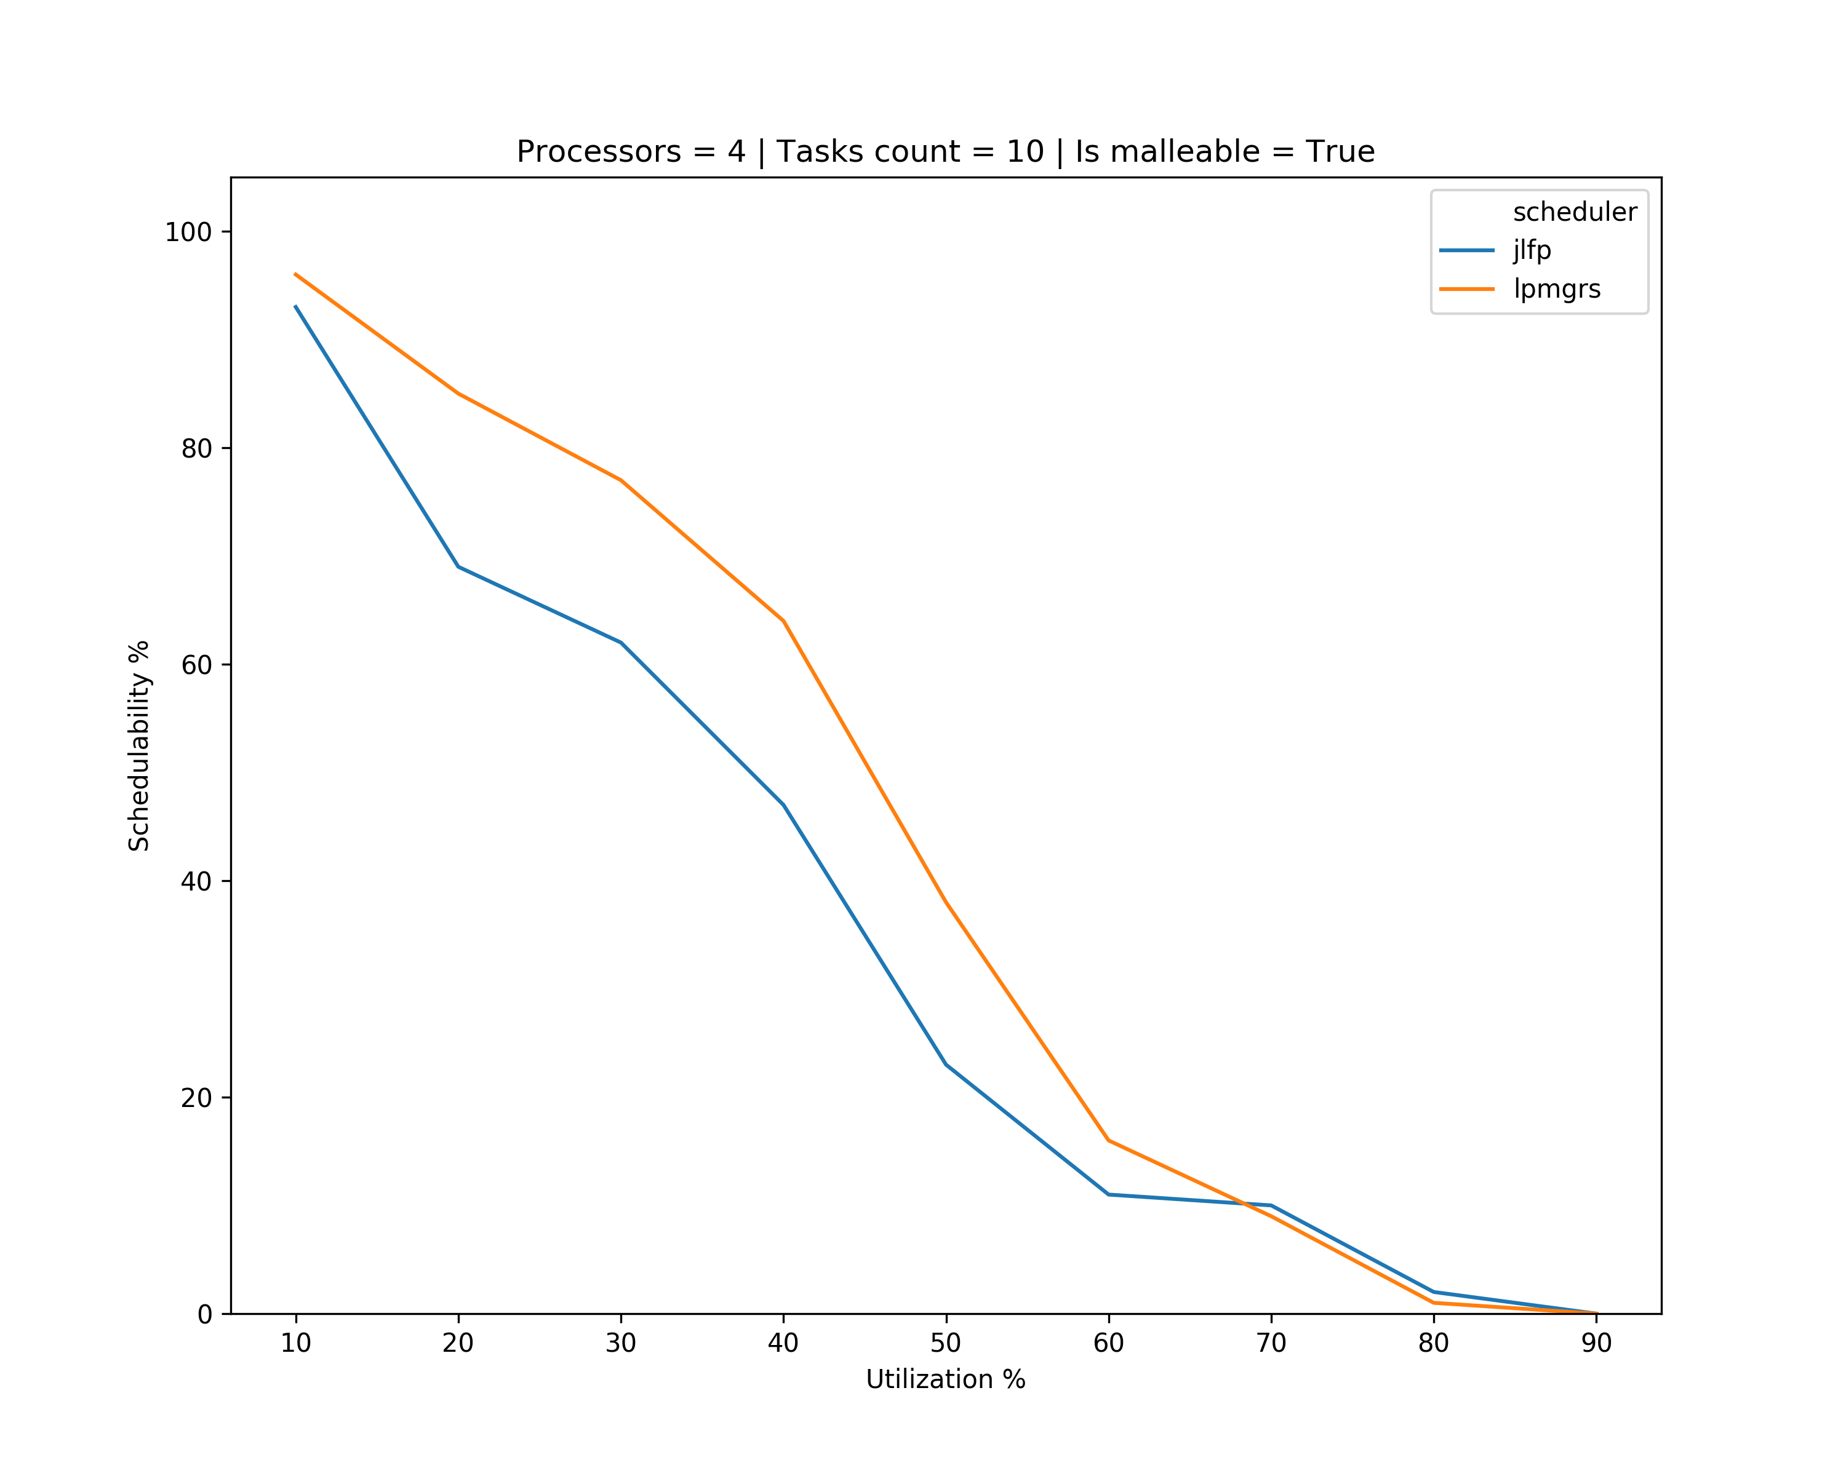
Results – multicore

Slide 22
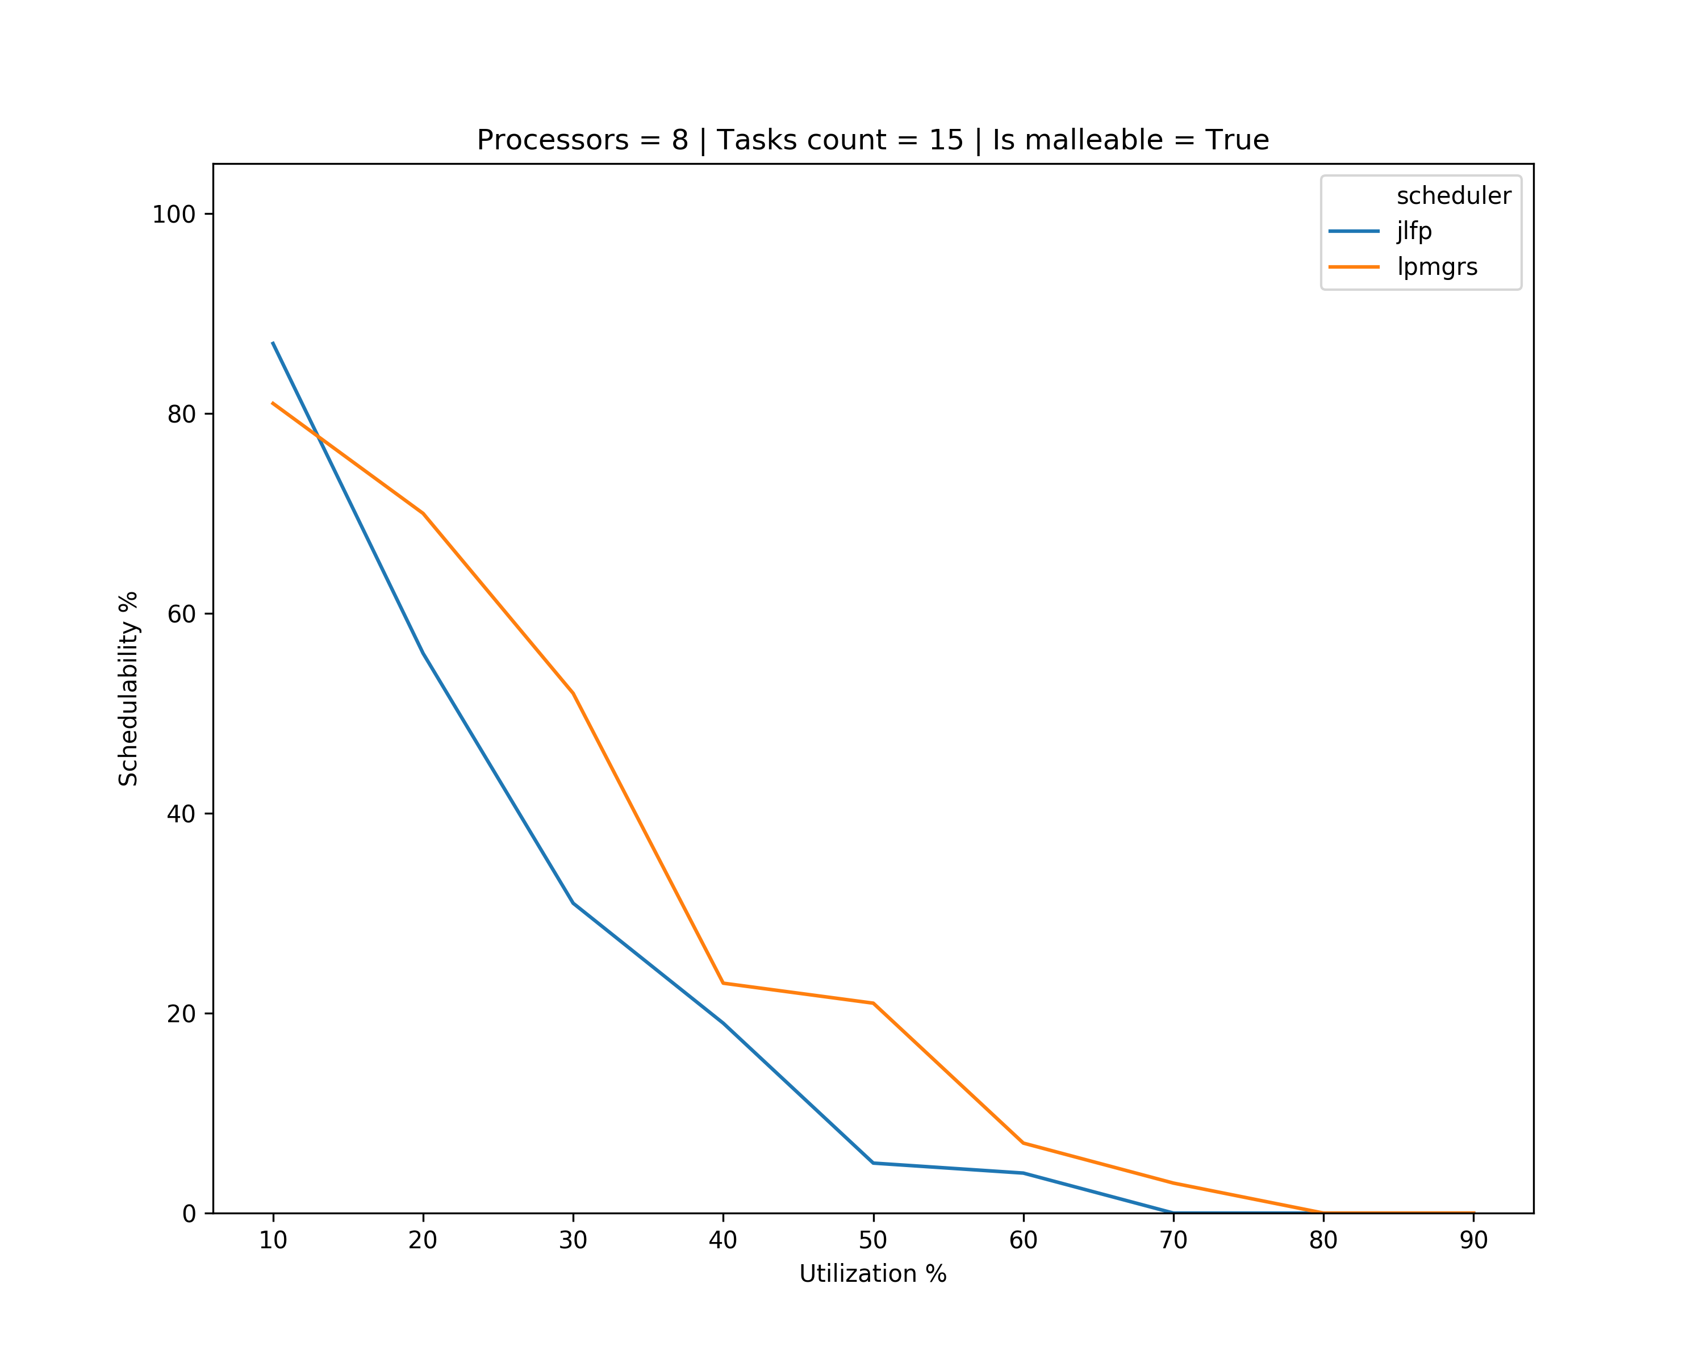
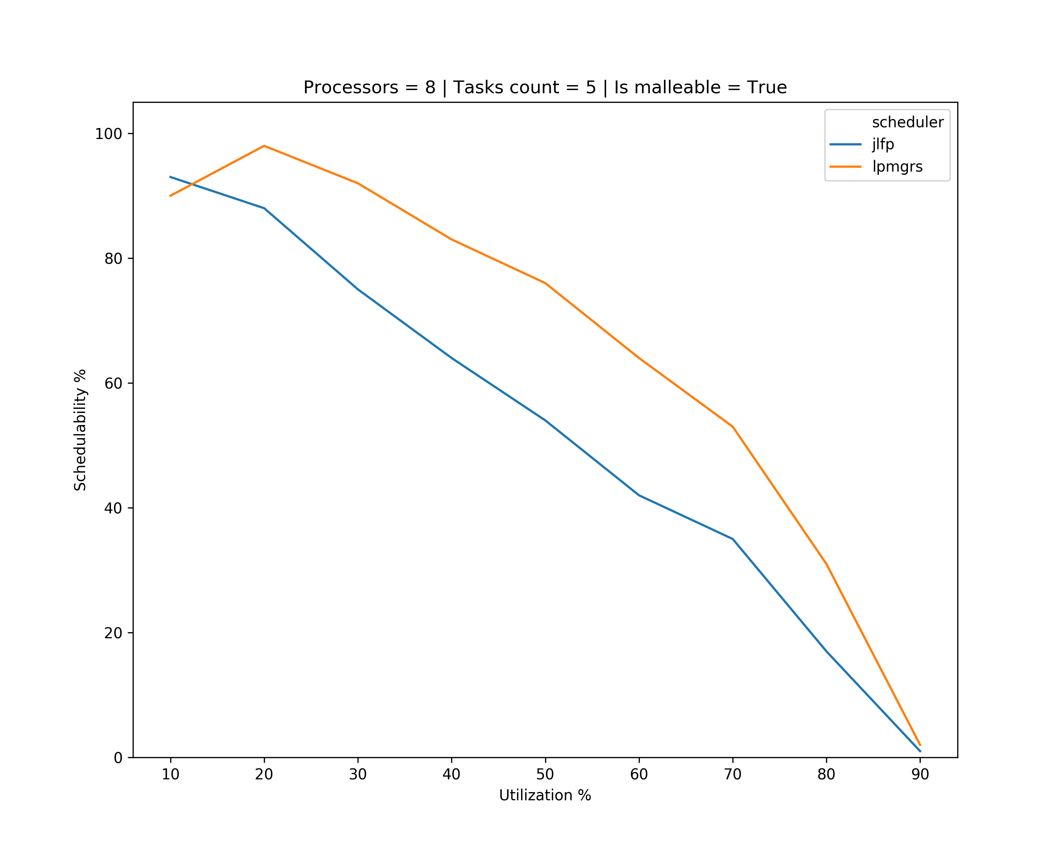
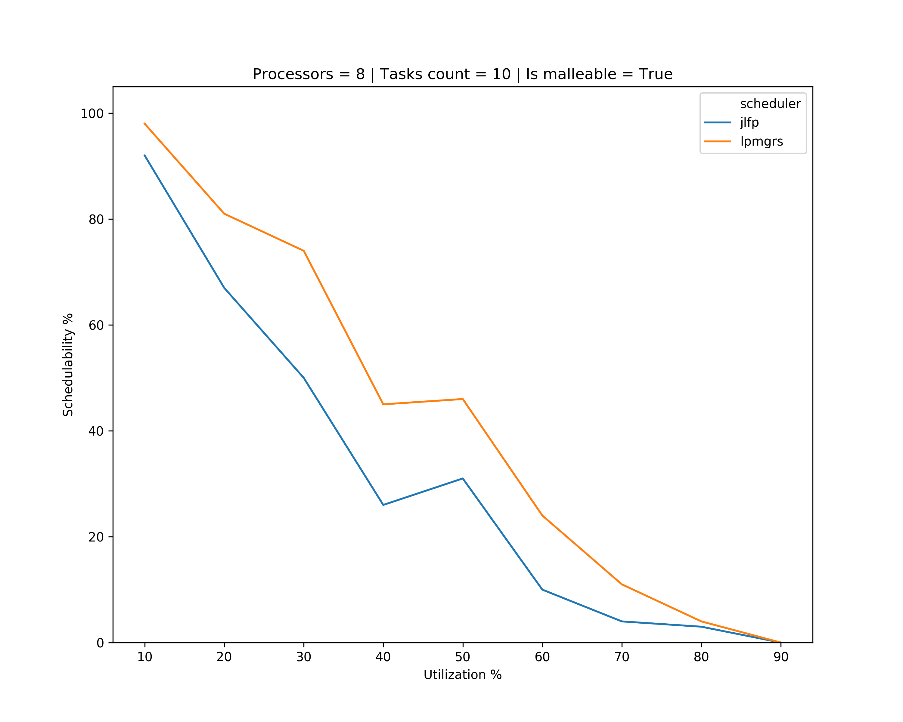
Results – multicore

Slide 23
What’s next?
Start start working towards schedulability analysis for LPMGRS
Start working on generating tasks with precedence constraints
Once finished generate results with more task sets
Find (probable) bugs

